Slide 1
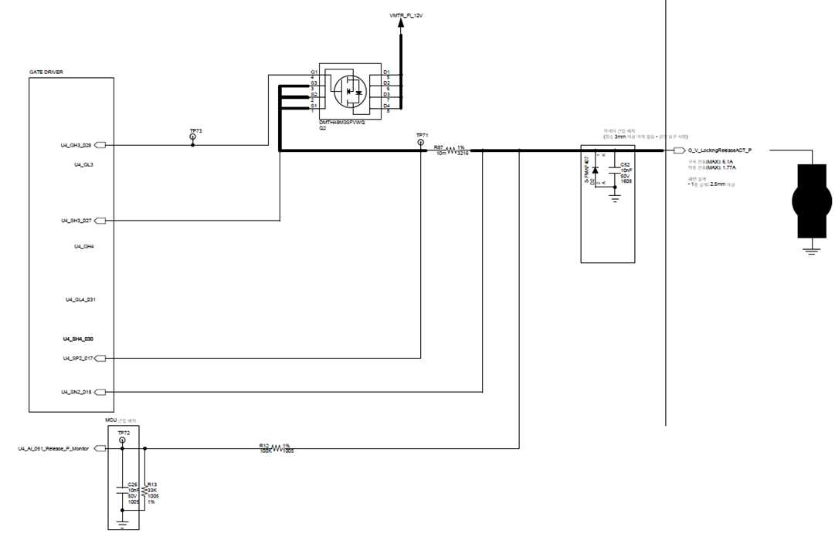
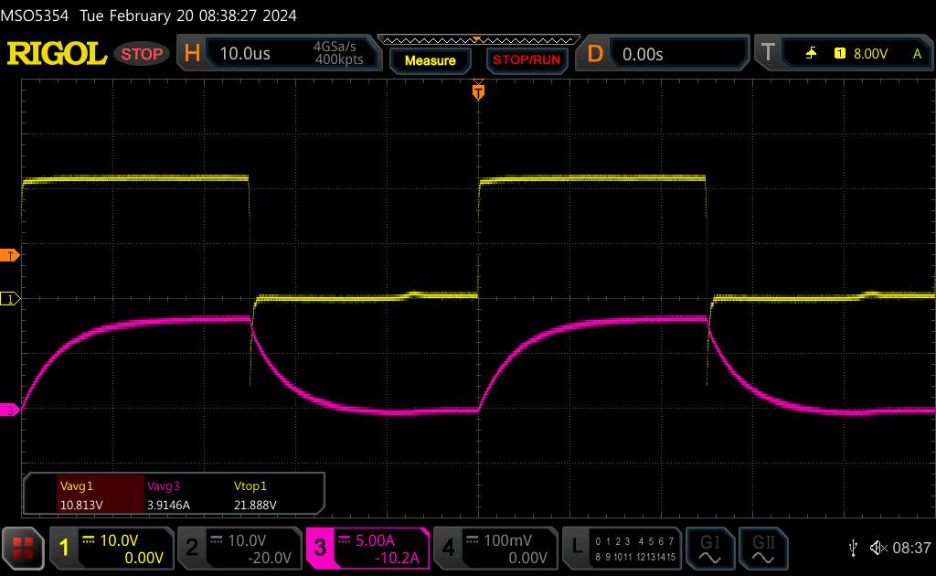
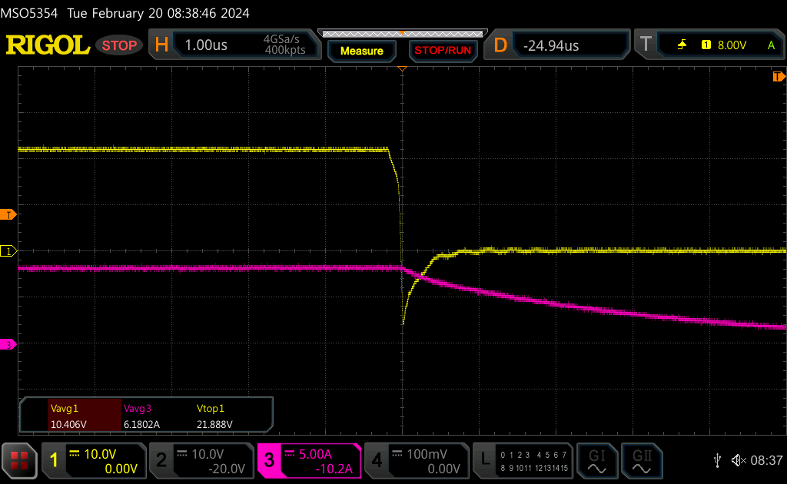
Resistive Load 1.2ohm (GH3 to gnd)

Slide 2
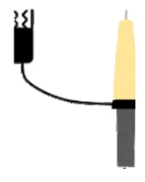
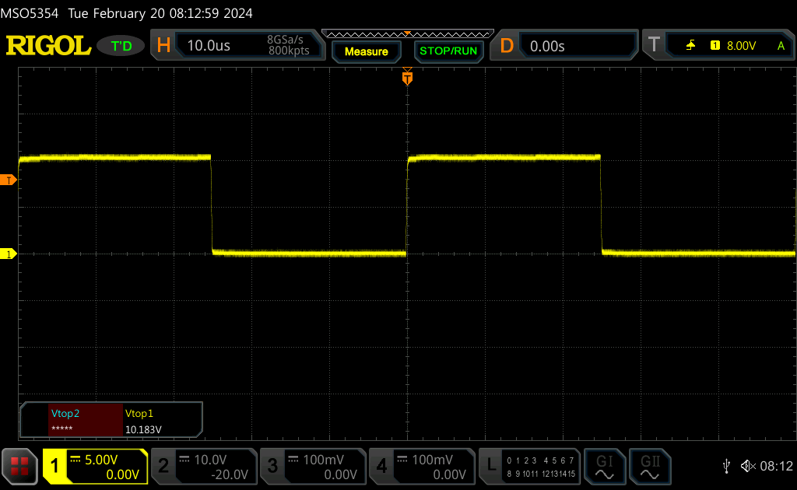
Open load
GH3 to SH3 waveform
DS21

Slide 3
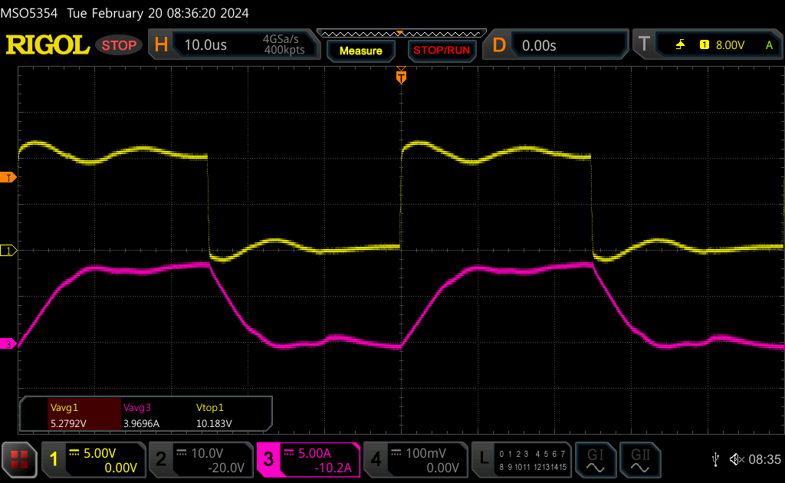
resistive load 1.2ohm
GH3 to SH3 waveform
DS22

Slide 4
