Slide 1
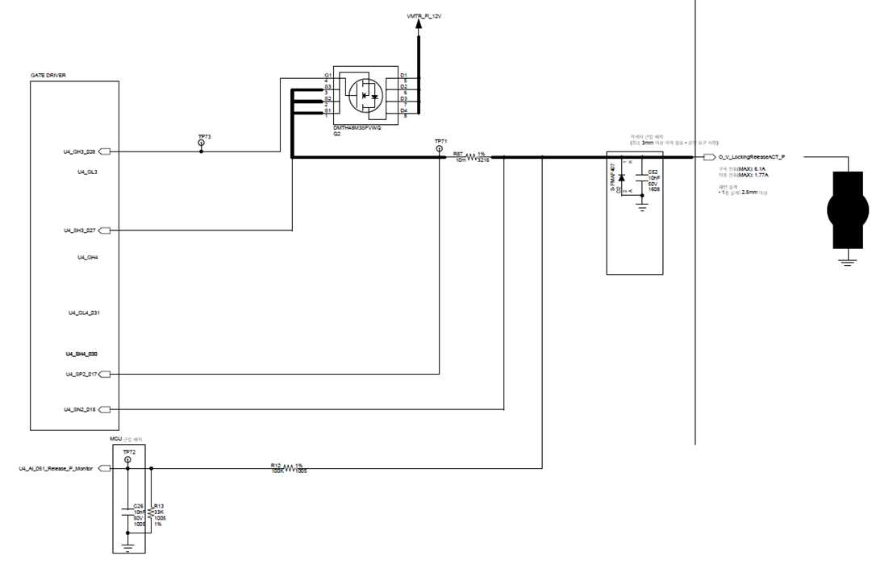
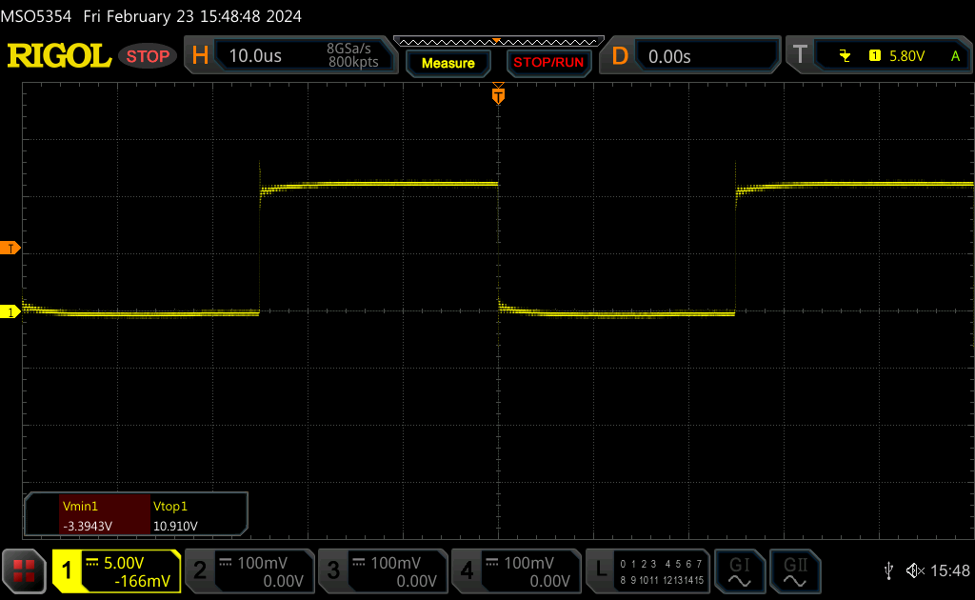
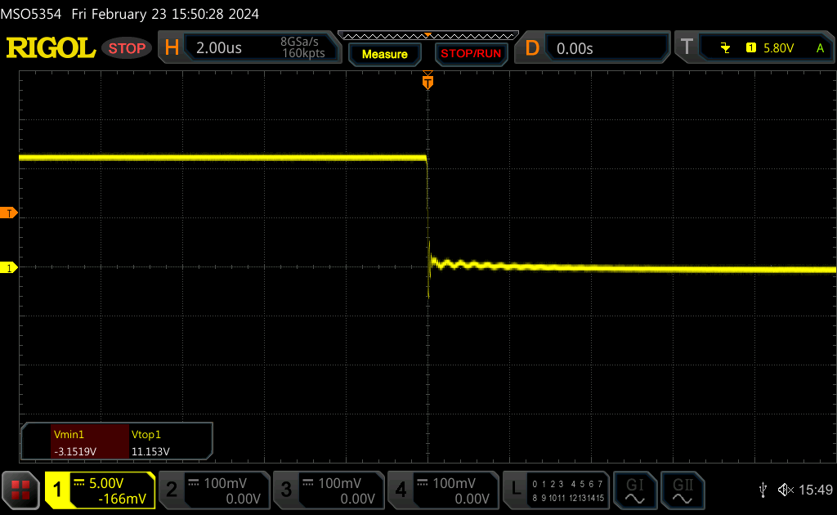
Resistive Load 1.2ohm
(SH3 vs GND)
(SH3 vs GND)

Slide 2
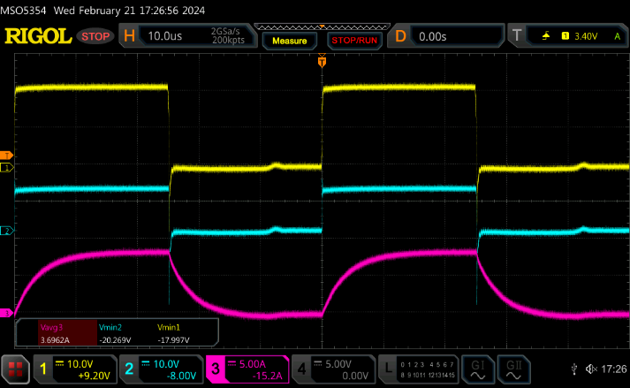
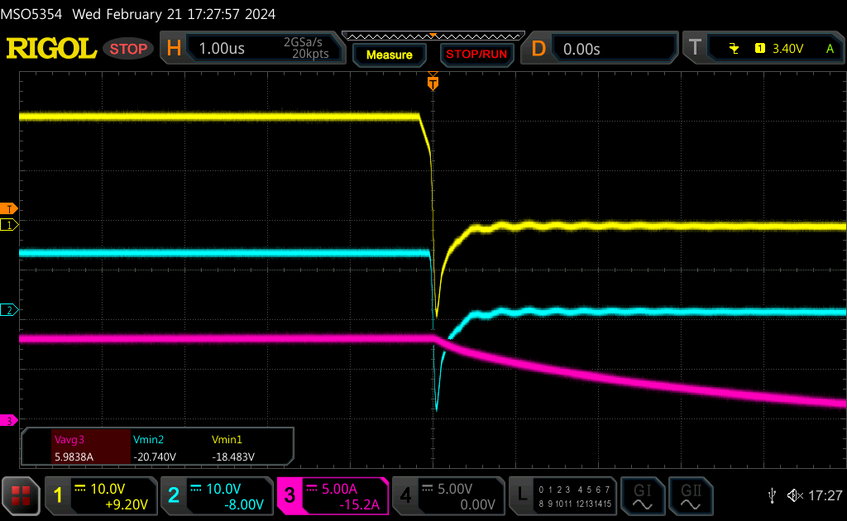
Resistive Load 1.2ohm
(GH3 vs GND)
(SH3 vs GND)
Load Current
(GH3 vs GND)
(SH3 vs GND)
Load Current

Slide 3
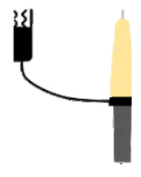
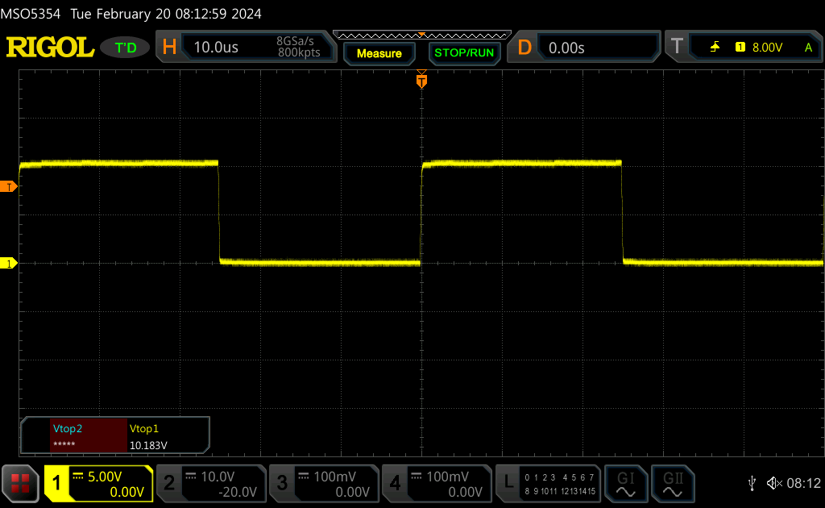
Open load
GH3 to SH3 waveform
DS21

Slide 4
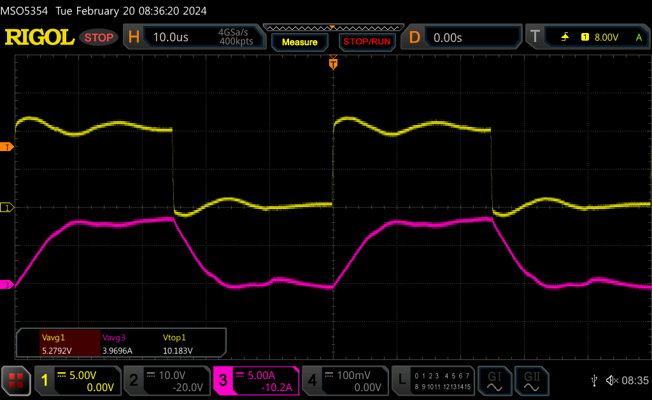
resistive load 1.2ohm
GH3 to SH3 waveform
DS22

Slide 5
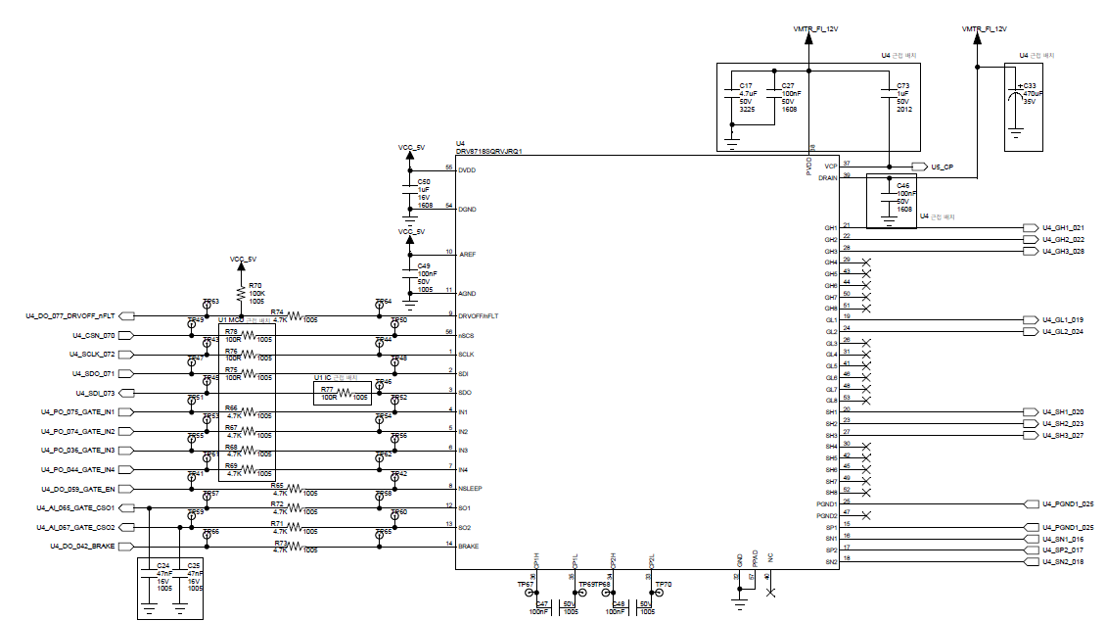

Slide 6
