Slide 1
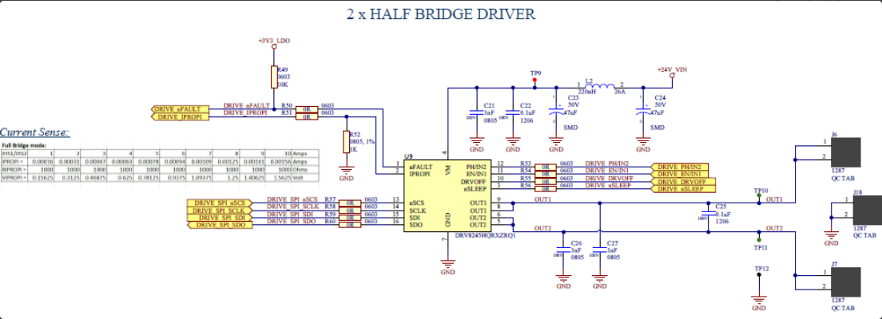
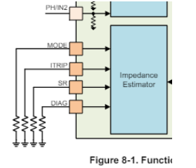
Assumption is HW-Variant use case
100nF (DNP):Foot print only
Optional for Itrip filter
nSLEEP pin requires ~30us(20-40us) pulse to wake DRV up.
FYI
External resisters required
100nF (DNP):Foot print only
Optional for Itrip filter

