Slide 1
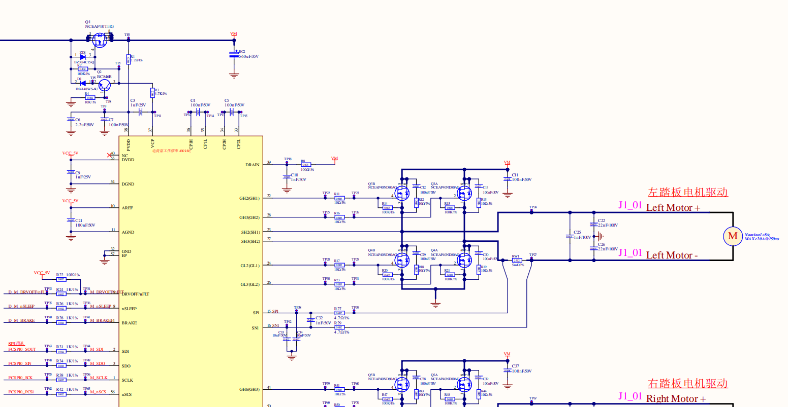
0ohm 0402(inch) resistor:
Optional: helpful debug for EMC or workaround.
0ohm
Ohm and Cap DNP is recommended.
Filter makes delay for VDS overcurrent protection response.

Slide 2
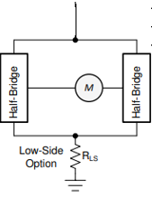
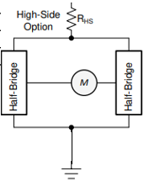
This is not MUST have, but better for low side current sensing. Low side VDS overcurrent detection is not impacted by sense resister.
Lowside sense
VBAT
Inline sense
DRAINpin
HB1
HB2
HB3
HB4
HB3
HB4
PGND1
PGND2
System GND
System GND
PGND1 is for HB1-2 (SH1/2/3/4) and PGND2 is for HB3-4(SH5/6/7/8)
Please be careful. Current schematic is paired with SH1 and SH8, SH4 and SH5. It will cause the problem with above PGND1/2 connection.

Slide 3
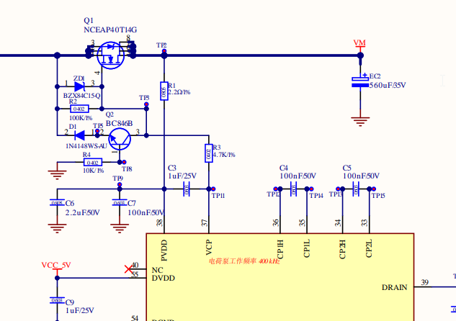
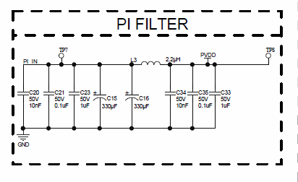
PI Filter ? This may be required for EMC. This is not TI DRV8718-Q1 requirement. PWM driving could need PI filter as EMC solution.

