Slide 1
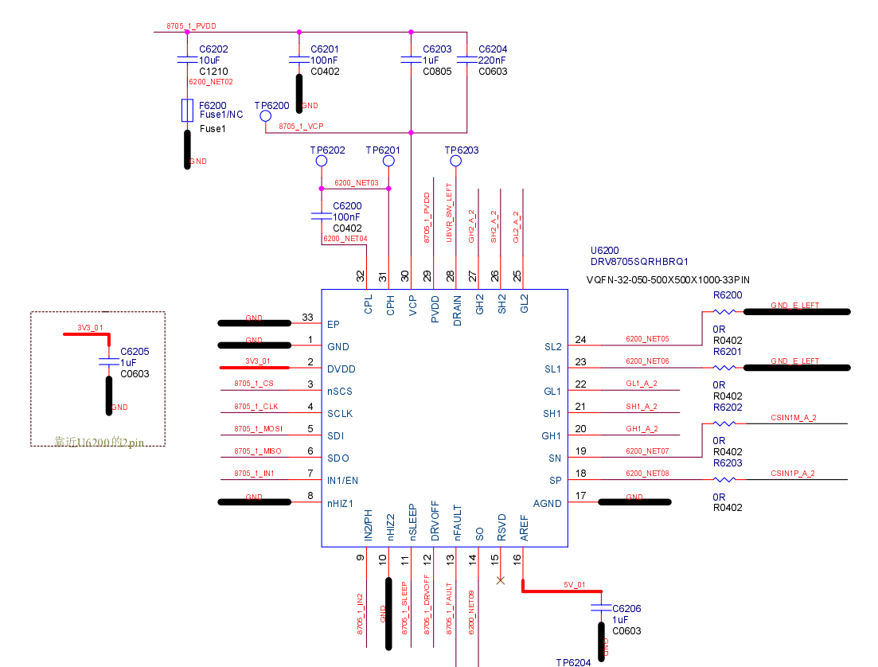
0ohm 0402(inch) resistor:
Optional: helpful debug for EMC or workaround.
12V
0ohm: Optional for debug purpose

Slide 2
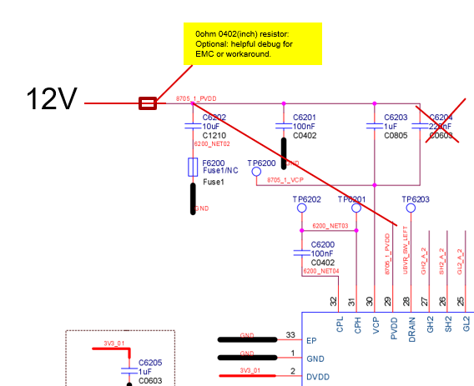
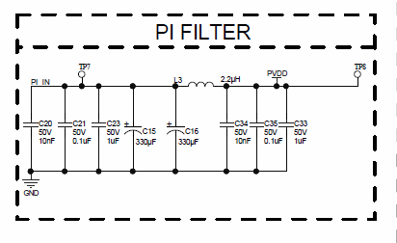
PI Filter ? This may be required for EMC. This is not TI DRV8705-Q1 requirement. PWM driving could need PI filter as EMC solution.

