Slide 1
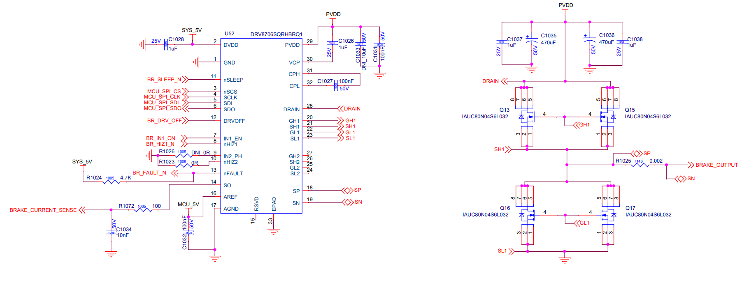
DRV8106S-Q1 is single Half bridge version of DRV8706-Q1
0ohm 0402(inch) resistor:
Optional: helpful debug for EMC or workaround.
0ohm
Do not drive 2 FETs on one GHx/GLx. Only 1 FET is allowed
0ohm on GHx and GLx.Optional. Can put some resister value if further slow down of tr/tf is needed.
GND
~1 nF (DNP):Foot print only.
Optional filter back up

