Slide 1
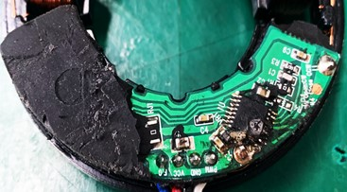
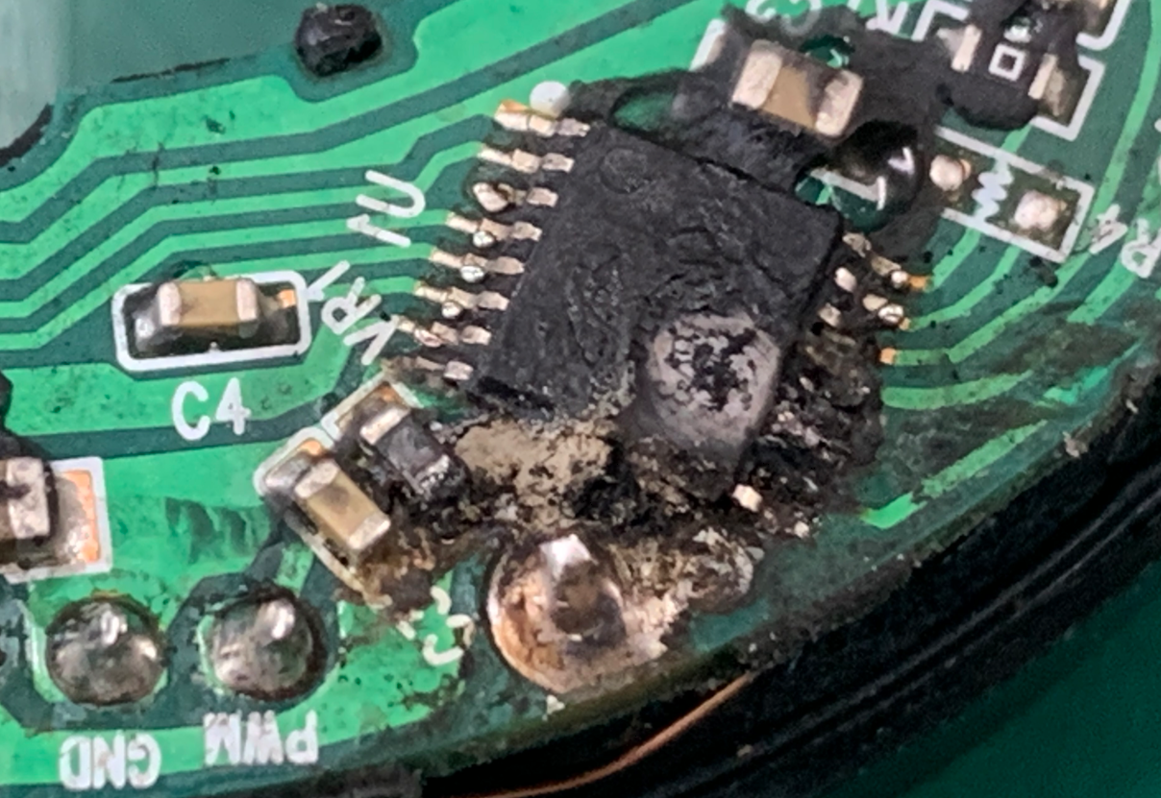
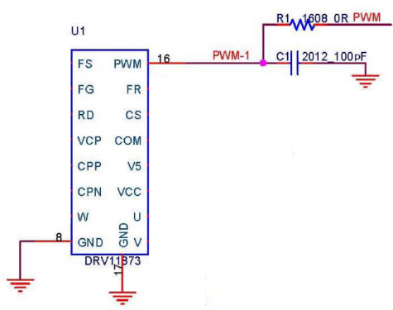
Cause of defect 1) Check for PCB Main IC abnormalities → External factors (surge, overvoltage, etc.) cause a short circuit between the U-phase circuit terminal and the V-phase circuit terminal, causing the motor to not operate due to damage to the main IC. Conclusion 1) Damage occurs in the internal circuit of the IC due to external factors (surge, overvoltage, etc.) on the PCB Main IC, and the Main IC is damaged and the motor does not operate.
U & V
Phase short
- PCB defect phenomenon (Main IC burnt) -
-Main IC_Schematic-

