Slide 1
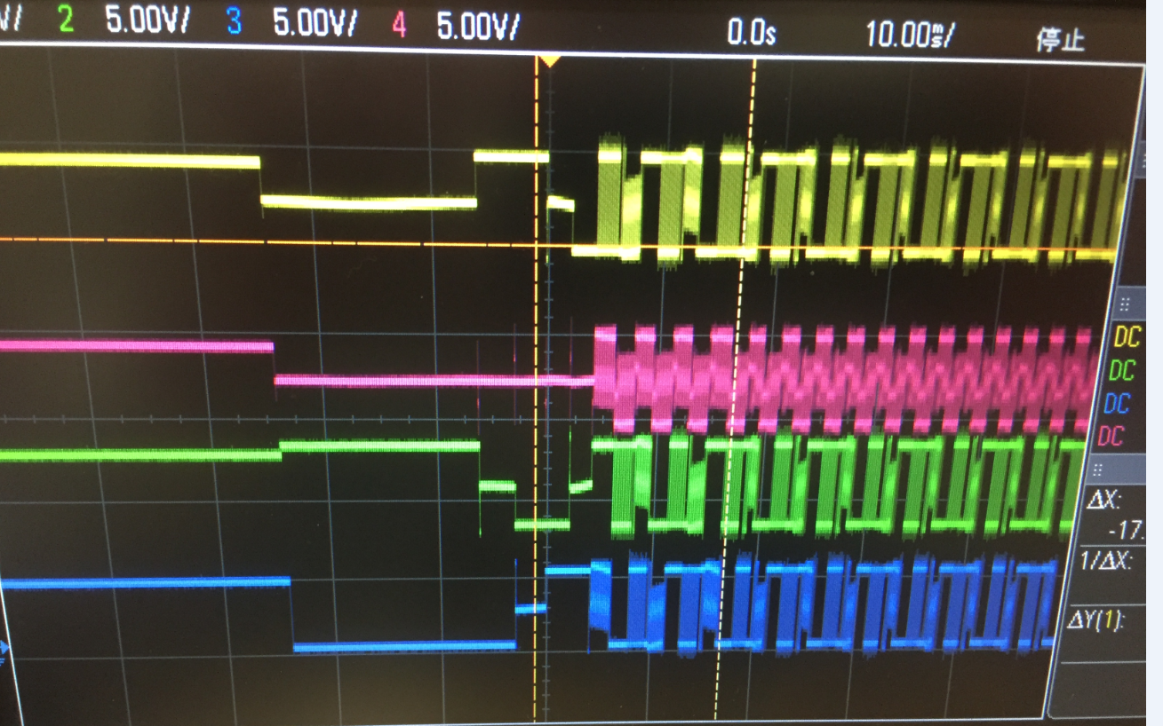
1
4
W phase
COM
2
U phase
V phase
3
This case is selected W phase as FG signal generation

