Slide 1
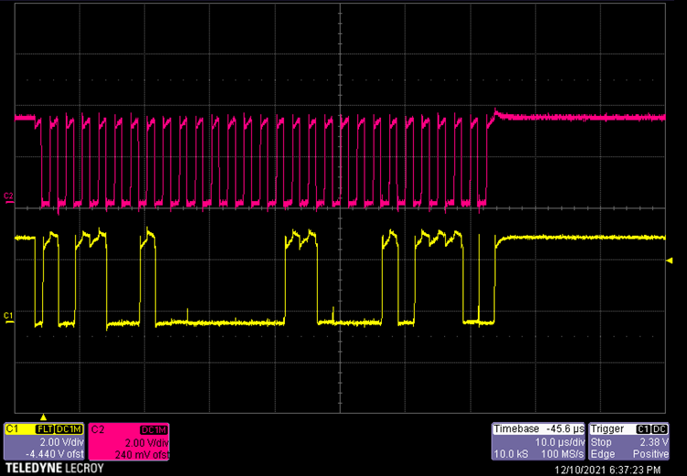
Start
Write address 0xB2
1011001
ACK
Register address 0x03
00000111
ACK
Data
0x17
00010111
ACK
STOP

Slide 2
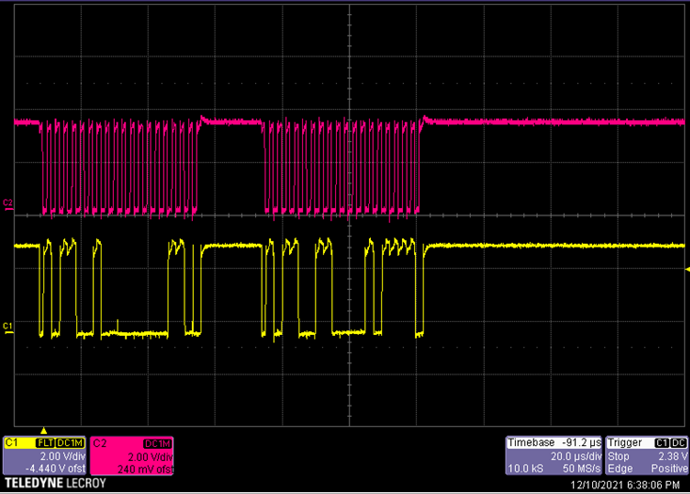
Start
Start
read address 0xB3
10110011
ACK
NACK
STOP
Start
Write address 0xB2
10110010
ACK
Register address 0x03
00000011
ACK
STOP
Write address 0xB2
10110010
Data
0x17
00010111

