Slide 1
DRV3946-Q1
QTO Waveforms
ASC-MD-BSM

Slide 2
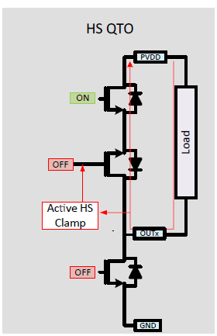
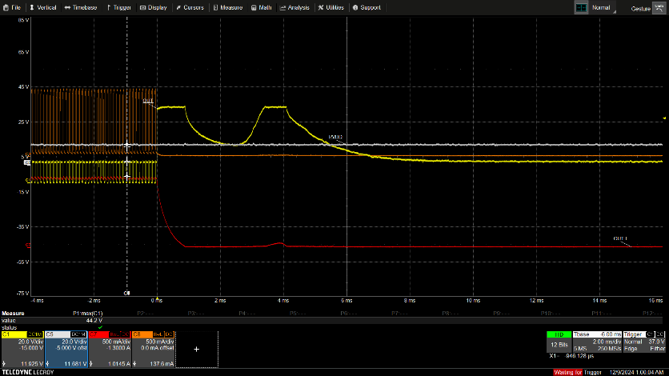
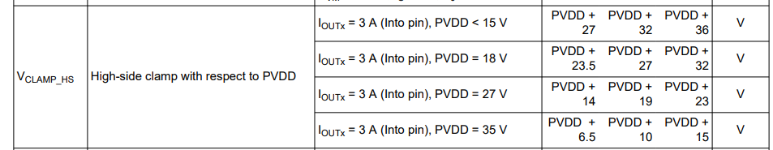
HS QTO
Turn OFF commanded
Current will decay in the path shown
No current flow from the PVDD supply path
Clamp voltages will follow the spec
PVDD Supply
PVDD_I
PVDD_I

Slide 3
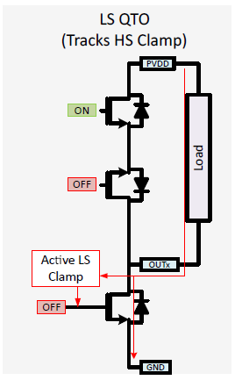
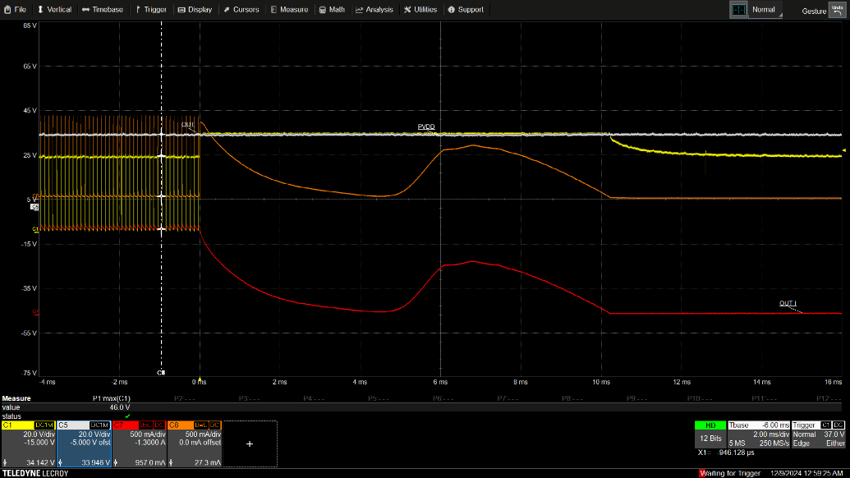
LS QTO
Redundant mechanism for HS QTO
By default, comes when contactor turns OFF at OV condition
Current will decay in the path shown
PVDD supply path will also show the current
PVDD Supply
PVDD_I
PVDD_I

Slide 4
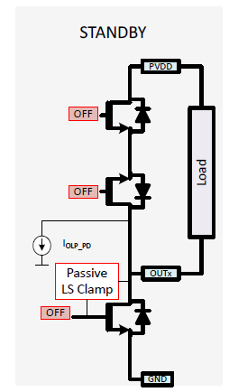
Passive LS clamp
Passive LS clamp is activated
  In case of any energy dumped on OUTx node during Standby Mode, passive LS clamp will limit the voltage on OUTx node
  PVDD goes into UV

Slide 5
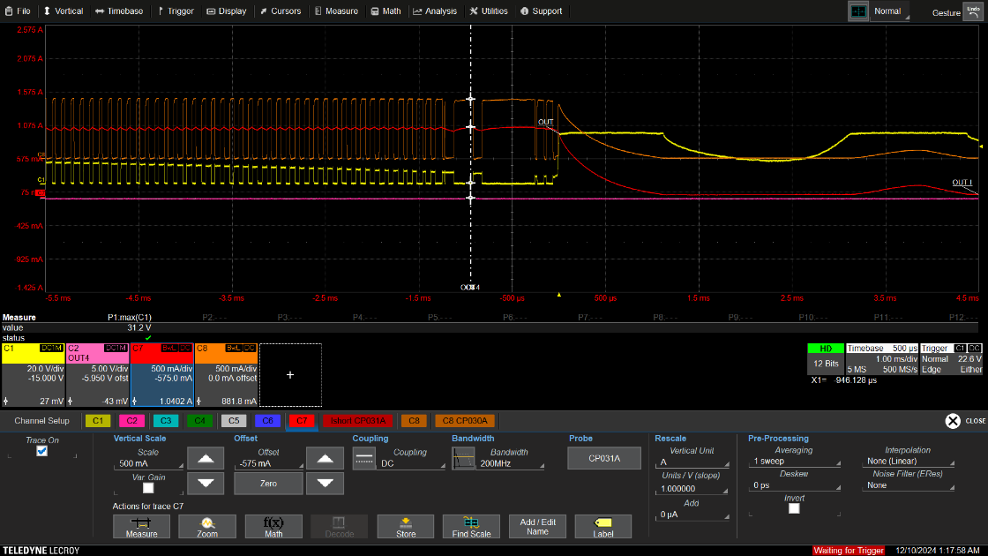
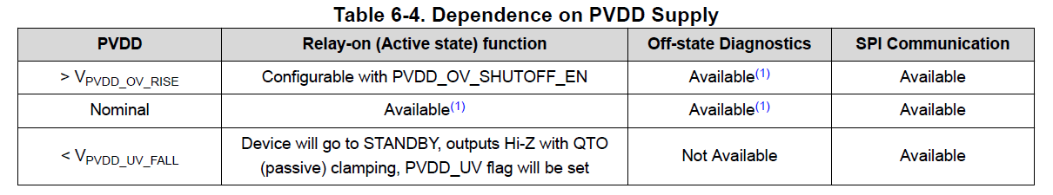
PVDD OFF : Only HS switch shut off case
PVDD turned OFF
  PVDD will come down gradually due to the cap on PVDD
  Current will be still regulated till PVDD reaches UV
  When PVDD reaches PVDD_UV device turned OFF with Passive clamp
PVDD_I

Slide 6
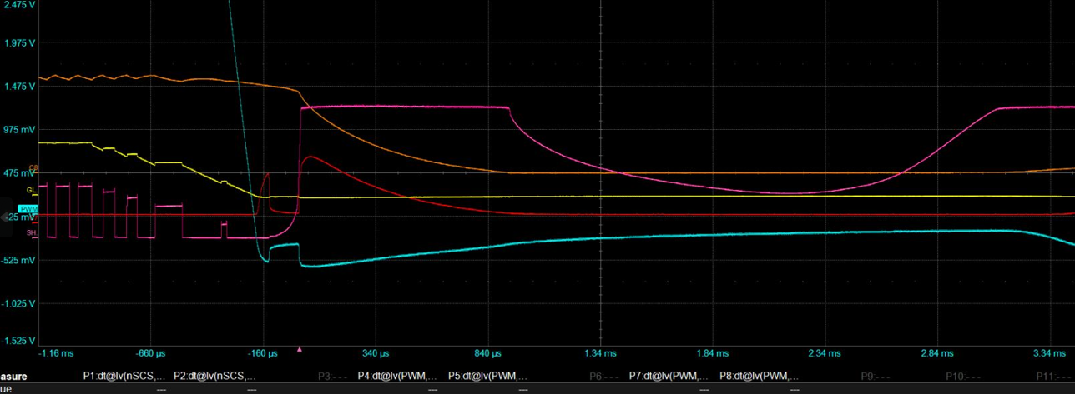
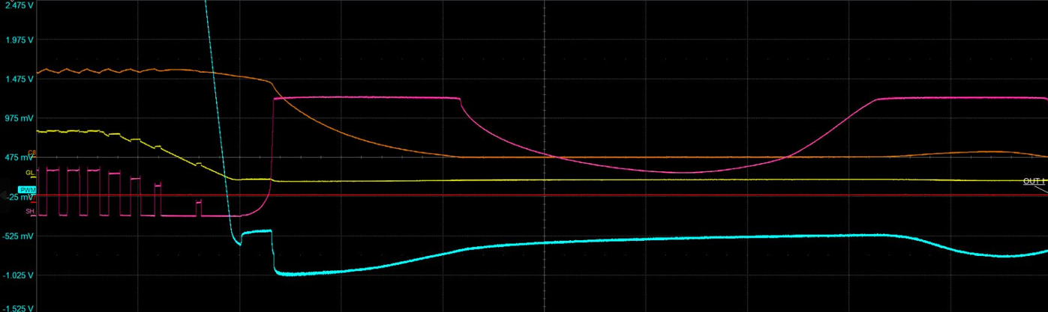
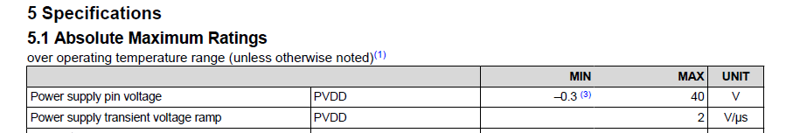
PVDD OFF : Only HS switch shut off case
With Diode
Orange : Load Current
Red : Diode Current
Blue : PVDD close to the pin(zoomed )
Pink : OUTx
Yellow : PVDD
For the current path to complete, there is a small duration of time PVDD goes slightly negative
  During this time diode helps conduct
  If diode is not present the PVDD can go lower and cause failures on the device
Without Diode
Orange : Load Current
Blue : PVDD close to the pin(zoomed )
Pink : OUTx
Yellow : PVDD

