Slide 1
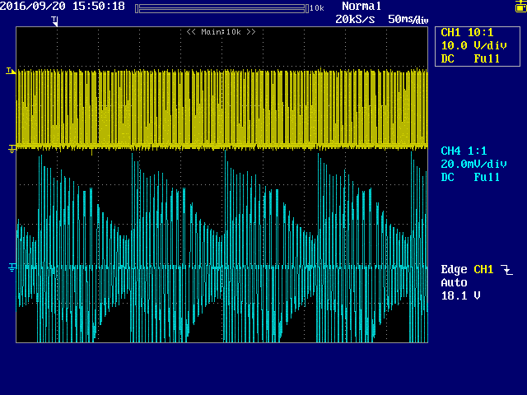
Wave form of U phase at hunting motor
*Next pages is zoom wave form
U phase Voltage
U phase current
200mA/div

Slide 2
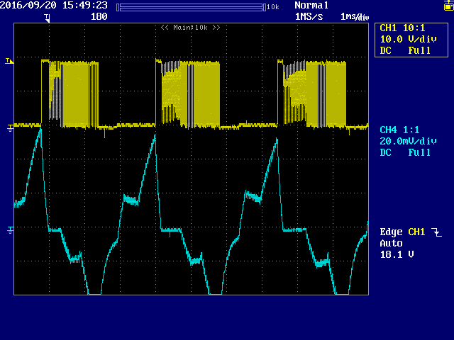
Wave form of U phase at hunting motor
*This is zoom wave form 1
U phase Voltage
U phase current
200mA/div

Slide 3
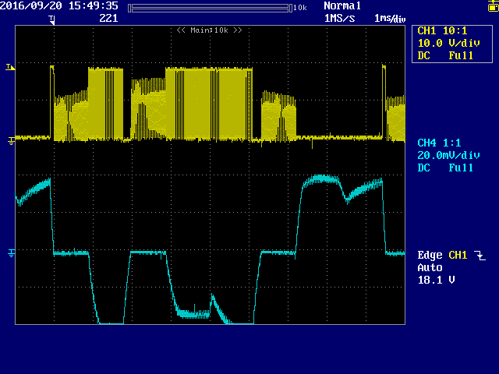
Wave form of U phase at hunting motor
*This is zoom wave form 2
U phase Voltage
U phase current
200mA/div

Slide 4
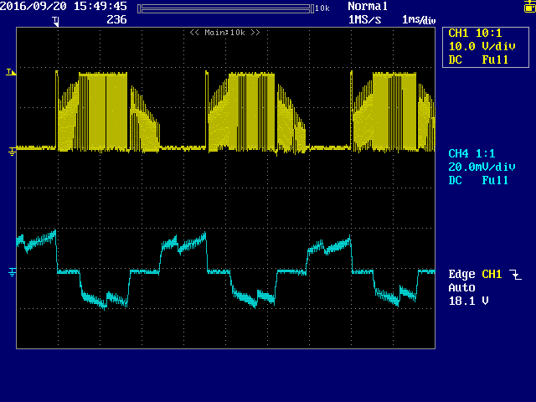
Wave form of U phase at hunting motor
*This is zoom wave form 3
U phase Voltage
U phase current
200mA/div

