Slide 1
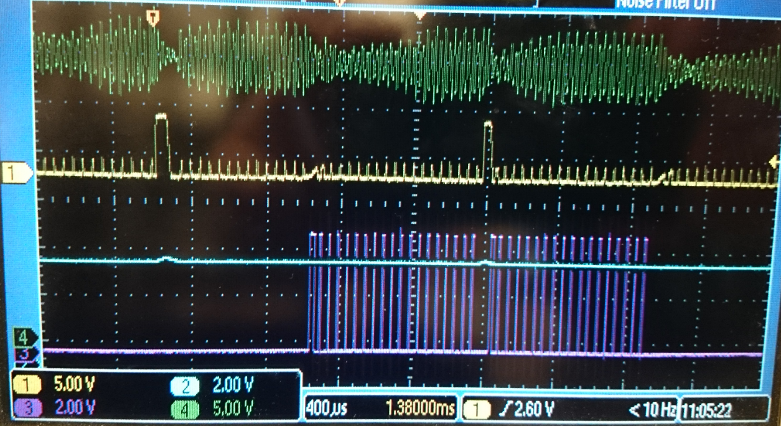
This shows the shoot through on the motor driver. You can see the shoot through happens during a pause in the PWM signal. We also monitored the FAULT pin on the driver and that did not go low during the current spike.
Green = driver input voltage
Yellow = sense resistor current
Purple = top PWM
Blue = RESET

Slide 2
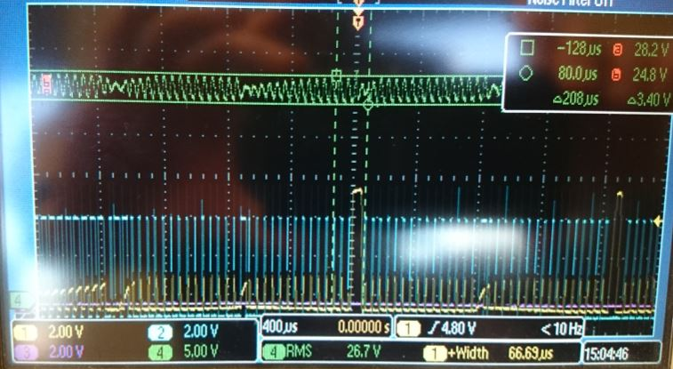
We added more ceramic capacitance on VCP
Green = driver input voltage
Yellow = sense resistor current
Blue = top PWM
Note VCP peak to peak is reduced to 3.4Vpp.
However you can still see shoot through.

