Slide 1


DRV832x (60V, 3-Phase BLDC Smart Gate Driver)
Released!
Features
Benefits
  Triple ½-H bridge motor gate driver
    Supply voltage: 6 to 60 V (abs max 65 V)
    Gate Drive: 1.0A source / 2.0A sink
  Smart Gate Drive eliminates 12-24 passive components
  Device selection options:
    SPI and H/W interface device options
    0- and 3- current shunt amplifier device options
    Optional integrated 600 mA buck converter
  6x/3x/1x PWM modes (including direct Hall sensor input)
  Adjustable dead time, VDS monitor, and gate drive current
  Fully Protected: Supply and charge pump undervoltage, overcurrent VDS monitors, gate driver faults, thermal warning and shutdown, sense amplifier overcurrent
Wide operating voltage range for battery-powered and regulated supply applications
Reduced board space and system cost: gate driver, gate drive supply, gate drive setting resistors, sense amplifiers, and buck regulator integrated into small QFN package
Advanced on-chip protection with optional diagnostic reporting through SPI ensures a robust system
5x5mm,32-pin - 7x7mm,48-pin
QFN package
Applications
Power Tool / Garden Tool
Drone ESC & Gimbal
Robotic Servos
Vacuum Robot
Major Home Appliance
Small Home Appliance
Integrated Motor Modules
Medical Equipment

Slide 2
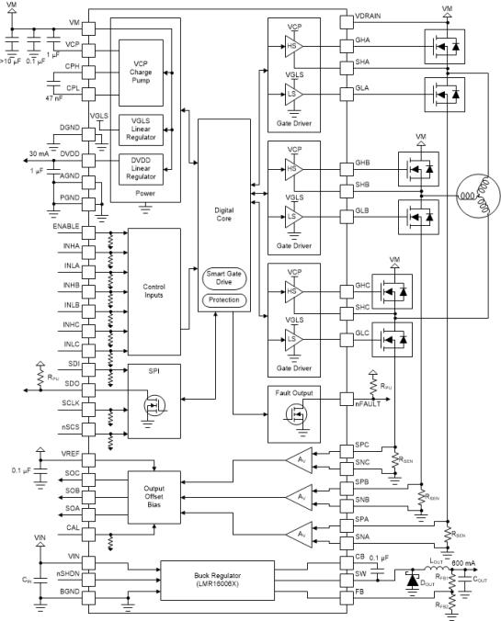
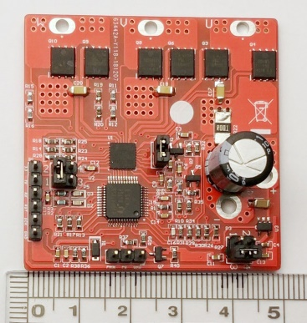
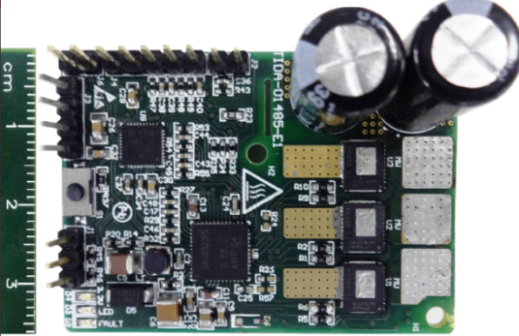
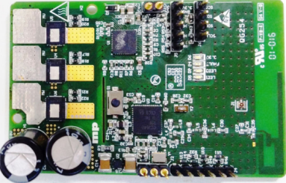
DRV832x (60V, 3-Phase BLDC Smart Gate Driver)
Released!
36-V, 1-kW, 99% Efficient, 18-cm2 Power Stage
25.2-V, 30-A High-speed sensorless (> 100 krpm)
DRV832x Family App Note
Single Microcontroller 18-V/600-W With Bluetooth® 5.0

Slide 3
DRV832x Family (65-V 3-Phase BLDC Smart Gate Driver)
Released!
DRV8323RH
7x7 mm QFN
Gate driver
600 mA buck
3x Shunt amps
H/W Interface
DRV8323H
6x6 mm QFN
Gate driver
3x Shunt amps
H/W Interface
DRV8320RH
6x6 mm QFN
Gate driver
600 mA buck
H/W Interface
DRV8320H
5x5 mm QFN
Gate driver
H/W Interface
DRV8323RS
7x7 mm QFN
Gate driver
600 mA buck
3x Shunt amps
SPI Interface
DRV8323S
6x6 mm QFN
Gate driver
3x Shunt amps
SPI Interface
DRV8320RS
6x6 mm QFN
Gate driver
600 mA buck
SPI Interface
DRV8320S
5x5 mm QFN
Gate driver
SPI Interface

Slide 4
DRV832x Features and Benefits
12, 24, 36 V batteries or regulated supplies
Smart Gate Drive, no gate drive resistors, gate current is adjustable
H/W for simple operation, SPI for more configuration
Up to 1A source, 2A sink
Optional triple current shunt amplifiers
Optional 600 mA buck regulator

Slide 5
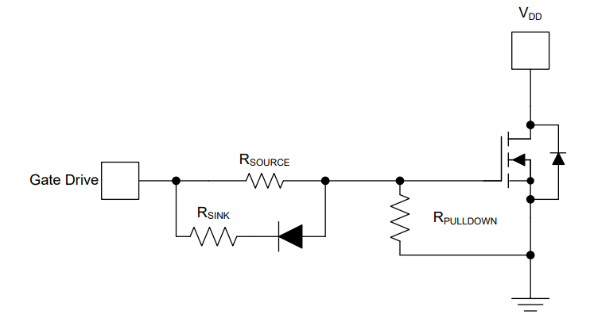
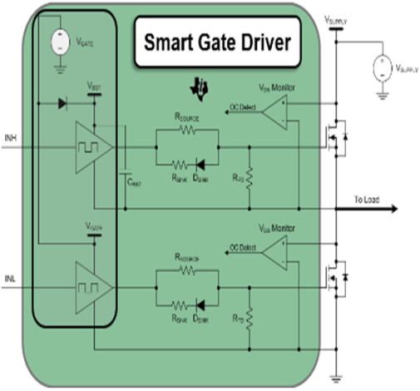
Current controlled architecture reduces external BOM
Typical voltage controlled gate driver
DRV832x/DRV835x smart gate driver
Smart gate driver (SGD) decrease the system bill of materials (BOM) and required board area.
Integrates 12-24 passive components for gate current setting (such as resistors and diodes).
Ability to adjust the MOSFET slew rate to trade off switching loss & EMI.
The SGD integrates high level protection:
    Over current, short circuit protection (V_{DS} monitors)
    MOSFET gate handshake
    Gate-fault detection
    dV/dt turn-on prevention
The R_{SOURCE} and R_{SINK} resistors manually adjust the gate source and sink current.
The diode lets the rise and fall V_{DS} slew rates to be individually adjusted.
R_{PULLDOWN} resistor makes sure that the MOSFET stays disabled even when the gate driver is inactive.
Notes:
5

Slide 6
Optimize the EMI and switching performance with IDRIVE
DRV832x: Gate drive controllable from 10 mA to 1A source & 20 mA to 2A sink
v
v
10 mA
10 mA
1000 mA
1000 mA
Notes:
6

Slide 7
DRV8323 & DRV8323R - Integrated current sense amplifiers
Current sense amplifier (CSA)
Sense amplifier - MOSFET V_{DS} sense mode (SPI Only)
Eliminates the need of external shunt resistor and hence reduces cost and power loss.
The CSA amplify the voltage across the external low-side MOSFET V_{DS.}
Gain options = 5, 10, 20, 40 V/V.
Offset calibration possible.
Sense amplifier can operate in bidirectional or unidirectional mode.
Unidirectional mode available on SPI only.
Notes:
7

Slide 8
DRV832x PWM Control Modes - Four different PWM control modes to support various commutation and control methods
6x PWM
3x PWM
Independent PWM
INL_{X} | INH_{X} | GL_{X} | GH_{X} | SHx
0 | 0 | L | L | Hi-Z
0 | 1 | L | H | H
1 | 0 | H | L | L
1 | 1 | L | L | Hi-Z
INL_{X} | INH_{X} | GL_{X} | GH_{X} | SHx
0 | X | L | L | Hi-Z
1 | 0 | H | L | L
1 | 1 | L | H | H
INL_{X} | INH_{X} | GL_{X} | GH_{X}
0 | 0 | L | L
0 | 1 | L | H
1 | 0 | H | L
1 | 1 | H | H
1x PWM
1x PWM mode uses 6-step block commutation tables that are stored internal to the gate driver.
Allows for a 3-phase BLDC motor to be controlled using one PWM sourced from a simple MCU.
State | Logic/Hall Inputs |  |  |  |  |  | Gate Drive Outputs |  |  |  |  |  | Description
 | INHC = 0 |  |  | INHC = 1 |  |  | Phase A |  | Phase B |  | Phase C
 | INLA | INHB | INLB | INLA | INHB | INLB | GHA | GLA | GHB | GLB | GHC | GLC
Stop | 0 | 0 | 0 | 0 | 0 | 0 | L | L | L | L | L | L | Stop
Align | 1 | 1 | 1 | 1 | 1 | 1 | PWM | !PWM | L | H | L | H | Align
1 | 1 | 1 | 0 | 0 | 0 | 1 | L | L | PWM | !PWM | L | H | B→C
2 | 1 | 0 | 0 | 0 | 1 | 1 | PWM | !PWM | L | L | L | H | A→C
3 | 1 | 0 | 1 | 0 | 1 | 0 | PWM | !PWM | L | H | L | L | A→B
4 | 0 | 0 | 1 | 1 | 1 | 0 | L | L | L | H | PWM | !PWM | C→B
5 | 0 | 1 | 1 | 1 | 0 | 0 | L | H | L | L | PWM | !PWM | C→A
6 | 0 | 1 | 1 | 1 | 0 | 1 | L | H | PWM | !PWM | L | L | B→A
Notes:
8

