Slide 1
DRV8350 Issue
2025.07.16 LEMTeam

Slide 2
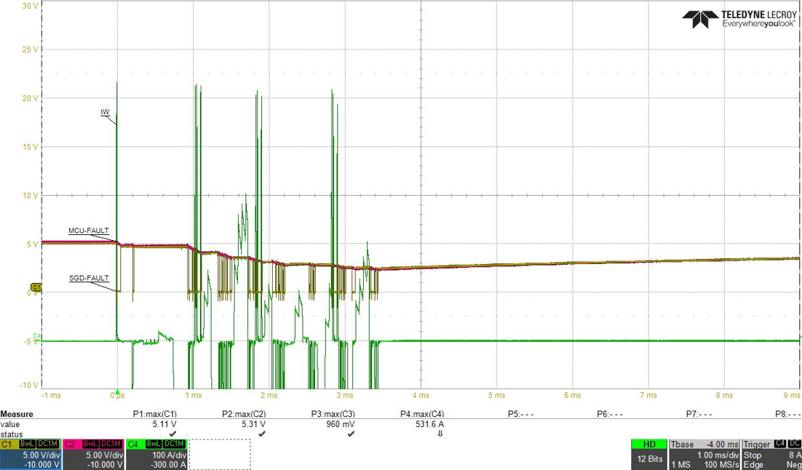
1. nFault Issue – Type One Configuration
When OC event happens on phase to phase Vout, you can see the bouncing behavior here on nFAULT pin.
Why the device could not detect the fault operation and pulling-down the nFAULT signal by
inside MOSFET? How is the bouncing happening?
10K
1K
1uF
CH1: nFAULT
CH2: MCU I/O
CH4: Current_UV
After bouncing, why the nFAULT pin doesn’t pulling down? It keeps a high level?

Slide 3
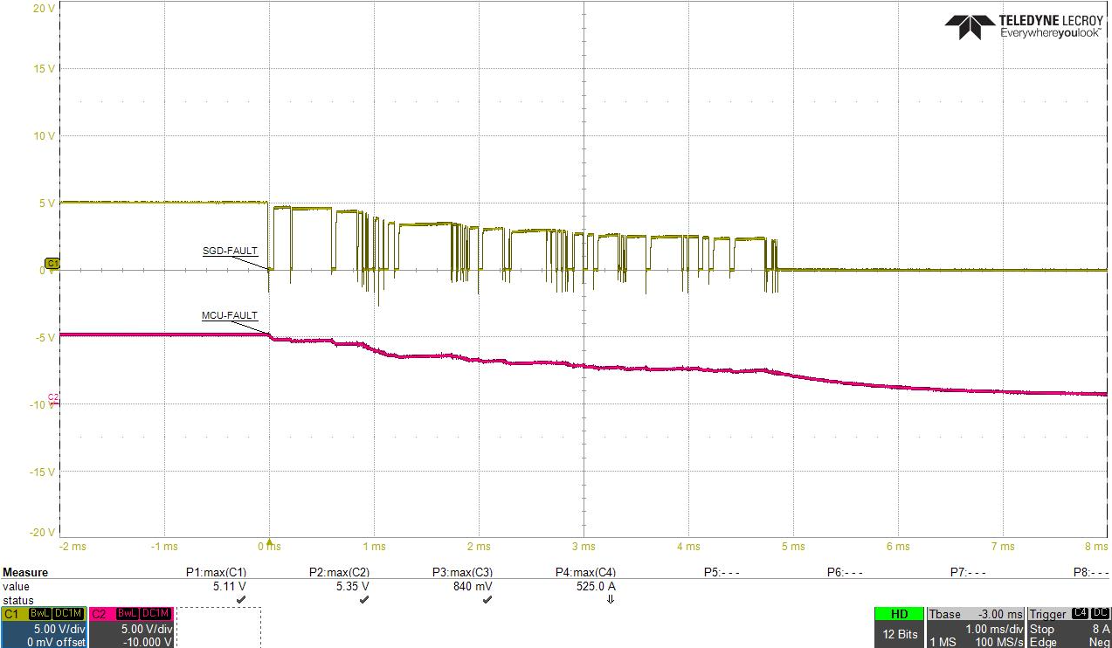
2. nFault Issue – Type 2 Configuration
10K
1K
1uF
Why the bouncing behavior is happening after OC event?
Is there other circuitry inside the Open-drain able to affect this bouncing behavior?
Where does the gate driver signal of the OPEN-DRAIN MOSFET come from?
Is that from VM? VGLS? DVDD?

