Slide 1
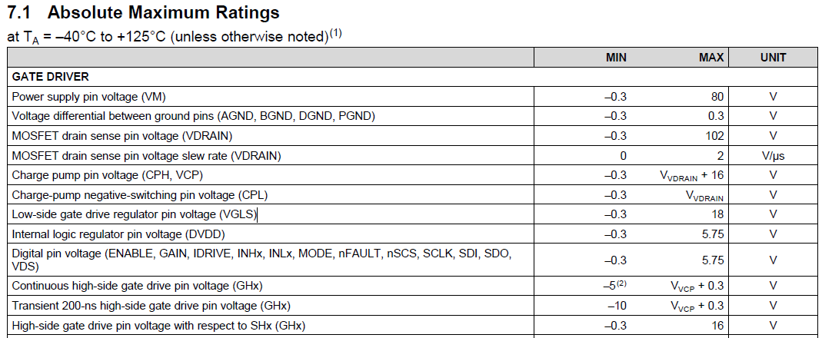
①Why is absolute maximum rating of GHx pin voltage
(Vvcp＋0.3V) lower than the same as DRV8320(Vvcp＋0.5V)?
②Could you tell me why is absolute maximum rating of GHx pin voltage
with respect to SHx (16V) higher than the same as DRV8320(13.5V)?
③ Let me know transiently (ex. under 50ns) absolute maximum rating of GHx pin voltage with respect to SHx ?

