Slide 1
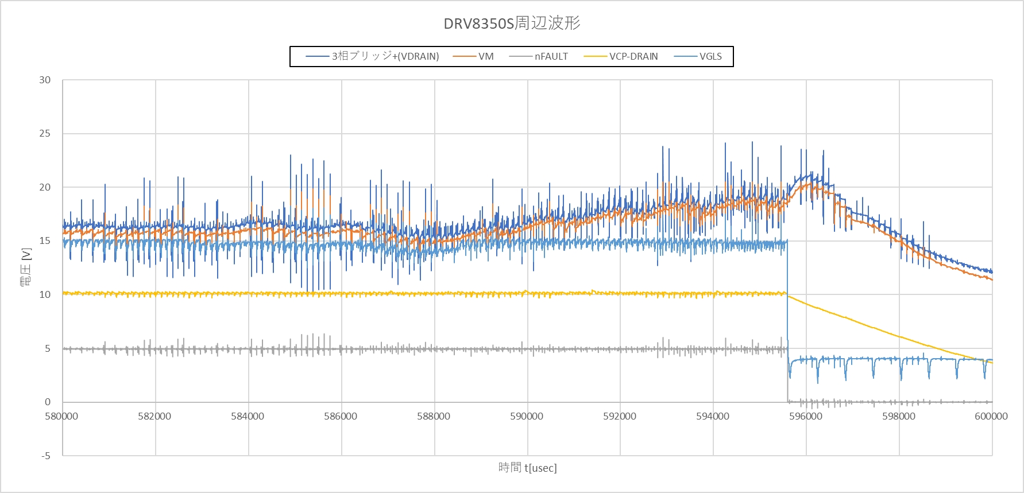

Slide 2
Request1
Please see waveform.
After Fault is reported , VCP-VDRAIN is decrease and then UVLO,GDF is found.
Please advise us what cause fault is reported from your checking waveform.

Slide 3
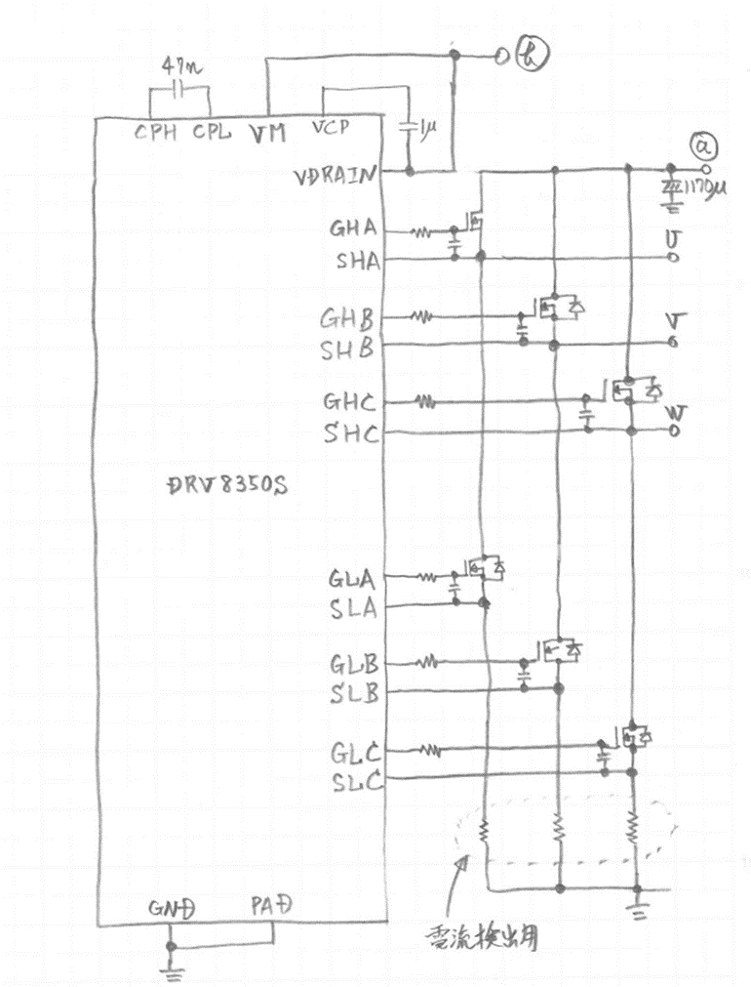
Question1
Figure1
When UVW is connected to 3Phase magnetic ACG and they
increase the rotation speed, They see a voltage across VDRAIN－GND
is this the correct behavior?
If this behavior is correct, please let us know why this happens.
image
3phase Bridge(+) - GND
voltage
VDRAIN&VM - GND
0
ACG rotation
For current sense

Slide 4
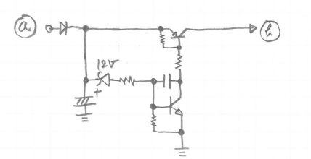
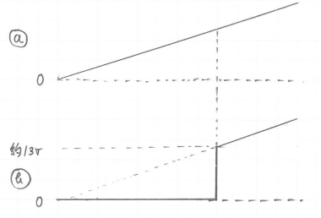
Question2
Figure2
Figure3
They are considering connecting the circuit shown in Fig. 2 to the circuit shown in Fig. 1
and inputting the voltage sequence shown in Fig. 3 between VDRAIN & VM∸GND.
The purpose is to make the timing of power supply to VM after reaching a sufficiently stable voltage.
Is there any problem with this usage?

