Slide 1
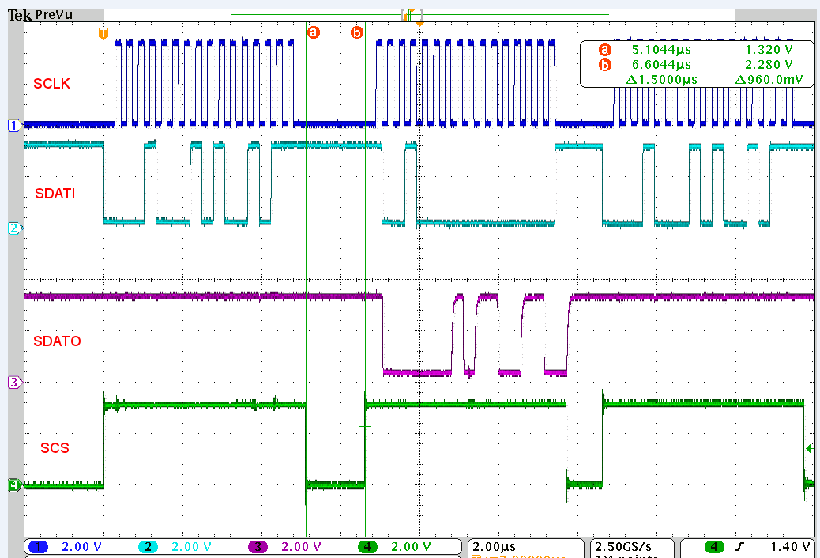
W
0
0
1
0
0
0
1
0
1
0
0
1
0
1
1
R
0
0
1
0x01 Address
001
Data
SMPLTH
0100 1011
0x4B
Data
TORQUE
0x01 Address
Write access to 0x01 address again
0
0
0
1
0
1
1
0
0
1
1
0
001
Data
SMPLTH
0110 0110
0x55
Data
TORQUE

