Slide 1
DRV8714S/18S-Q1 Register set up guide
2023

Slide 2
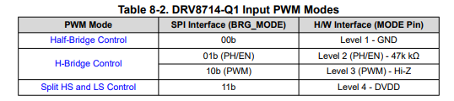
DRV8714S/18S-Q1, here is the quick start up to spin motor easily.
<<Example configuration>>
On of bridge(HB1) is PWM, another HB2 is HS or LS continuous on.
H-Bridge motor configuration.
<<Register set up steps>>
1)MODE selection (e.g PWM)

Slide 3
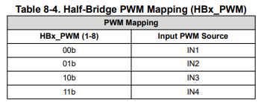
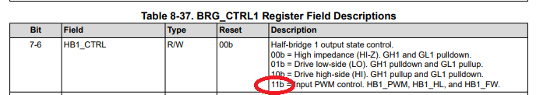
2) PWM input pin assignment for HB1
3) BRG_CTRL is set for PWM for HB1

Slide 4
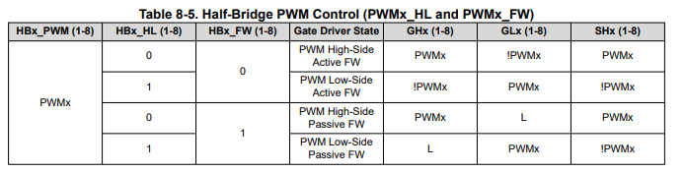

4) PWM control selection. Choose one of 4.
As common use case for H-Bridge motor driving, one HBx is assigned above, then another HBx is assigned LS ON or HS ON here.
5)Another HBx(HB2) is for HS or LS continuous ON

Slide 5
6)Set max driving current IDRVP_x and IDRVN_x if needed.
7)Set higher VDS over current threshold if needed (VDS_LVL_1)
9)Do not need to touch ADV_Registers from 2Ah to 3Bh. They are for advanced settings.
9)CLR_FLT and EN_DRV=1 on IC_CTRL1. (EN_OLSC=0b surely)
10)Input PWM signal on Inx(IN1) pin externally. Then motor start spinning.
If fault happen, read fault flag for debug.

