Slide 1
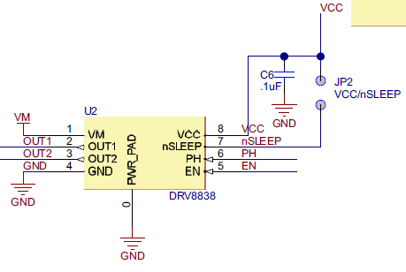
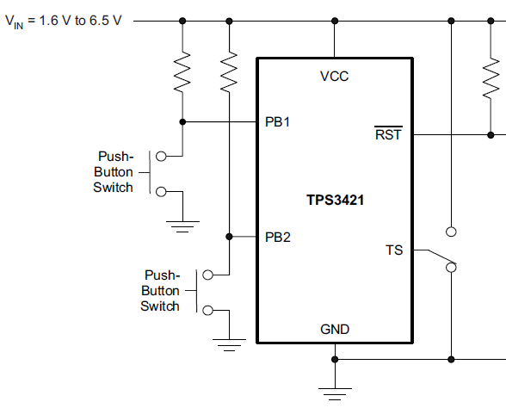
Logic High or Low to control direction forward and reward
forward
reward
SW1
SW2
SW1
SW2

Slide 2
PH
PH
EN
EN

