Slide 1
DRV8846 winding waveform

Slide 2
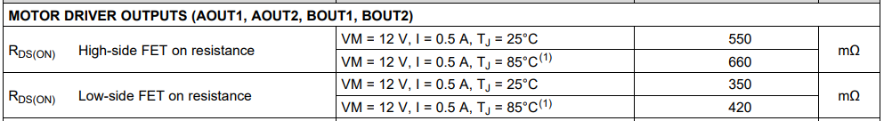
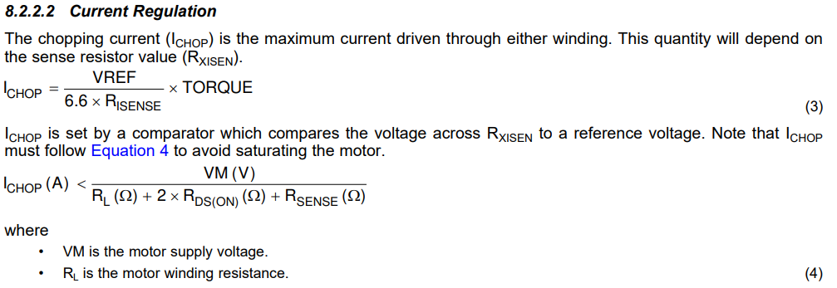
System design input parameters
VM | 5 | V
Rsense | 3.9 | Ω
RL | 60 | Ω/phase
Vref | 3.3 | V
Imax | 128.21 | mA
Torque DAC | 75 | %
Full Step | 70 | %
peak | 67.31 | mA
Full step → 71% winding current A/B
Ichop | 0.0683 | mA | (3) | VREF*TORQUE DAC*71%/6.6*RISENSE
Ichop(A) | 0.0770 | mA | (4) | VM/RL+1ohm+Rsense
※from next slide, use 70% as full step winding current A/B

Slide 3
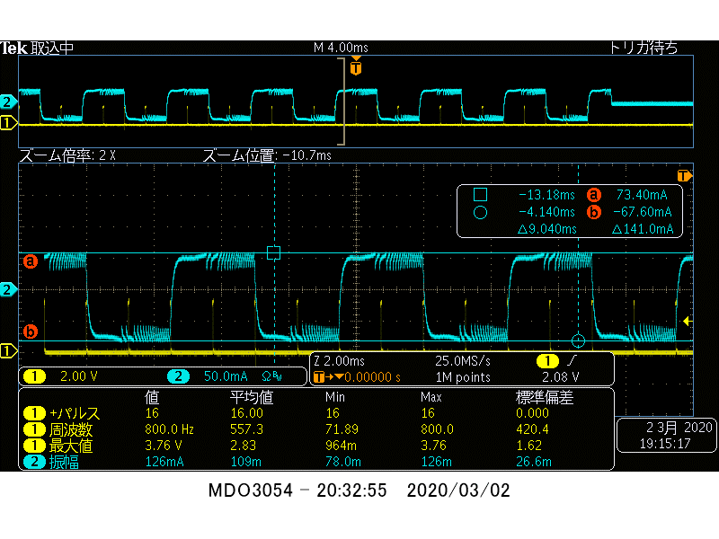
Ichop=3.3V*0.75*0.70/6.6*3.9=67.3mA
VREF*TORQUE DAC*70%/6.6*RISENSE
Full step current / phase
M0 | M1 | DEC0 | DEC1 | TOFF_SEL | current
L | L | Z | Z | Z | 6
Full Step (70%) |  | Increase:Mix decay Decrease:Mix decay |  | Toff=10us | 67.3mA
  ①From the beginning of switching to end of switching, dv/dt changes.
It this normal behavior?
VM | 5 | V
Rsense | 3.9 | Ω
RL | 60 | Ω/phase
Vref | 3.3 | V
Imax | 128.21 | mA
Torque DAC | 75 | %
Full Step | 70 | %
peak | 67.31 | mA

Slide 4
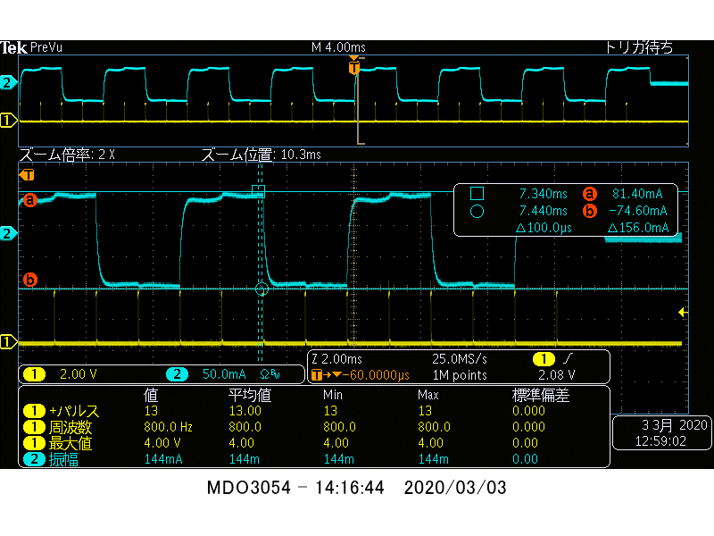
Ichop=3.3V*0.875*0.70/6.6*3.9=78.5mA
VREF*TORQUE DAC*70%/6.6*RISENSE
Full step current / phase
M0 | M1 | DEC0 | DEC1 | TOFF_SEL | current
L | L | Z | Z | Z | 7
Full Step (70%) |  | Increase:Mix decay Decrease:Mix decay |  | Toff=10us | 78.5mA
②RL=60Ω and Rsense=3.9Ω so VM/Rtotal=5/63.9=78mA. (not include Rdson).
±78mA=156mApk-pk so ⊿156mA looks correct but the waveform looks unstable.
Is this normal behavior?
VM | 5 | V
Rsense | 3.9 | Ω
RL | 60 | Ω/phase
Vref | 3.3 | V
Imax | 128.21 | mA
Torque DAC | 75 | %
Full Step | 70 | %
peak | 67.31 | mA

Slide 5
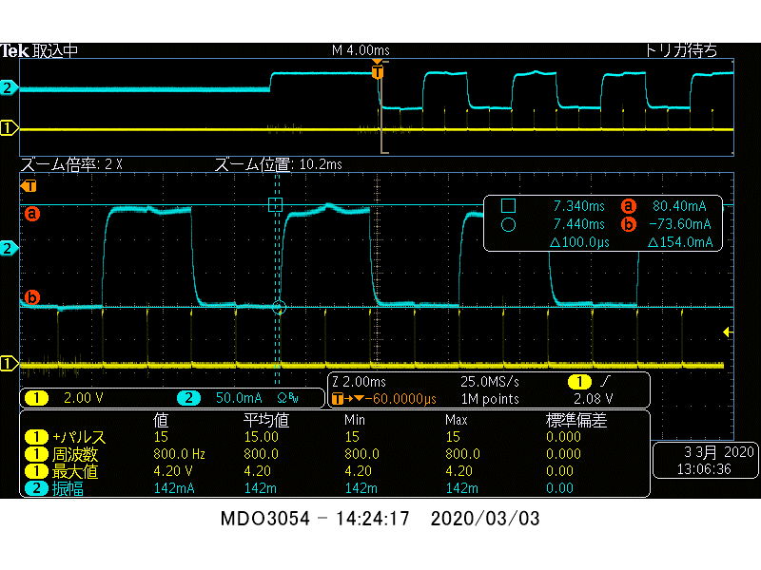
Ichop=3.3V*1.00*0.70/6.6*3.9=89mA
VREF*TORQUE DAC*70%/6.6*RISENSE
Full step current / phase
M0 | M1 | DEC0 | DEC1 | TOFF_SEL | current
L | L | Z | Z | Z | 8
Full Step (70%) |  | Increase:Mix decay Decrease:Mix decay |  | Toff=10us | 89mA
③when Torque DAC=100%, VREF*TORQUE DAC*70%/6.6*RISENSE) > 78mA(VM/RL+Rsense)
Is it ok to use this Ichop > 78mA_Imax setting?
VM | 5 | V
Rsense | 3.9 | Ω
RL | 60 | Ω/phase
Vref | 3.3 | V
Imax | 128.21 | mA
Torque DAC | 75 | %
Full Step | 70 | %
peak | 67.31 | mA

Slide 6
Question
Question 1
    From the beginning of switching to end of switching, dv/dt changes. It this normal behavior?
Question 2
    RL=60Ω and Rsense=3.9Ω so VM/Rtotal=5/63.9=78mA(not include Rdson). ±78mA=156mApk-pk so ⊿156mA looks correct but the waveform looks unstable. Is this normal behavior?
Question 3
    when Torque DAC=100%, 89mA (VREF*TORQUE DAC*70%/6.6*RISENSE) > 78mA (VM/RL+Rsense). Is it ok to use this Ichop > 78mA_Irmax setting?
※ motor saturation current is higher than 80mA so motor current doesn’t saturate in all waveform.

