Slide 1
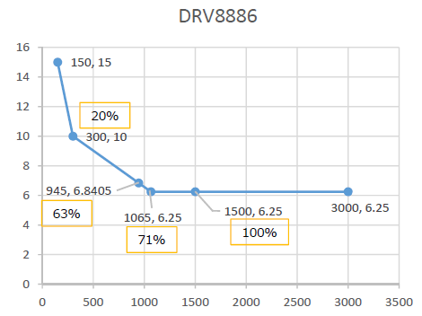
DRV8886 IFS accuracy
63% accuracy is linearly calculated from 20% and 71% accuracy
IFS accuracy(%)
IFS(mA)

