Slide 1
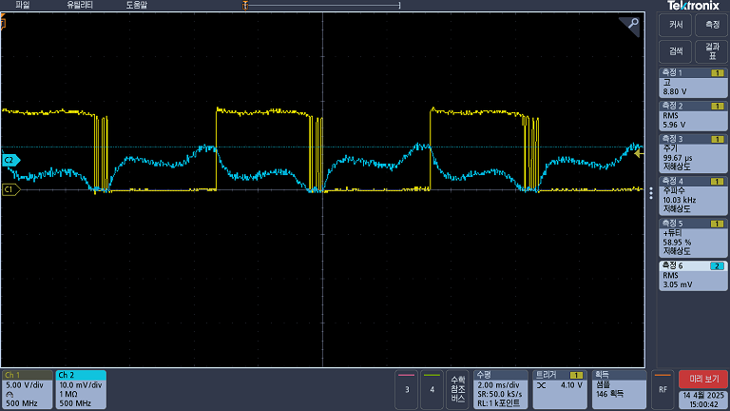
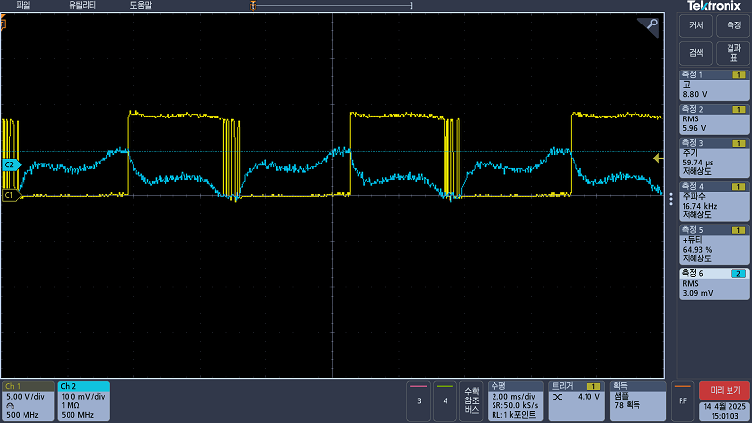
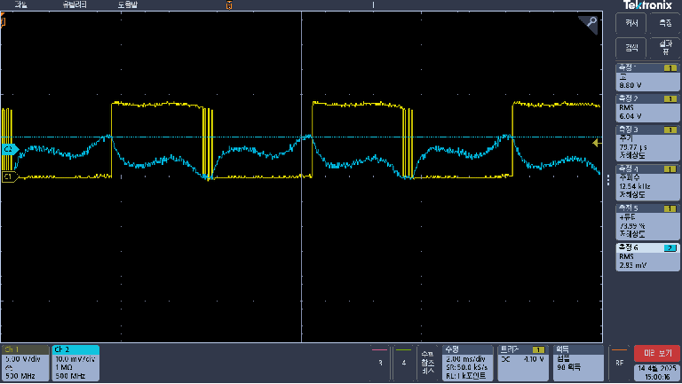
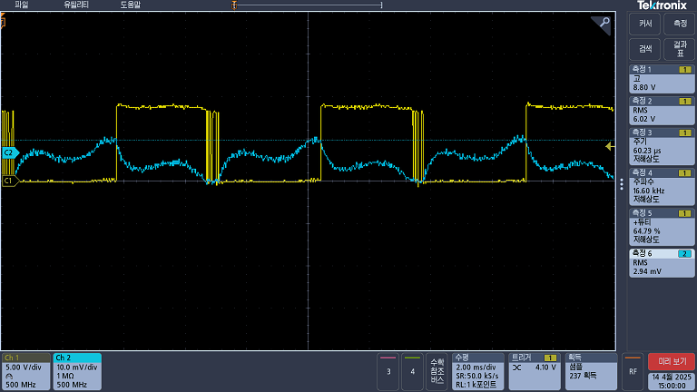
■ EVB Board waveform / 9V @600PPS
"A" motor CW
"A" motor CCW
“B" motor CW
“B" motor CCW

Slide 2

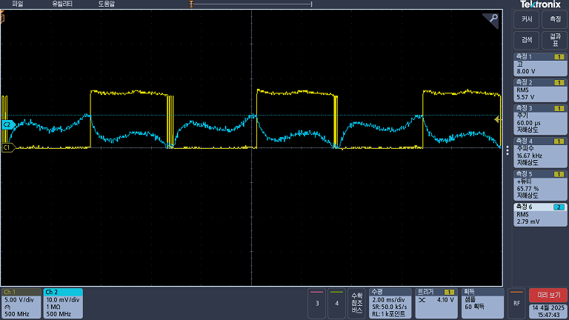
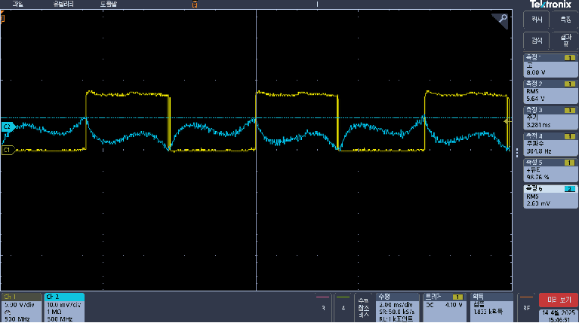
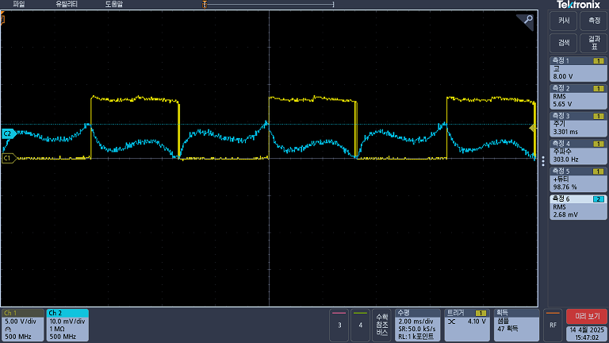
■ My controller waveform/ 9V @600PPS
"A" motor CW
"A" motor CCW
“B" motor CW
“B" motor CCW

