Slide 1
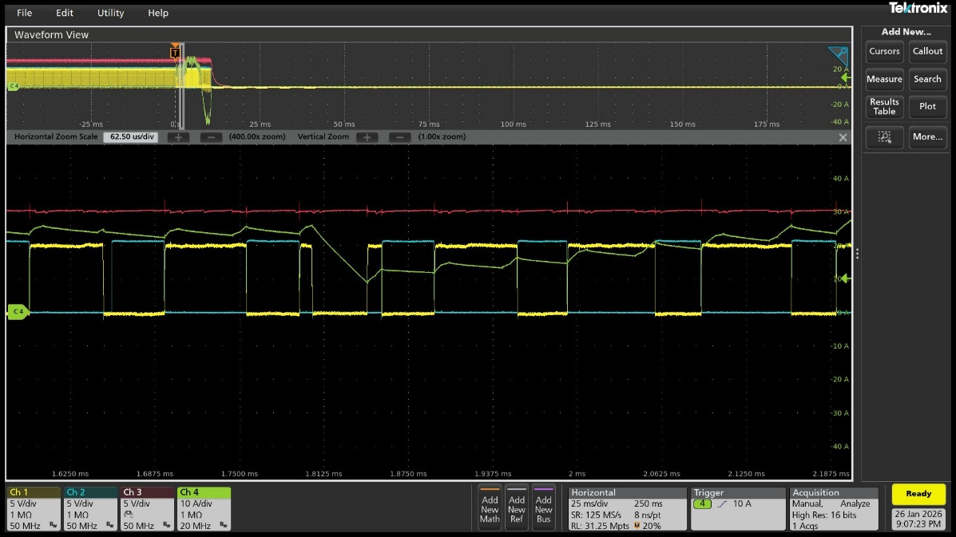
Verification of gate supply voltage distortion.
Observation of the VGLS waveform.
  CH1 : GHA, CH2 : GLA, CH3 : VGLS, CH4 : U Phase Current
  Idrve Setting : 700mA (source) / 1400mA (sink)
  VGLS_UV : 4.25V
  Waveform analysis:
    At the time when GHA waveform distortion occurs, VGLS UVLO does not operate.
    VGLS is observed to be normal.

Slide 2
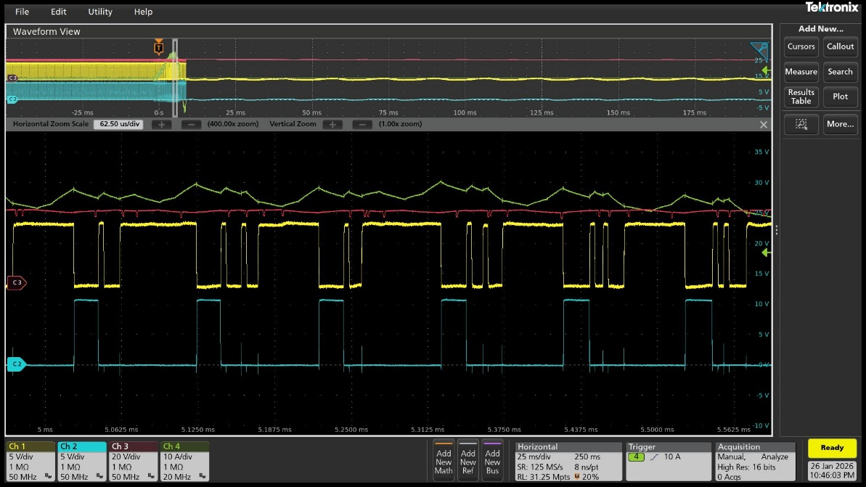
Verification of gate supply voltage distortion.
Charge pump operation observed.
  CH1 : GHA, CH2 : GLA, CH3 : CHP<-> CHL, CH4 : U Phase Current
  Idrve Setting : 700mA (source) / 1400mA (sink)
  Waveform analysis:
    At the time when GHA waveform distortion occurs, no abnormal operation of the charge pump switch is observed.

Slide 3
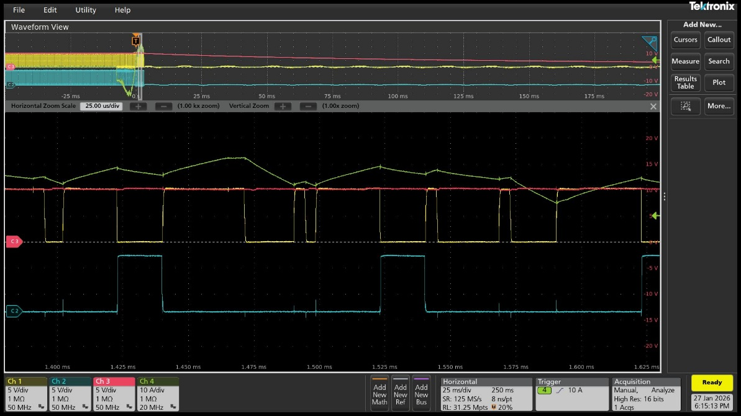
Verification of gate supply voltage distortion.
Charge pump operation observed.
  CH1 : GHA, CH2 : GLA, CH3 : VCP, CH4 : U Phase Current
  Idrve Setting : 700mA (source) / 1400mA (sink)
  VCP_UV : 5V
  Waveform analysis:
    At the same time point, VCP UVLO does not occur.
    After the alarm event, VCP is confirmed to decrease normally.

