Slide 1
Problem statement : -
HBRIDGE DRIVER ISSUE

Slide 2
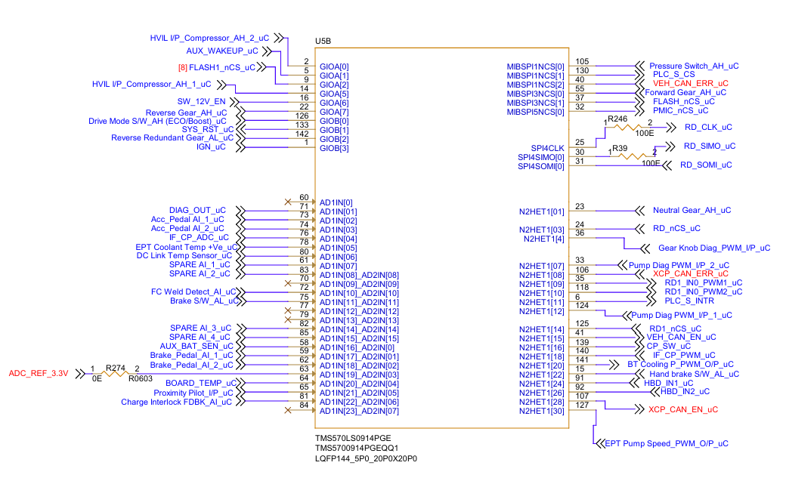
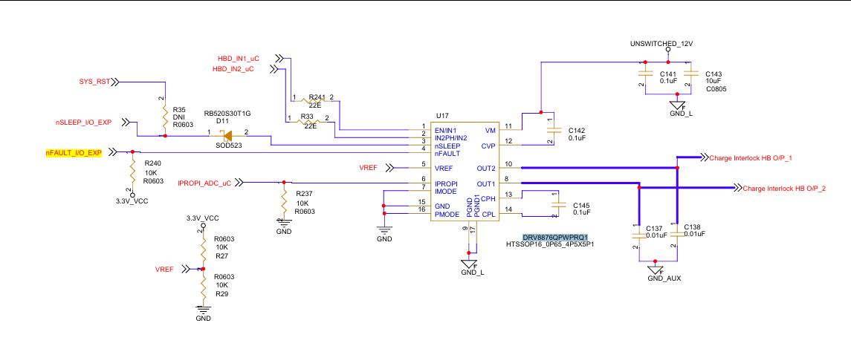
H/W config

Slide 3





DETAILS HOW THE IC IS NOT WORKING
TEST CONDITION
WHEN IPROPI 1000 Ohm and VREF 1.65 V = ILIMIT 1.65 A ( IC DOES NOT RESPOND , CAPTURES ARE MENTIONED IN BELOW SLIDES )​
NFAULT = HIGH ​
NSLEEEP = HIGH ​
LOAD CURRENT = 300mA
IN1 AND IN2 ARE PROVIDED WITH HIGH AND LOW

Slide 4
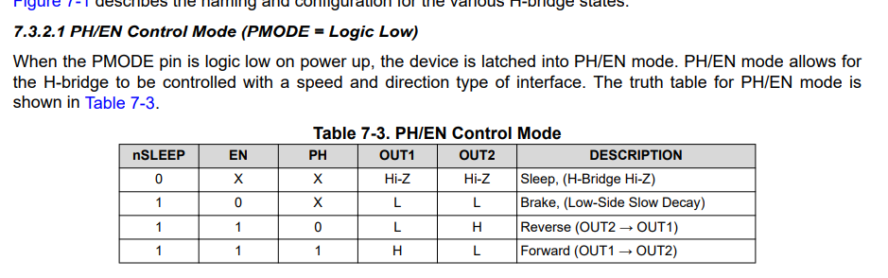
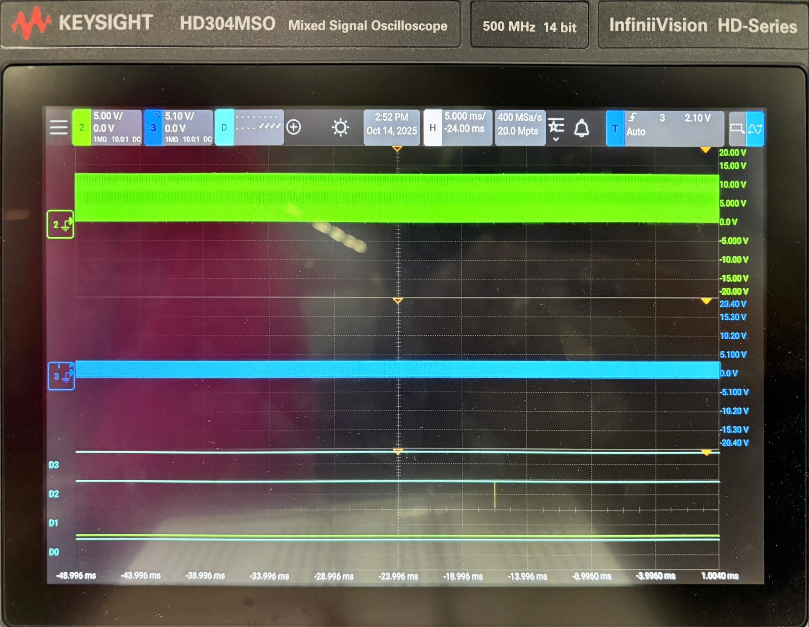
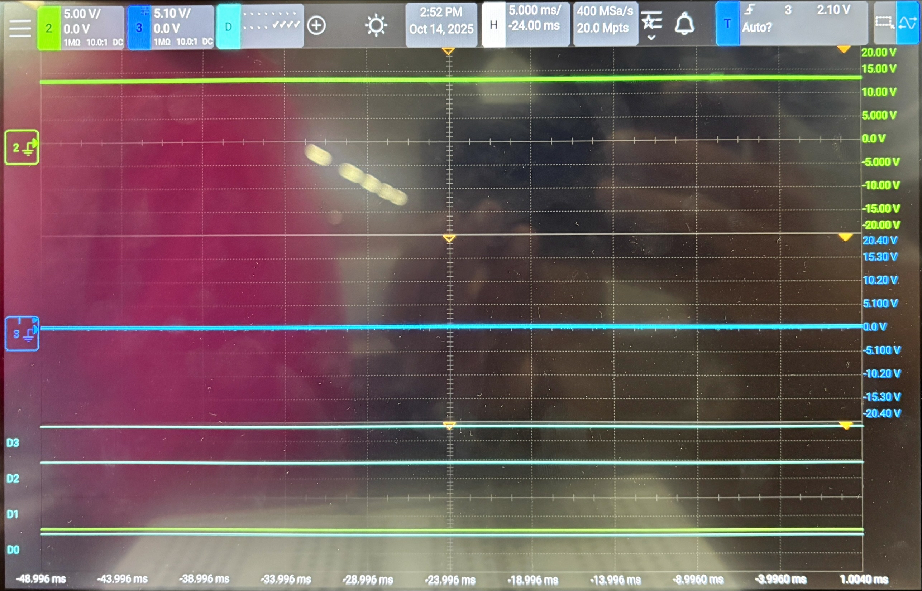
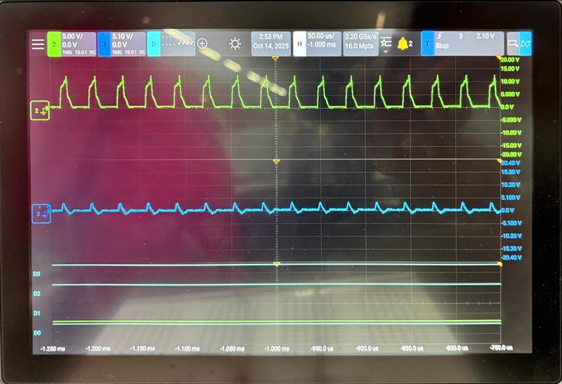
Oscilloscope captures:
Config mode : Reverse (out1 – out2)
D0 = EN/IN1 = HIGH
D1 = IN2PH/IN2 = LOW
D3 = N sleep = HIGH
D4 = N fault =HIGH
PROBE 3 = out+
PROBE 2 = out-
WITH MOTOR CONNECTED
WITHOUT MOTOR CONNECTED

Slide 5
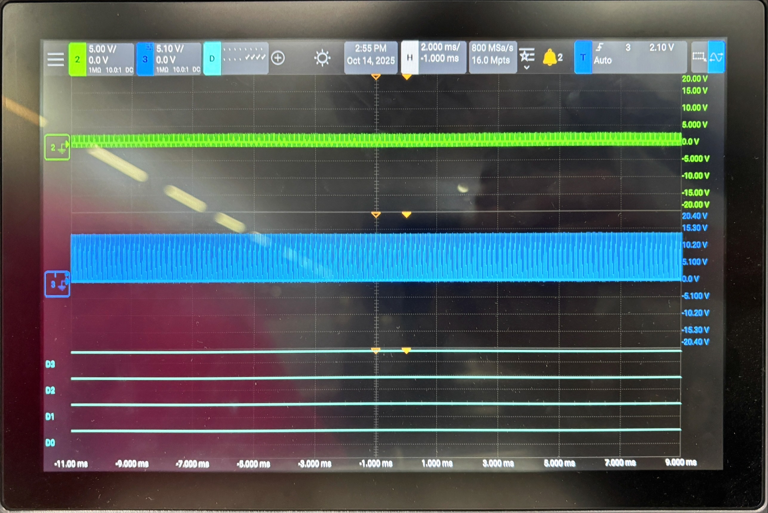
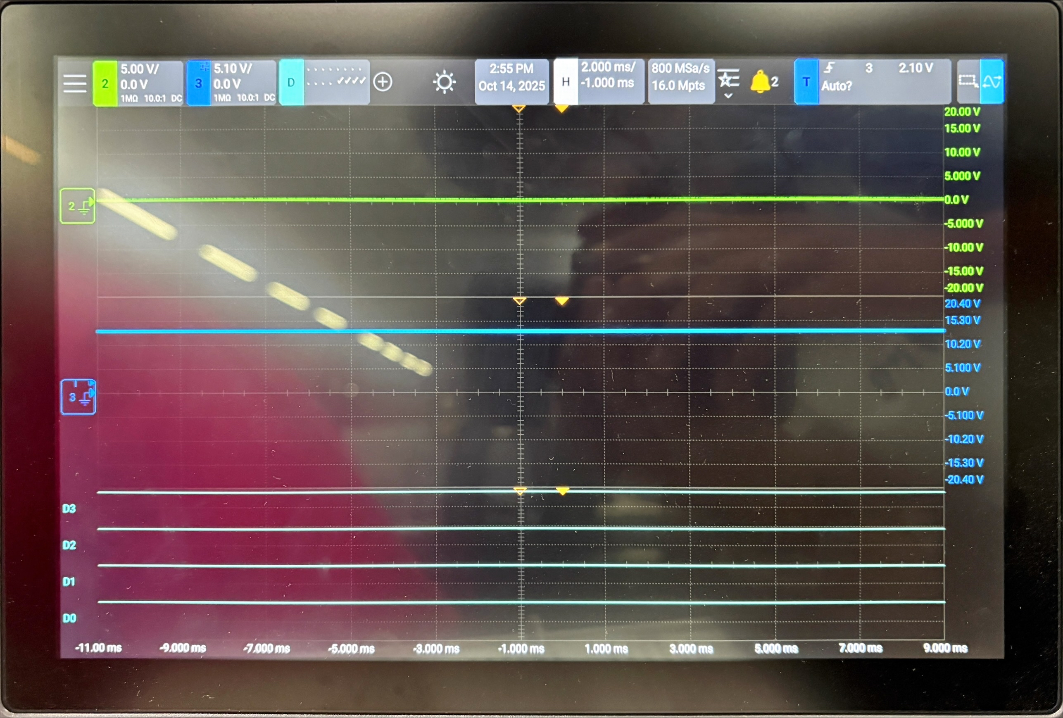
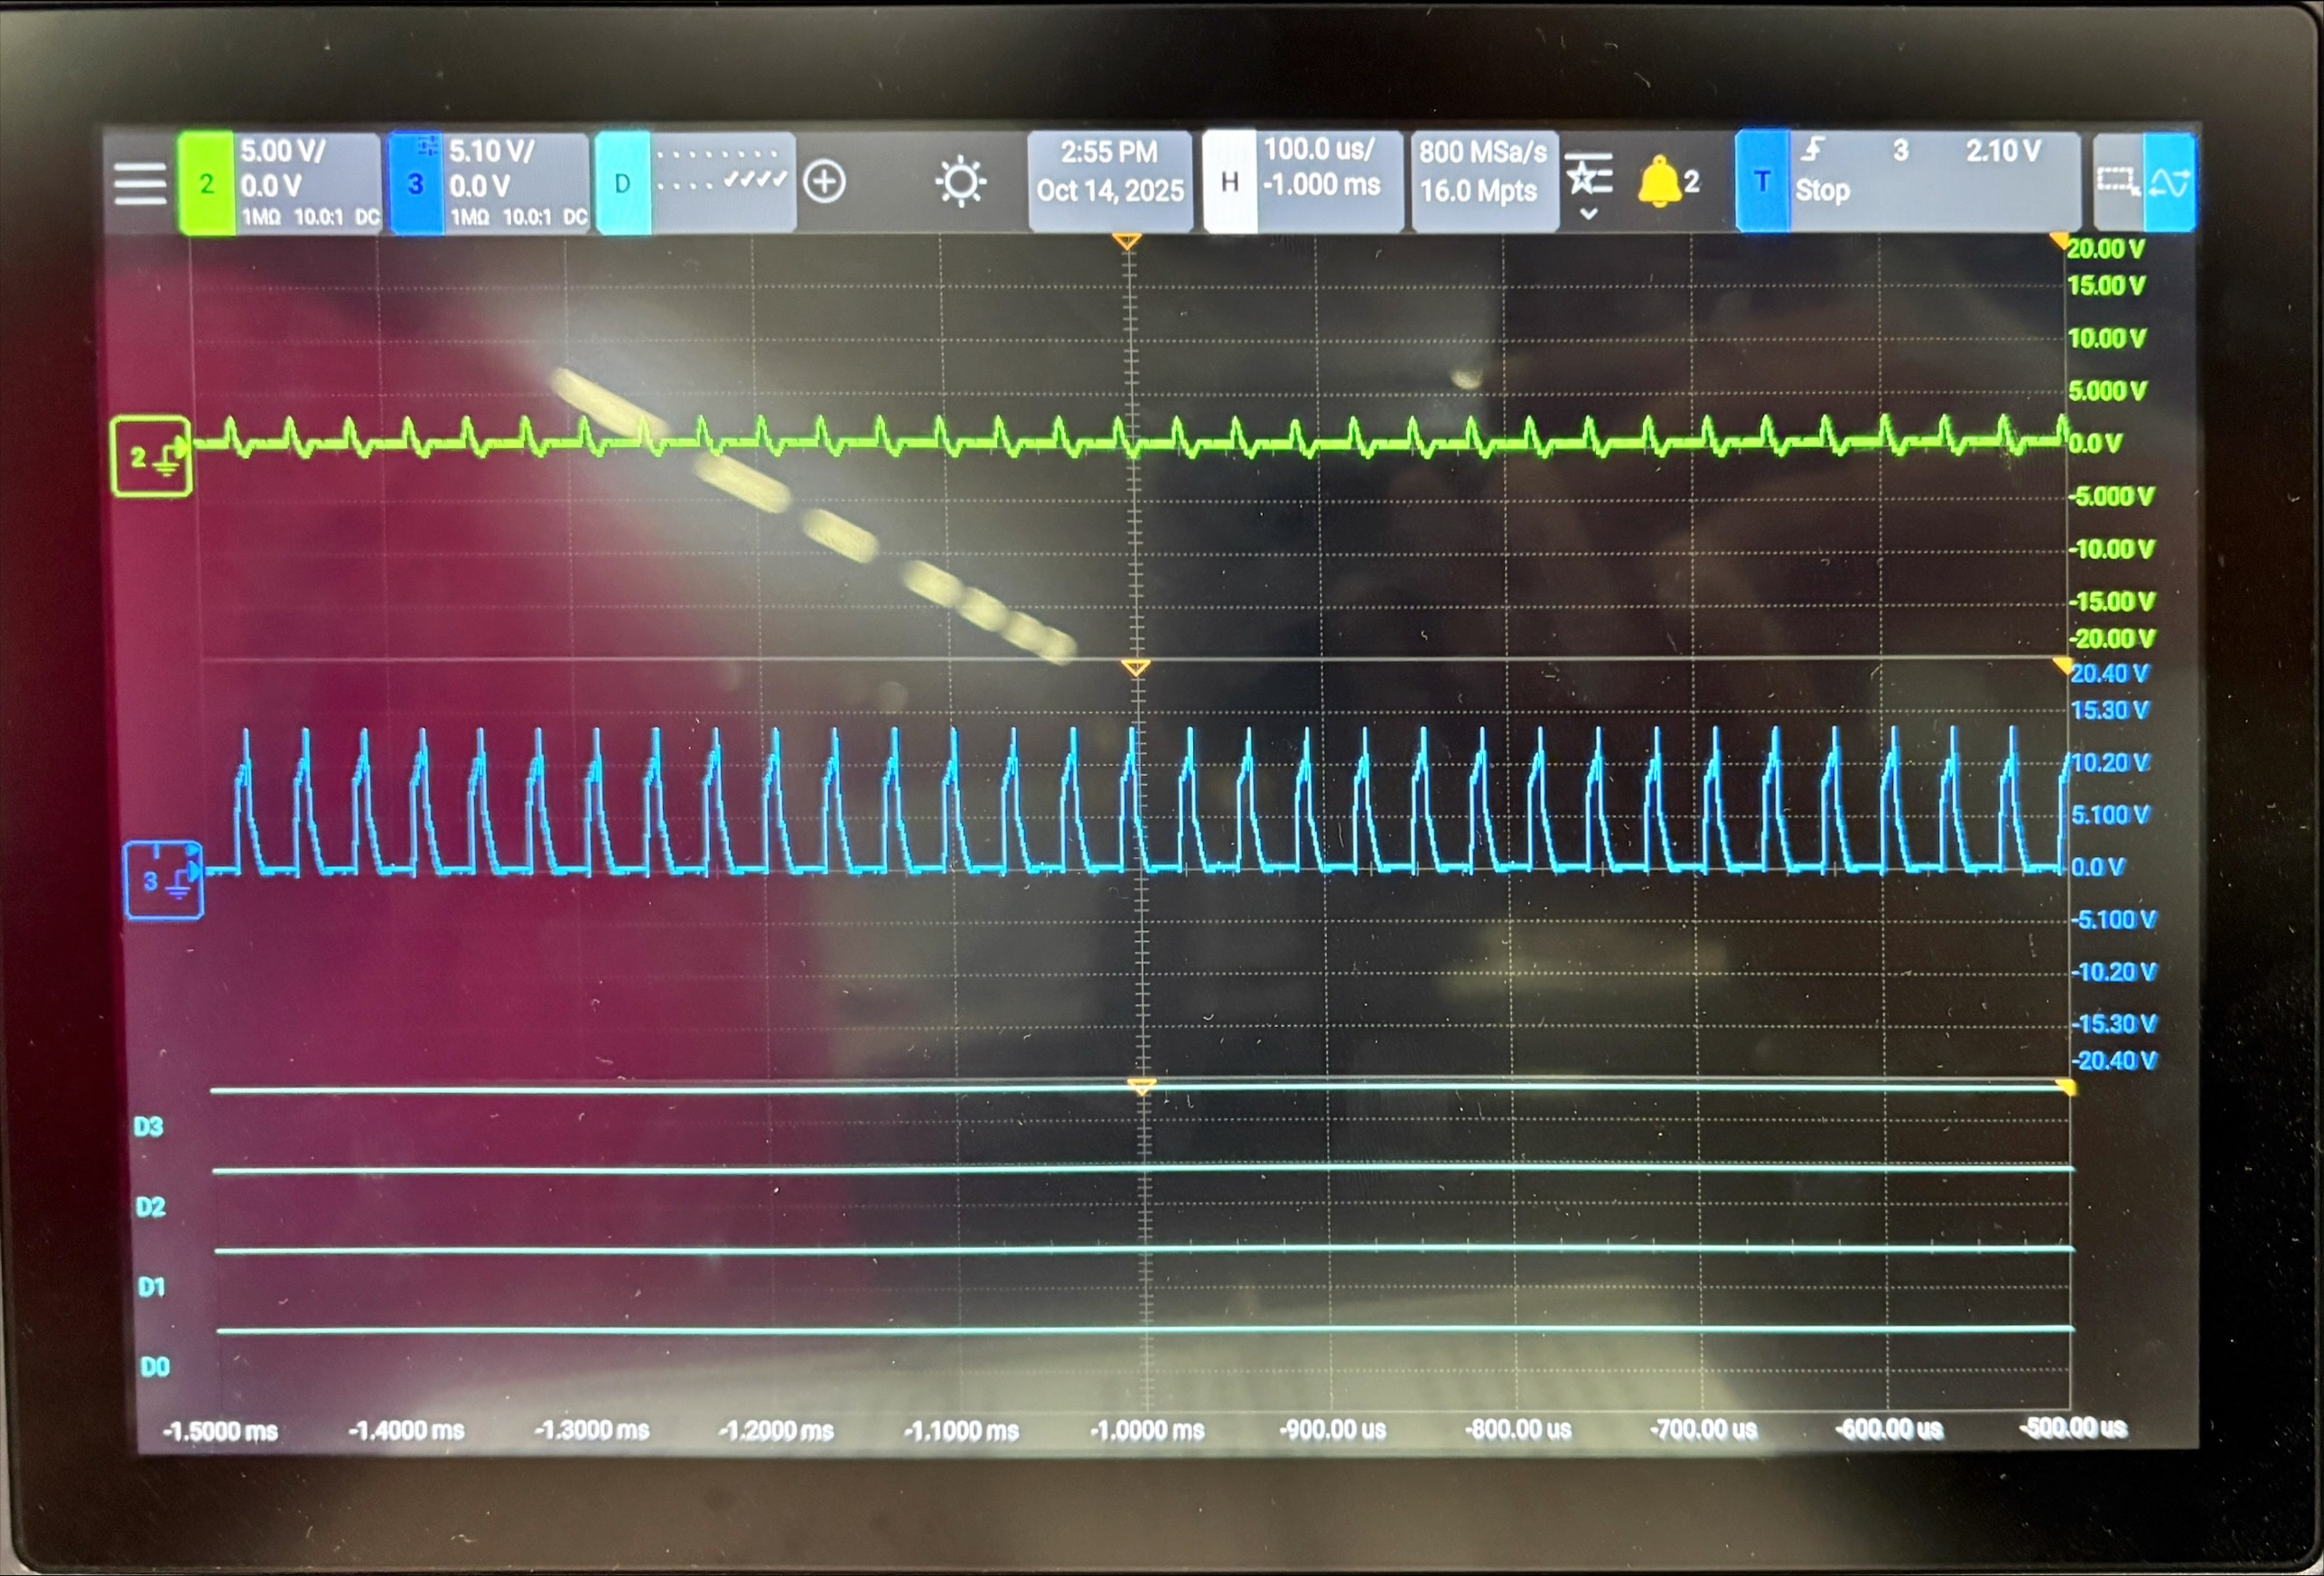
Oscilloscope captures:
Config mode : FORWARD (out1 – out2)
D0 = EN/IN1 = HIGH
D1 = IN2PH/IN2 = HIGH
D3 = N sleep = HIGH
D4 = N fault =HIGH
PROBE 3 = out+
PROBE 2 = out-
WITH MOTOR CONNECTED
WITHOUT MOTOR CONNECTED

Slide 6



Debugging Steps Taken
Verified EN/IN1 , N sleep , N fault , Signals are high = FOUND OK
Set the ITRIP = VREF/1000*0.001 = 1.65 Amps ( max allowed current)
Motor tested OK with direct 12V supply = FOUND OK
Open points needs to be clarified:
We need to set the current limiting factor ILIMIT = 850mA (Design consideration)

