Slide 1
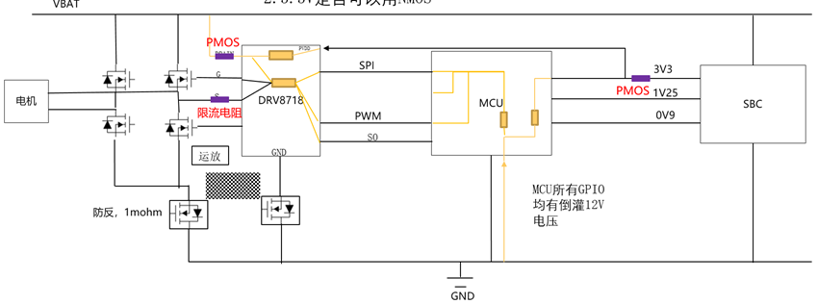
PMOS for DRAIN pin battery anti reverse protection
10K current limit resistor for SHx pin battery anti reverse protection
NMOS for battery anti reverse protection

