Slide 1
Luna
Vibe test

Slide 2
High voltage issue
Expect rated voltage 2.0 Vrms. Overdrive voltage 3.5 Vp with following setup.
Result voltages are too high. See the following slides.
Reg | Value
0x1F | 0x4E
0x20 | 0xA5

Slide 3
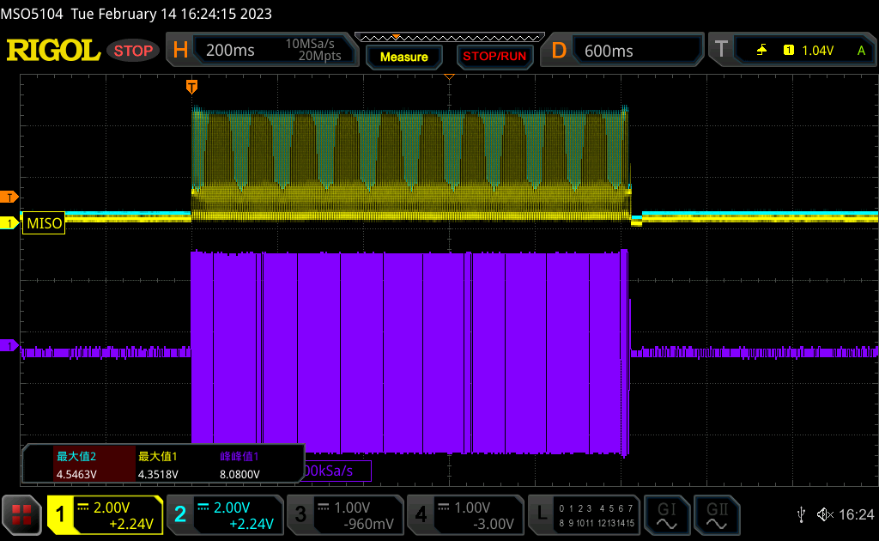
Before calibration

Slide 4
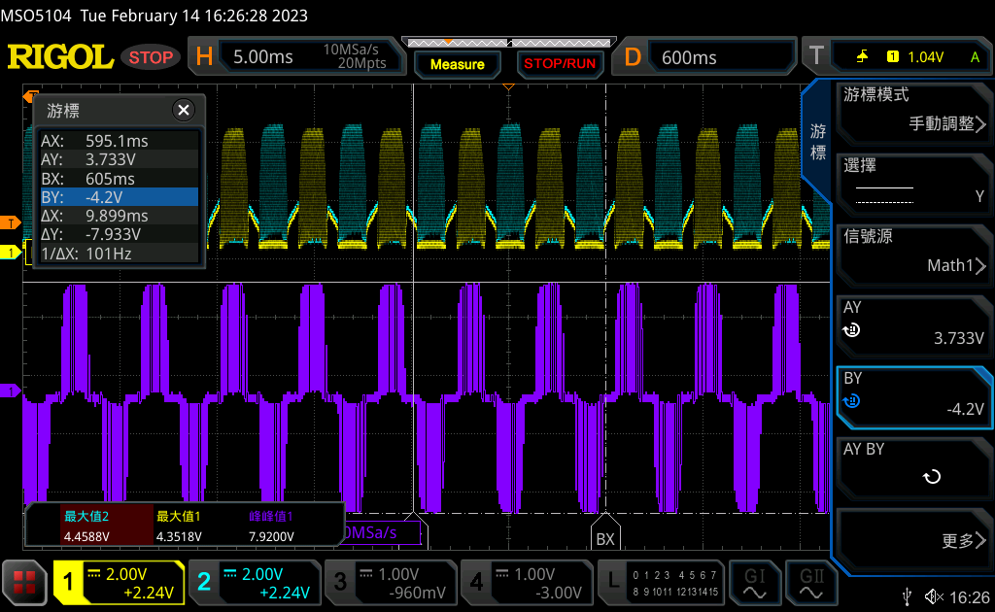

After calibration
Zoom in

Slide 5
Additional register setup
These are the additional registers setup for the test this time. I checked all of them today and some are different from default setting. We are going to set them all default and have a test. In the meantime, could you please help to confirm if you are using the all the default for these register?
0x00, /* Reg: 2E, ol_period_msb, see below */
0xA9, /* Reg: 2F, ol_period_lsb, OL_LRA_PERIOD[9:0] × 24.615 μs. 240Hz*/
0x00, /* Reg: 2C, ol configuration (default), */
0x40, /* Reg: 07, mode_settings, no LRA period average, pulse-triggered */
0x88, /* Reg: 08, control_1, LRA mode, auto-brake before standby mode */
0x00, /* Reg: 0D, control_2 (default) */????????????????????????????????????????????
0x10, /* Reg: 27, drive_time, (1/240Hz)/2==2.1ms */
0x37, /* Reg: 23, loopback_ctrl, brake factor 4x, slow loop gain, B-EMF 30x */

