Slide 1
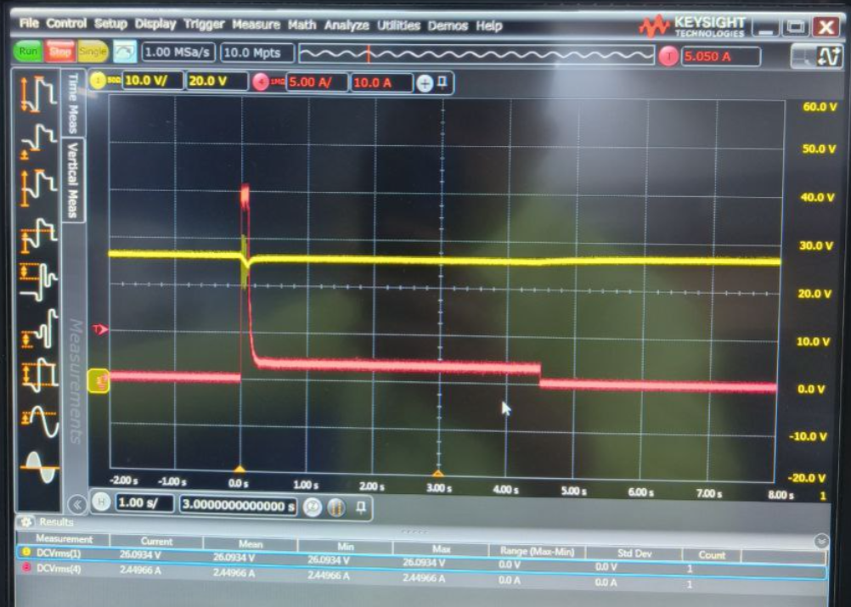
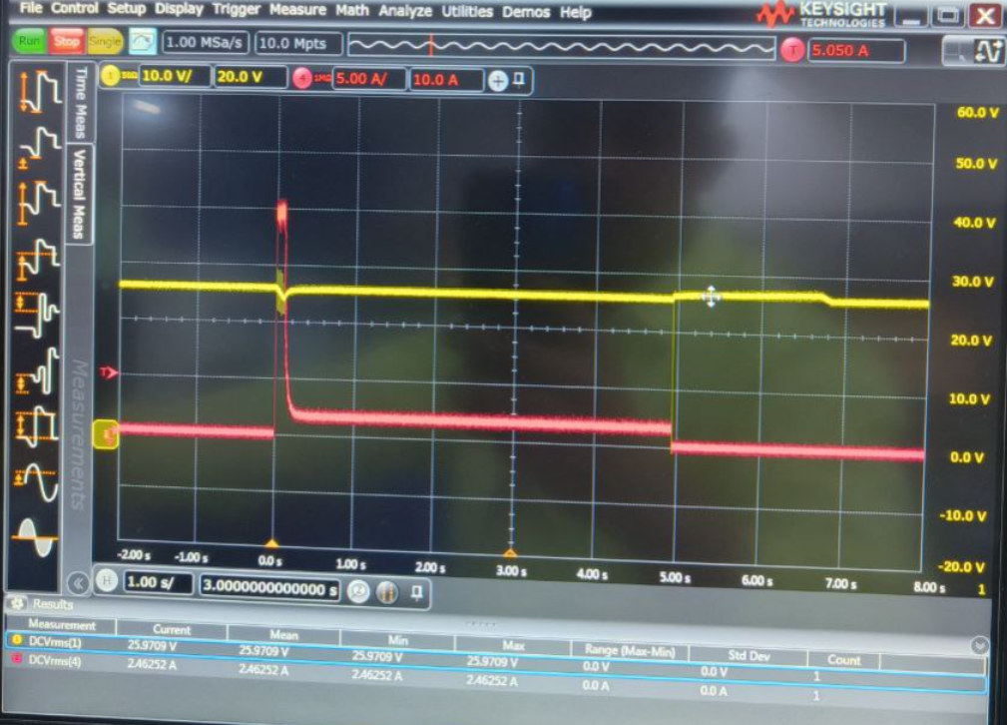
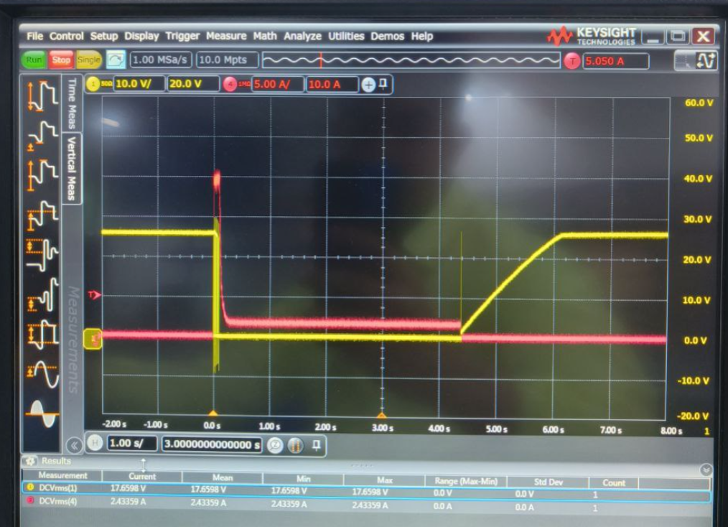
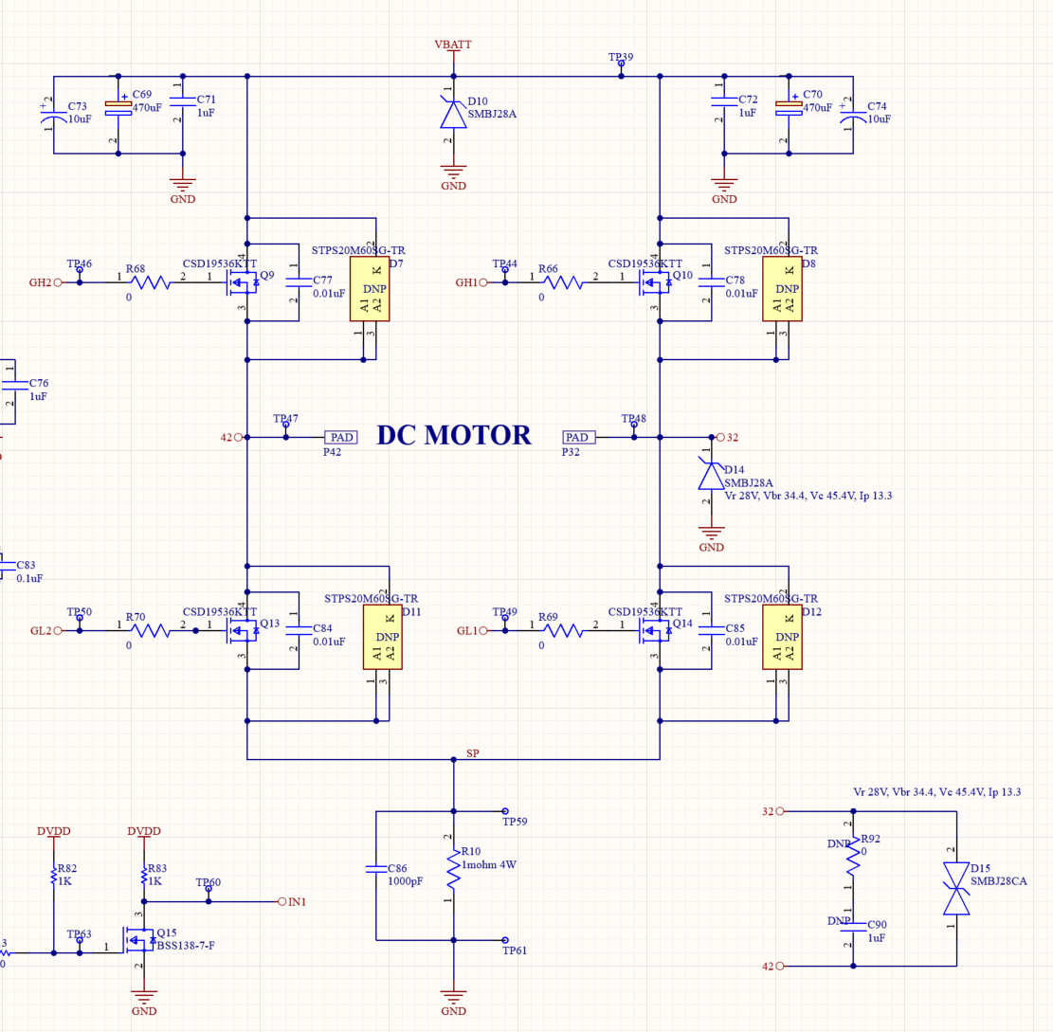
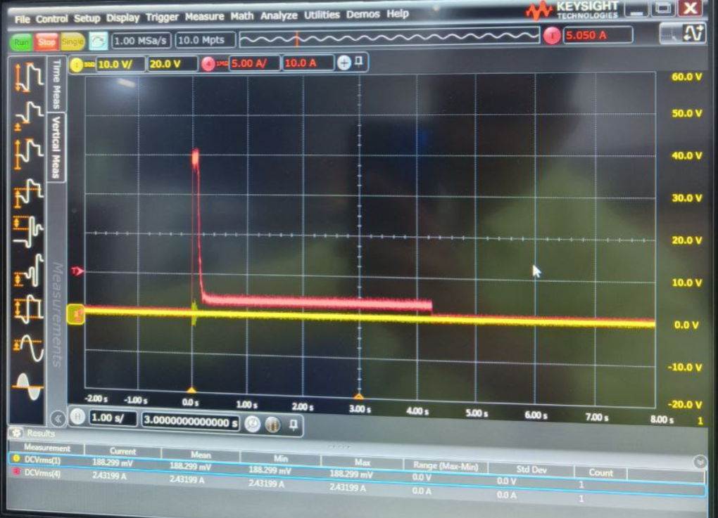
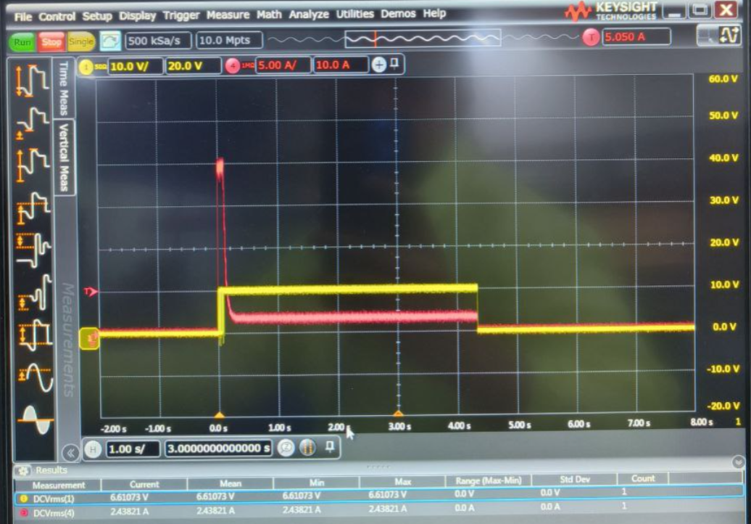
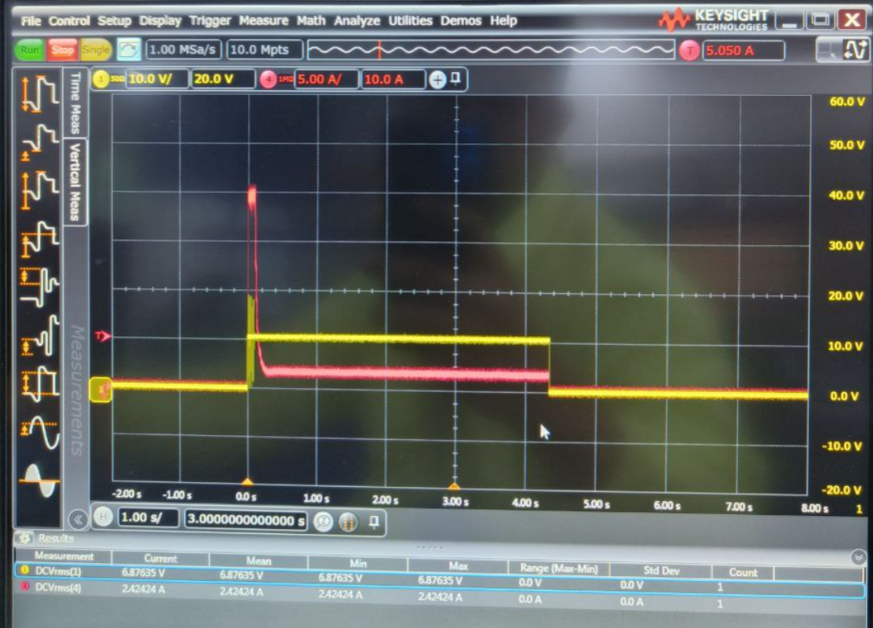
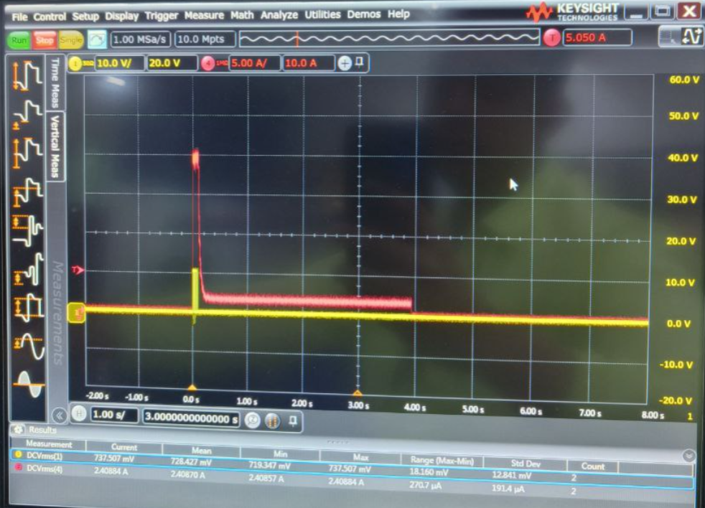
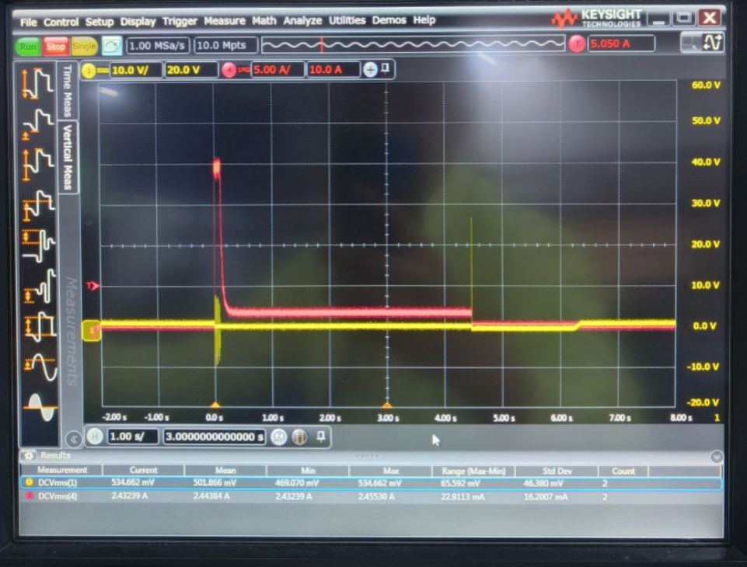
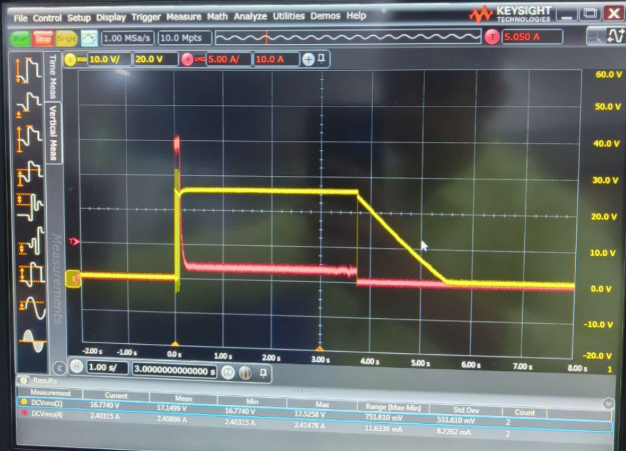
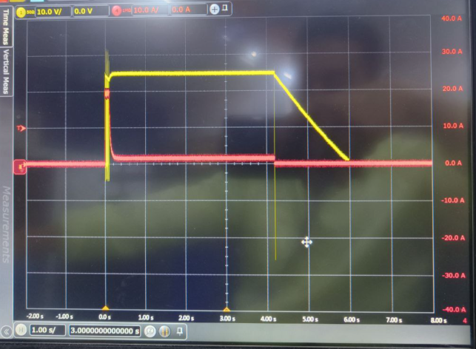
Vds Q9
Vds Q10
Vbatt-GND
Vgs GH2
Vgs GH1
MOTOR OPERATION (FWD DIRECTION)
- Current Flow +
Vgs GL2
Vgs GL1
Vds Q13
Motor +/-
Vds Q14
Yellow – Voltage probe at respective location. eg: Vds, Vgs Vbatt-gnd, Motor+/-
Red – Motor current going out from P32

Slide 2
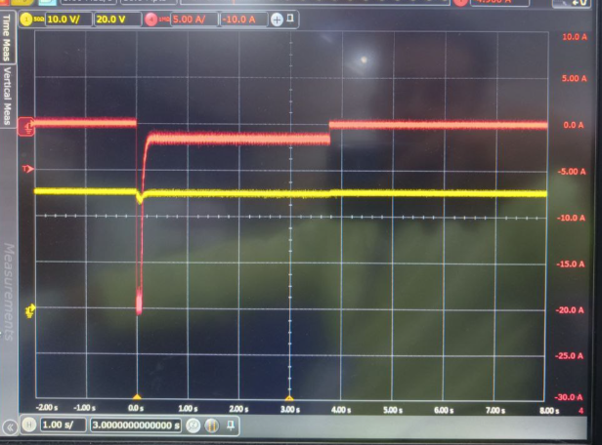
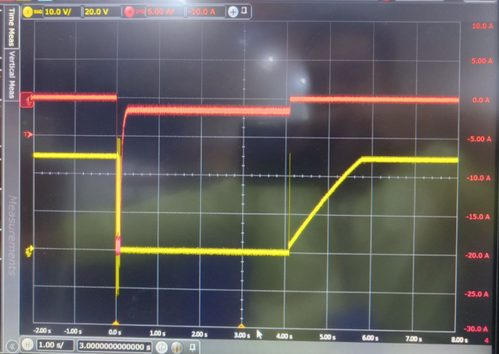
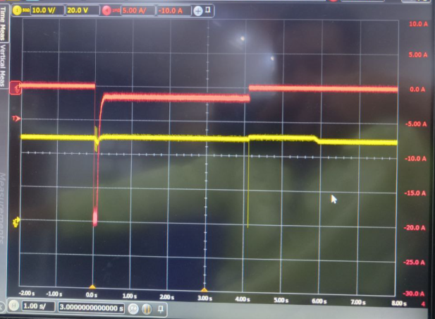
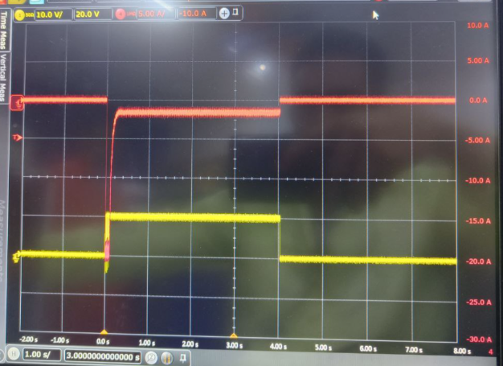
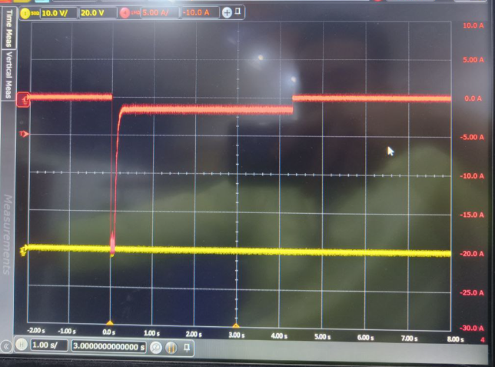
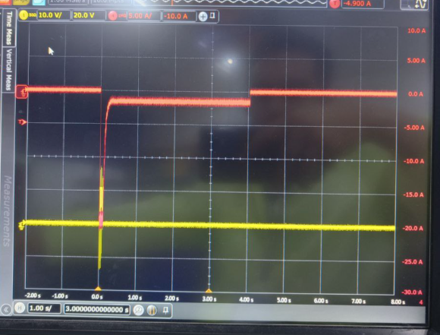
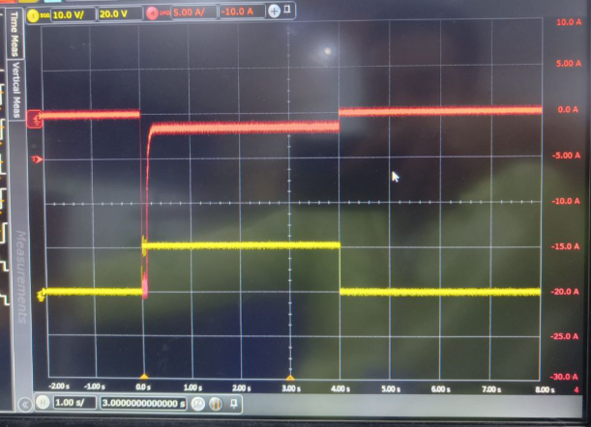
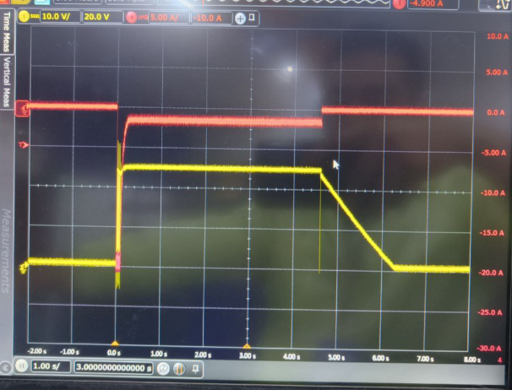
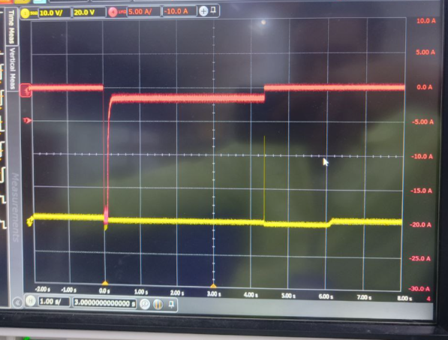
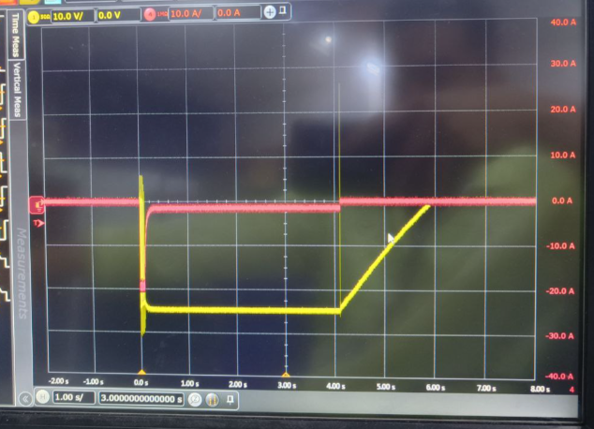
Vds Q9
Vds Q10
Vbatt-GND
Vgs GH2
Vgs GH1
MOTOR OPERATION (REV DIRECTION)
Current Flow
Vgs GL2
Vgs GL1
Yellow – Voltage probe at respective location. eg: Vds, Vgs Vbatt-gnd, Motor+/-
Red – Motor current going out from P32. Maintained. Maintained to probe here so that we can see inverse current.
Vds Q13
Motor +/-
Vds Q14

