Slide 1
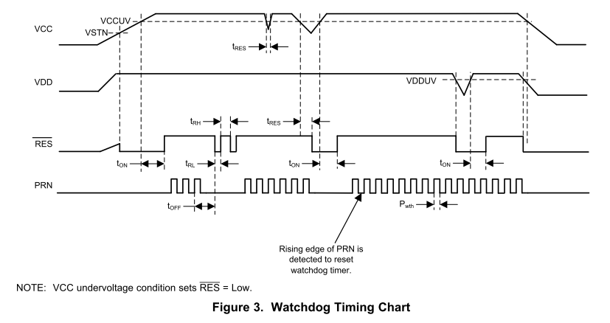
Assertion of the fault flags may occur during power up.
x sec min/ y sec max

