Slide 1
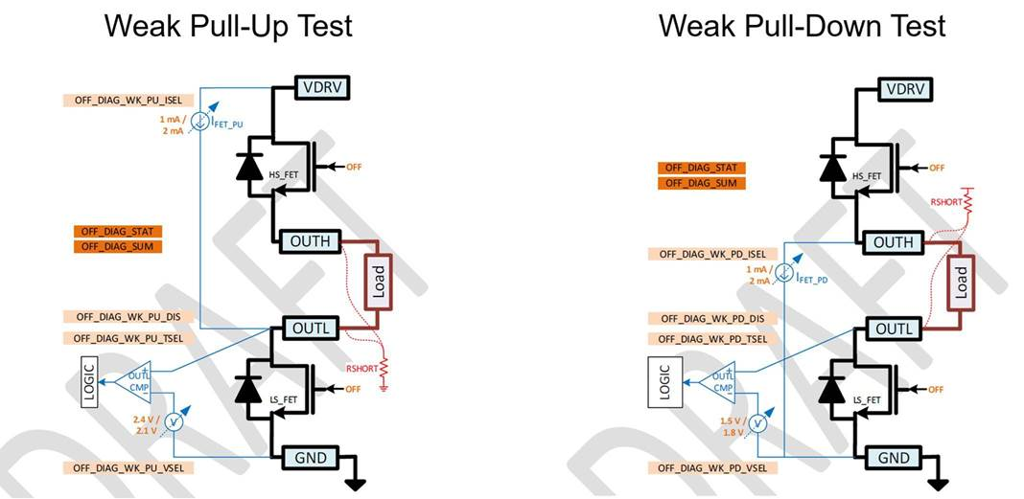
Off State Diagnostics : Open Load
Weak pull down test will fail if there is open load
With Open Load
  During weak pull up test OUTL will be charged to a higher voltage & once the voltage crosses the threshold, test will pass.
  During weak pull-down test OUTL remains at a higher voltage as in #1 with no current flow possibility which will fail Weak-Pull down test and abort the off-state diagnostics at that point.
  The open impedance which can fail the weak pull down will depend on the cap on OUTH, OUTL pins & threshold settings.
    For a 1nF cap on OUTH/OUTL node the open impedance to fail the test will be of the order of ~50MOhms.
X
X

