Slide 1
Programming MCF8316 using MCx8316AEVM
ASC / MD / BLDC
(Brushless-DC Motor Drivers)
Analog Signal Chain

Slide 2
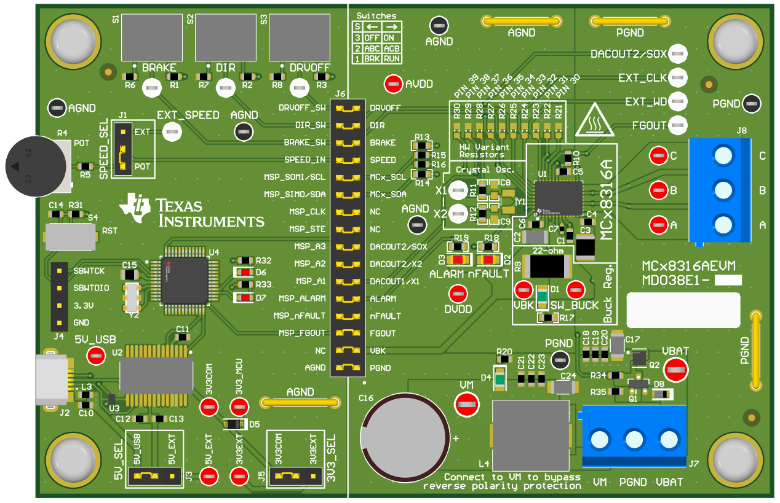
Step 1
Connect 24V power supply to VM. Connect power supply ground to PGND.
If programming device on custom board, connect PGND/AGND from custom board to AGND on MCx8316AEVM
MCx8316AEVM

Slide 3
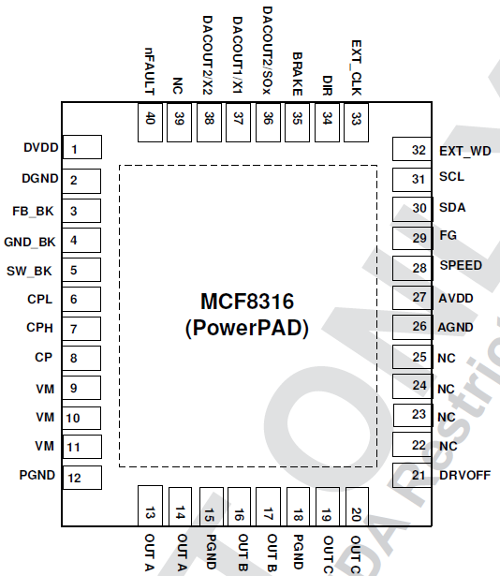
Step 2
If programming device on custom board, remove SCL jumper on the MCx8316AEVM and jumper wire the MSP_SOMI/SCL signal to MCF8316A Pin31 SCL on the custom board
Note that the custom board needs to have its own I2C pull-up resistors on SCL and SDA
MCx8316AEVM

Slide 4
Step 3
If programming device on custom board, remove SDA jumper on the MCx8316AEVM and jumper wire the MSP_SIMO/SDA signal to MCF8316A Pin30 SDA on the custom board
Note that the custom board needs to have its own I2C pull-up resistors on SCL and SDA
MCx8316AEVM

Slide 5
Step 4
Connect micro-USB from MCx8316AEVM to your computer. Open MCF8316 GUI, and it should connect automatically. If not, click on the Connect icon on the bottom left corner.

Slide 6
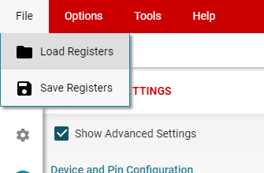
Step 5
Load existing register values into the GUI by clicking “File -> Load Registers” from the top menu.

Slide 7
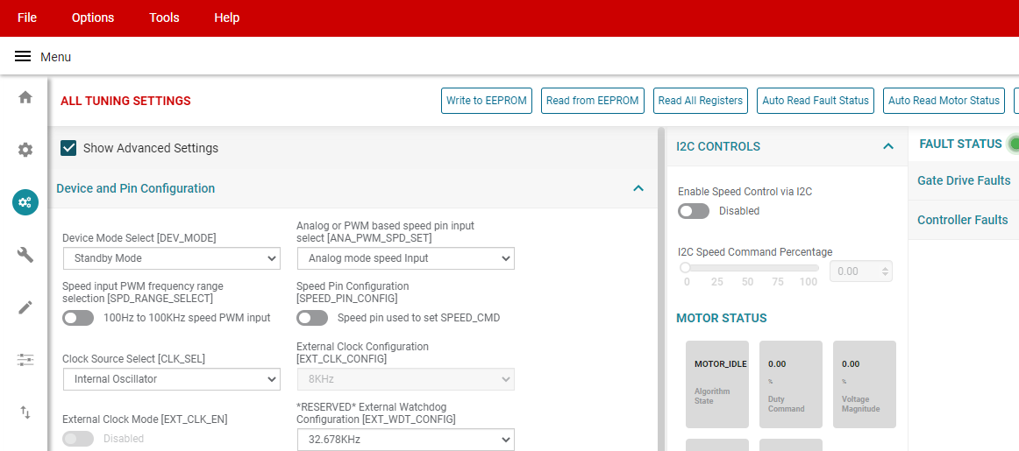
Step 6
After loading or configuring the desired register values, write the settings into EEPROM by clicking the “Write to EEPROM” button.

Slide 8
Step 7
To verify if the EEPROM registers are programmed correctly, power cycle the device, restart the GUI and click “Read from EEPROM”. All the saved EEPROM register values should be displayed in the GUI.

