Slide 1
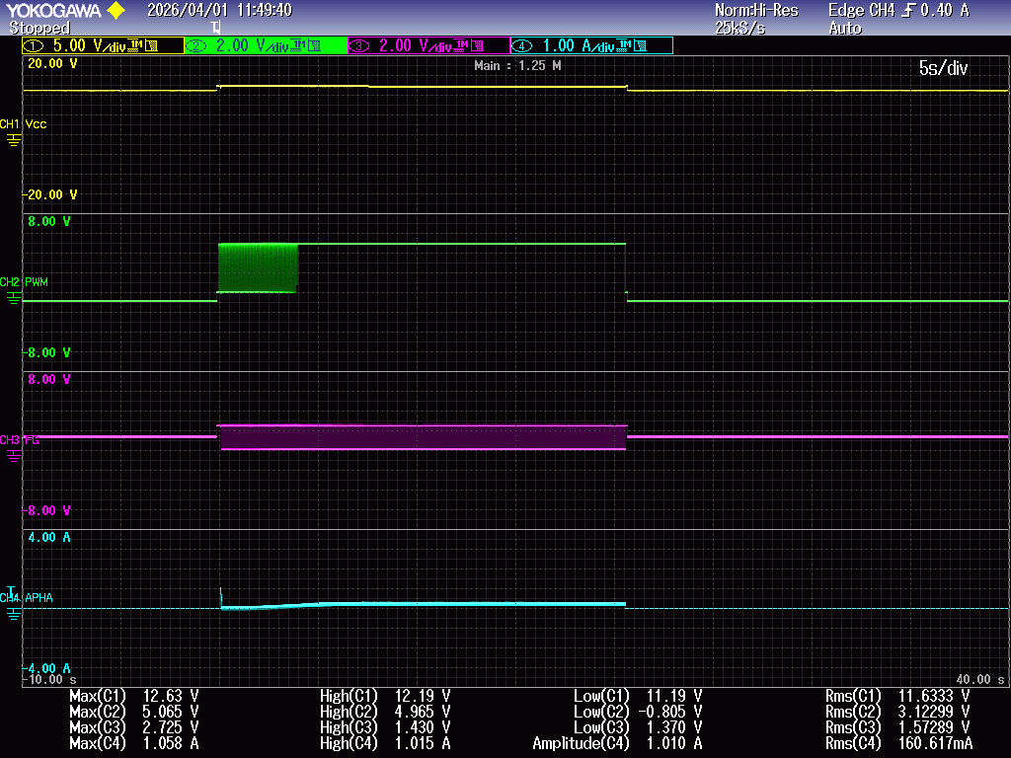
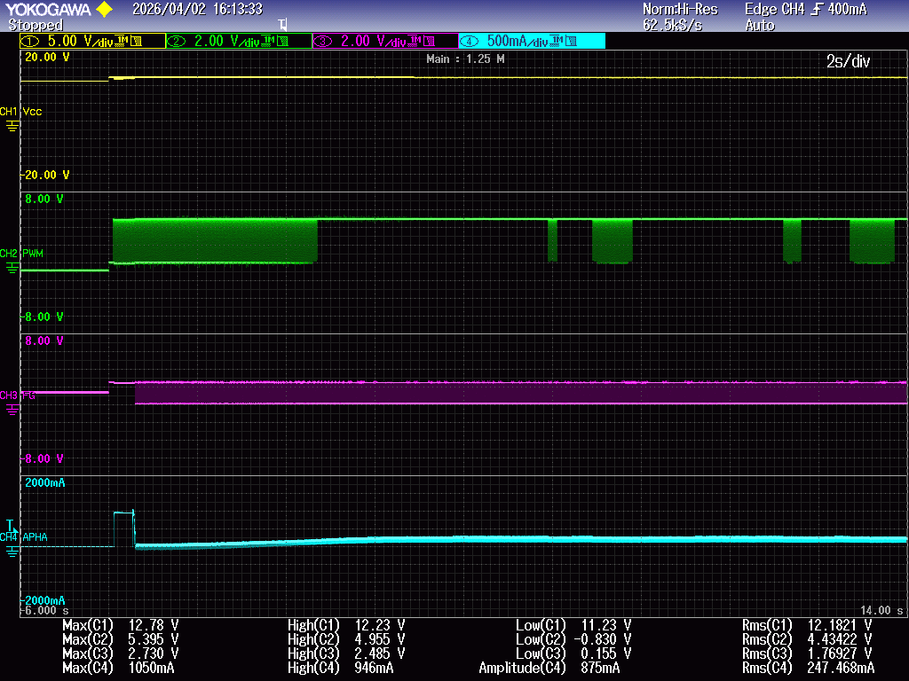
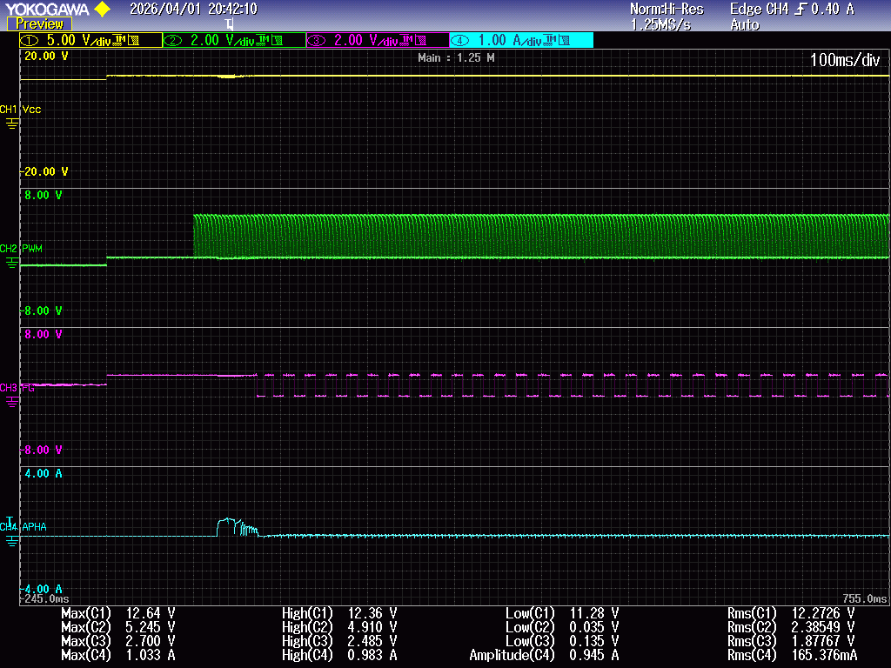
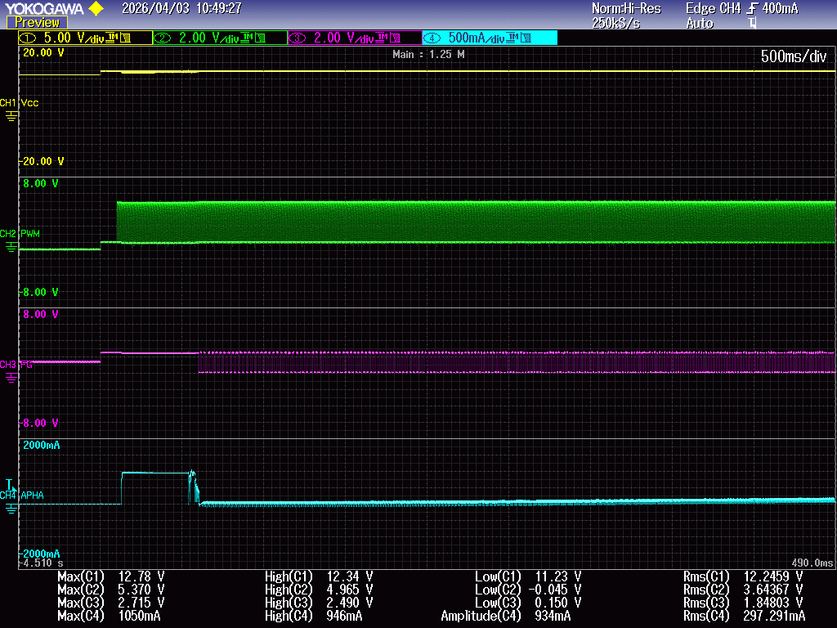
NORMAL
ABNORMAL
전압[V]
DUTY 0% to 100% for approximately 4s
PWM
FG
전류[A]
Operation current 1.033A/MAX for approximately 0.05s
Operation current 1.050A/MAX for approximately 0.5s

