Slide 1
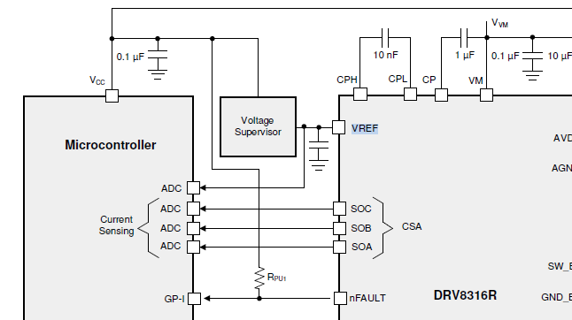
DRV8316R Question
Question
Q1) Why is VREF connected to MCU and monitored?
Q2) If VREF monitoring is not mandatory, can I delete the ADC connection from the MCU?
To MCU ADC pin connection
DRV8316R

