Slide 1
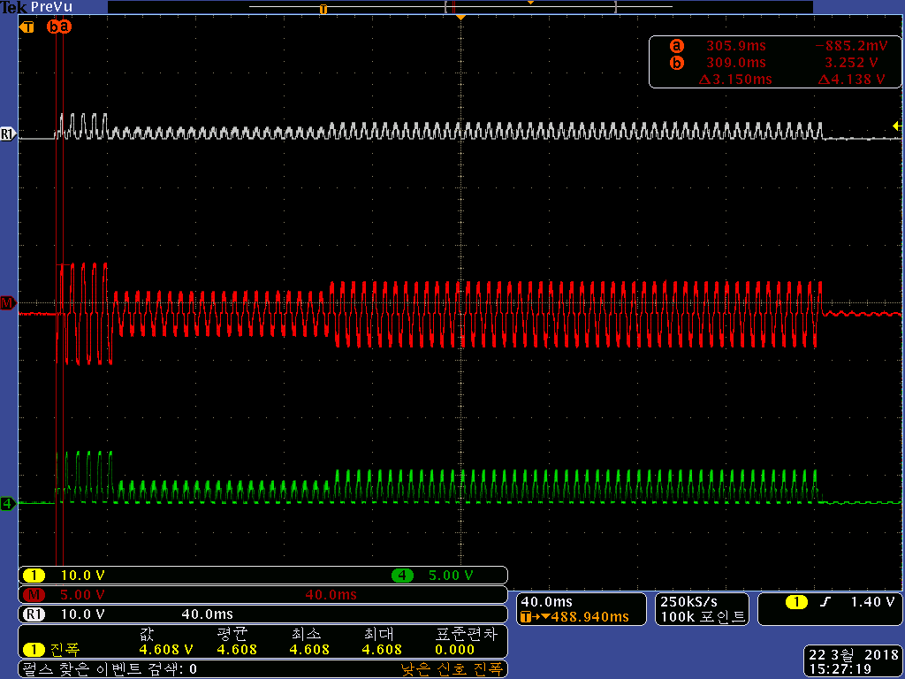
DRV 2624 IC EVM Over Voltage waveform
DRV2624 Incomming Signal Oscilloscope
Over Voltage
Rated Voltage
Low Voltage
1

