Slide 1
Analysis of the VCP to VDRAIN
Sep/25, 2023

Slide 2
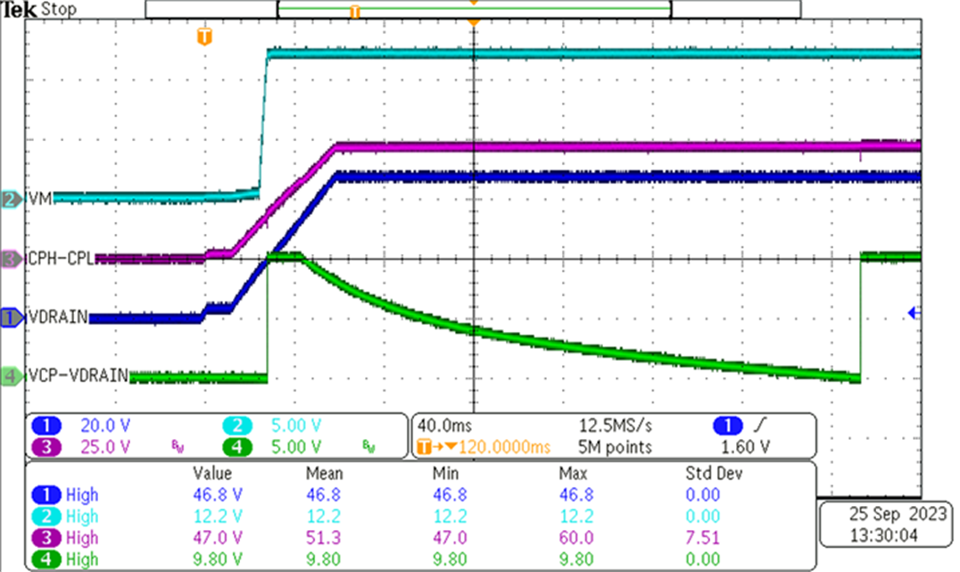
VCP - VDRAIN
Dropout

Slide 3
Impedance Measurements
Pin - Pin | Good Part | NG Part 1 | NG Part 2
MODE – GND | Open | 53M | 4.7M
IDRIVE – GND | Open | Open | 6M
VDS – GND | Open | Open | 1.7M
nFAULT – GND | Open | Open | 11.4M
VCP – GND | 4.45M | 3.86M | 3.79M
VDRAIN – GND | 3.85M | 3.84M | 3.78M
VCP – VDRIAN | 0.49M | 236 | 71.5
VDRAIN – VCP | 0.48M | 235 | 71.4
VM – GND | 3.88M | 3.83M | 3.75M
CPH – GND | 5.45M | 4.8M | 4.68M
CPL – GND | 1.48M | 1.35M | 1.46M
VGLS – GND | 706k | 66.8k | 66.8k
DVDD – GND | 38.4k | 37k | 36.6k

Slide 4
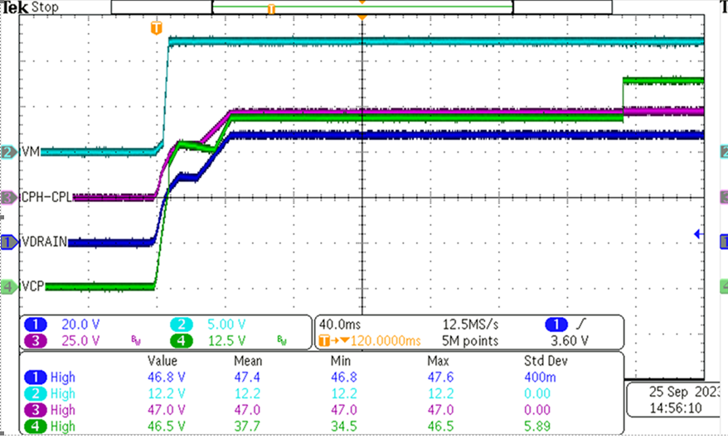
Condition: 48V on VDRAIN PIN
CH4: Probe Measured between VCP to GND

Slide 5
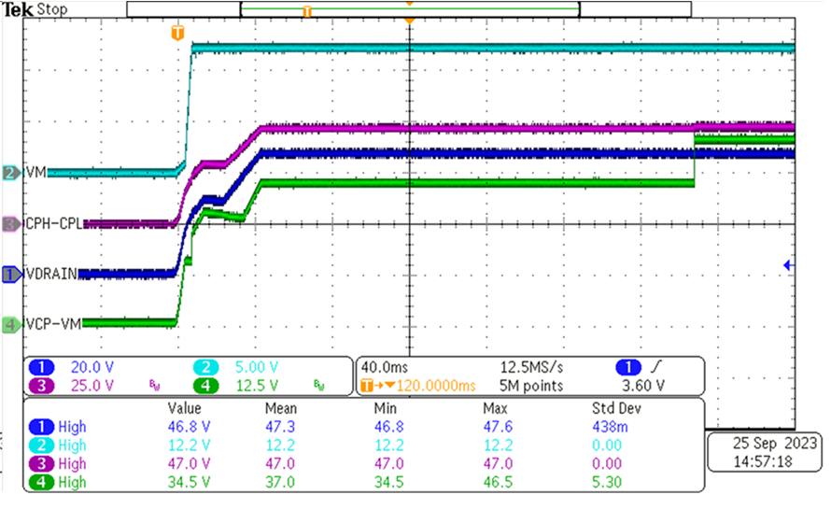
Condition: 48V on VDRAIN PIN
CH4: Probe measured between VCP-VM

Slide 6
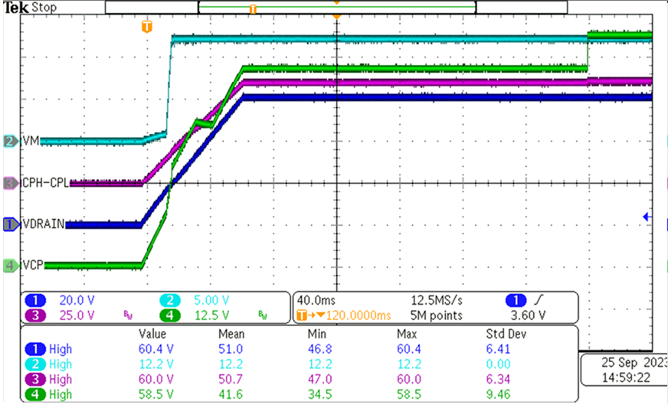
Condition: 60V on VDRAIN PIN
CH4: Probe measured between VCP-GND

Slide 7
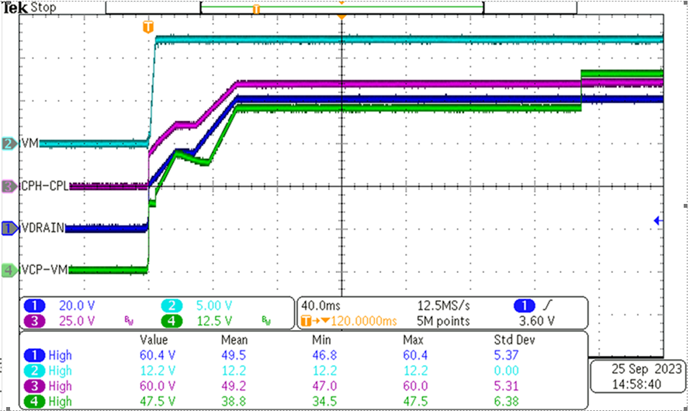
Condition: 60V on VDRAIN PIN
CH4: Probe measured between VCP-VM

Slide 8
Summary
Customer would like to know more about the root cause of the damaged pins when you mentioned they would be caused by the cap connected between VCP to VM. Is that possibly you can comment the how come some of impedances become lower on page 3?
Even the input voltage is up to 60V from 480V, we don’t see any risk on the waveform. We’d like to know that how the device is damaged. Thanks.

