Slide 1
The motor connected to the DRV8825 has stalled abnormally in Fast Decay mode

Slide 2
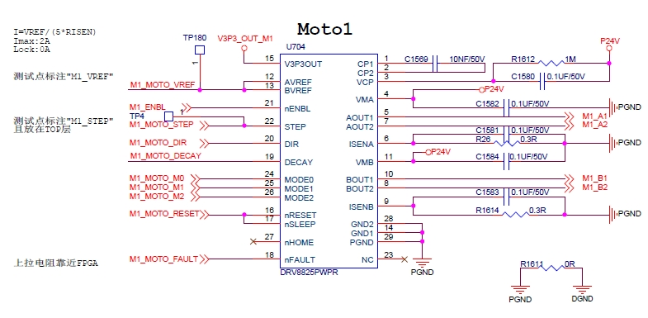
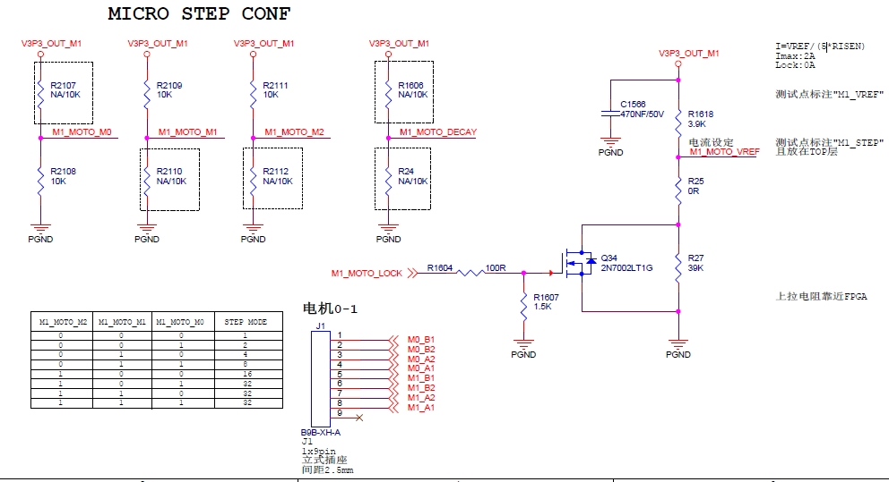
Related parameters:
1.Moto p/n = SST43D2145 (2 phase,1.8 degree, 2A,1.15r,2.5mH,441mN*m,56g*cm2)
2.Schematic Diagram as below:
a)32 Microstep
b)Mix Decay
c)2A working current ,0A static current(using external mosfet to change voltage of xVref pin(12,13))
d)Driver IC p/n = DRV8825
3.Runing Speed
170 full step per-second

Slide 3
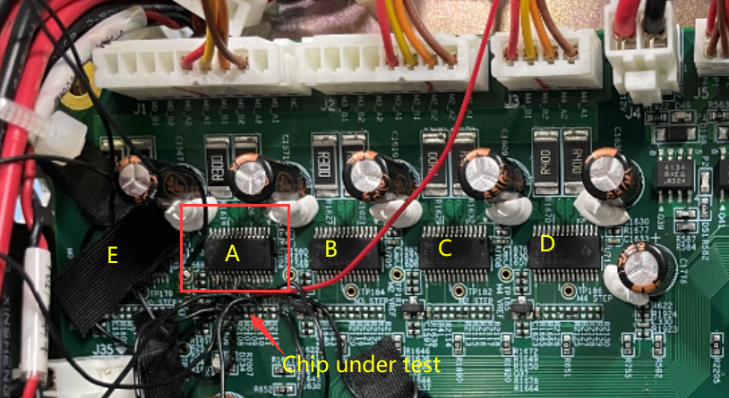
issues: The motor stops rotating abnormally
The abnormally stall is only found with the motor connected with DRV8825 at position A (total 5 pcs of DRV8825 on a board).
The issue happens when decay mode is set at Fast decay mode. The issue is disappeared when mix decay mode is chosen.
This problem occurs in only one of the 70 circuit boards. The issue can be repeated with this board. No A-B-A experiment was done to avoid the issue disappeared.
By using fan blows the board to make assure the board’s temperature is low, the issue still exists.
Customer doubts The discontinuity of the current with phase B causes this problem.
Question:
what are possible reasons to lead the discontinuity of the current with phase B ?

Slide 4
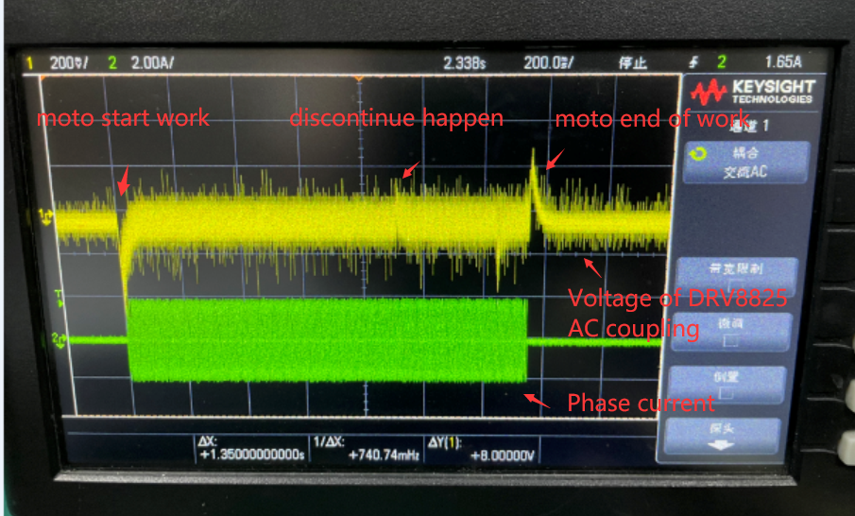
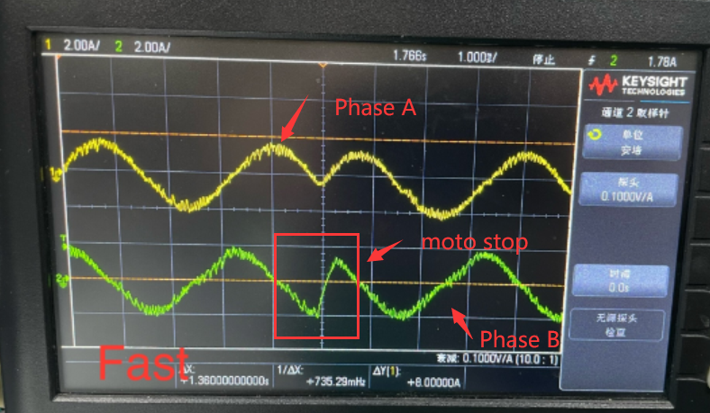
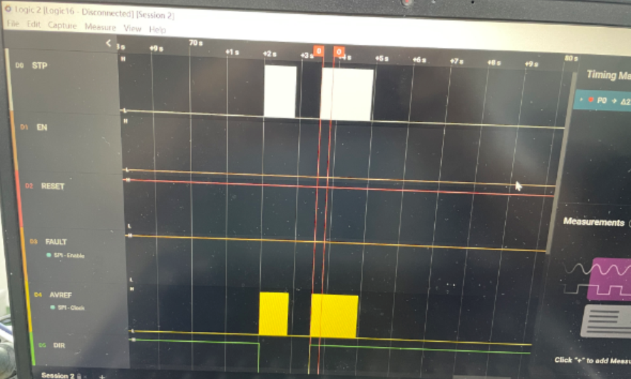
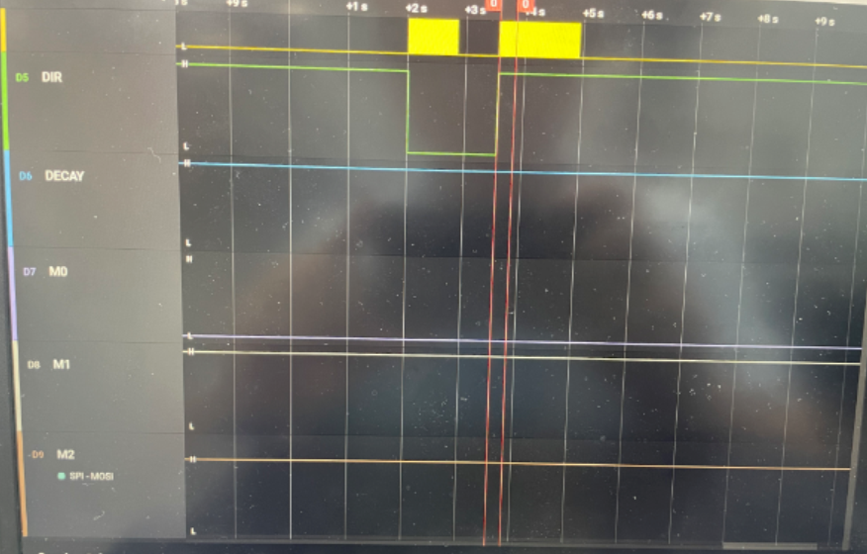
Fig. 01 CH1:VMB(AC coupled);ch2:B phase current
Fig. 02 CH1:A phase current;ch2:B phase current; in fast ecay mode
When the moto is stalled abnormally, the phase current B seems to be discontinuous which should make moto stop and make big noise.
There are no abnormal signal which are captured with the control signal for DRV8825, such as the voltage of pins of STEP, nENBL, nRESET,nFAULT,AREF(BREF),DIR,M0/1/2 while current B is not continuous.

