Slide 1
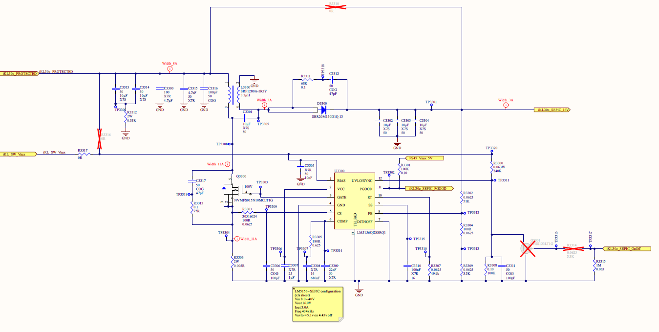
Problem Statement
The following slides document characteristics observed for a SEPIC Circuit using a ‘TI Voltage Regulator LM5156QDSSRQ1’
This circuit is used to control the operation of Contactor Coil Switches.
The Voltage input is 24VDC and the SEPIC output Voltage is 16VDC
This circuit configuration is causing the Inductor L3300 to overheat when the Contactor Switches are in closed position.
Inductor Peak Current is 2A for 80mS and holding Current 500mA
Inductor is heating to ~30 degrees above room temperature, inductor should only increase by only a few degrees in these operating conditions
Inductor supplier has been contacted and confirmed that Inductor should not be overheating given the operating conditions
When circuit is Voltage probed at both Contactor Switch open and closed positions, there is an AC signal evident on the MOSFET output. Test point TP3308
No signal is expected when circuit is open
A square wave PWM signal is expected at circuit is loaded
40% Duty Cycle

Slide 2
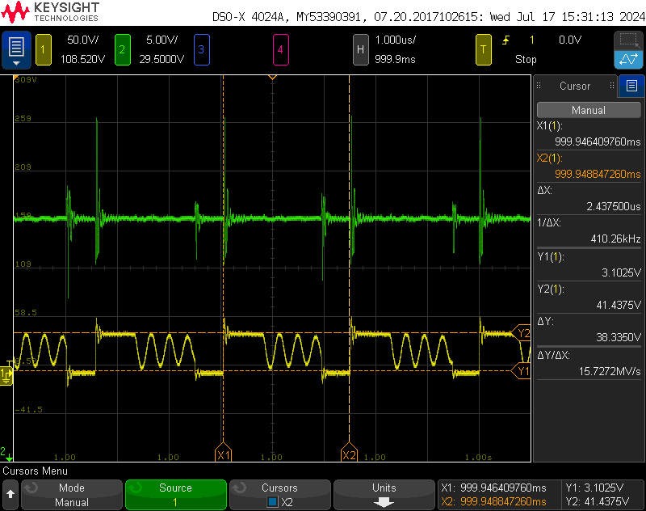
Investigation Questions
Signal in yellow is expected to be a PWM Square wave at 40%
Duration of PWN is as expected however an AC signal can be seen coupled onto the trace
Can TI advise on the root cause of this unexpected AC signal?
Is this due to improper tuning of Loop Compensation or Hiccup Overload Mode?
On slide 4, the signal can be seen in the ‘Contactor Open’ position to derate duration of each pulse,
When Contactors are closed, the frequency of PWM does not allow for derating to occur. This occurrence of AC is observed through Contactor closed Holding state. It does not diminish.

Slide 3
PCB

Slide 4
SEPIC Voltage Tests
Probes used on SEPIC Circuit TP3308 and Gate input for the KL30c Circuit
Vin stable at 24VDC
Conditions are ‘Contactors Open’ and ’Contactors Closed’
SEPIC Voltage is Yellow (Inductor Output)
Gate Voltage is Green
Aim is to understand if the Voltage characteristics measured are within the expected parameters for this circuit

Slide 5
Probes used on SEPIC Circuit TP3308 and Gate input for the KL30c Circuit
Vin stable at 24VDC
Conditions are ‘Contactors Open’ and ’Contactors Closed’
SEPIC Voltage is Yellow
Gate Voltage is Green
Contactor Open
Contactor Closed
Ripple is observed on both Open and Closed states
Pulses at ~87KHz in Open and 400KHz in closed

Slide 6
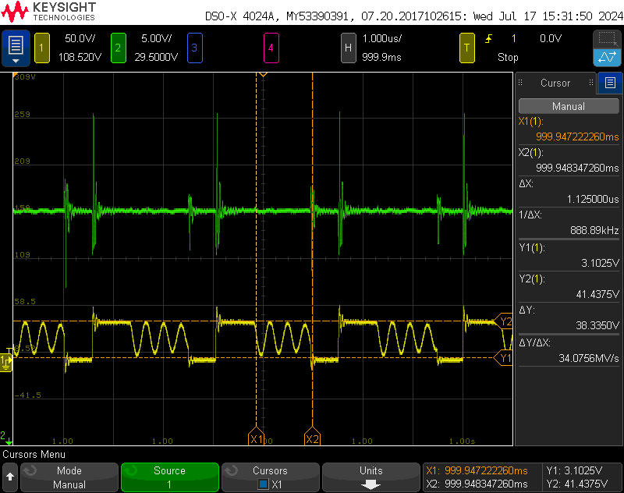
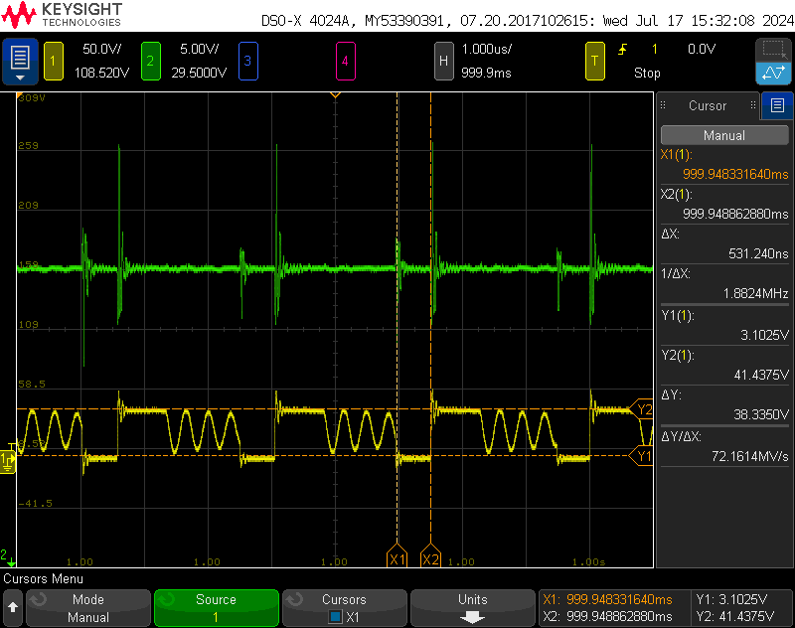
Probes used on SEPIC Circuit TP3308 and Gate input for the KL30c Circuit
Vin stable at 24VDC
Conditions are ‘Contactors Open’ and ’Contactors Closed’
SEPIC Voltage is Yellow
Gate Voltage is Green
Contactor Closed
Pulse window is ~2.44us
Square rise pulse is ~800ns // 40% duty cycle as expected for holding Contactors Closed
Ripple duration is 1.13us
Low voltage is 530ns

