Slide 1
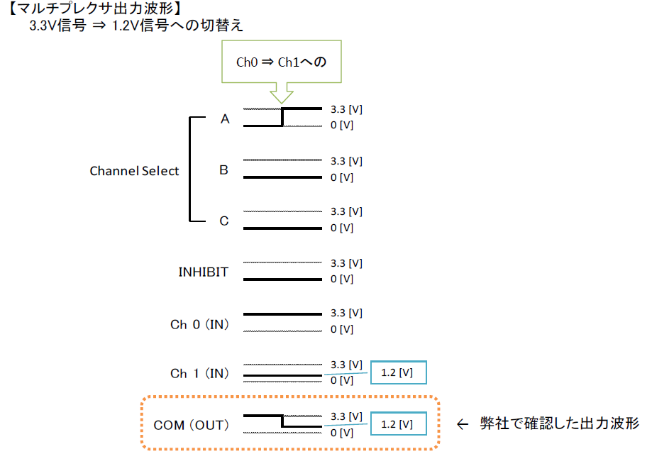
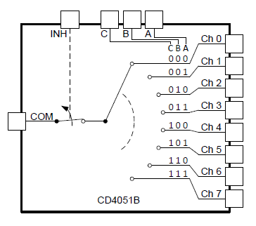
Test Condition
3.3V
1.2V
comfirmed waveform

Slide 2
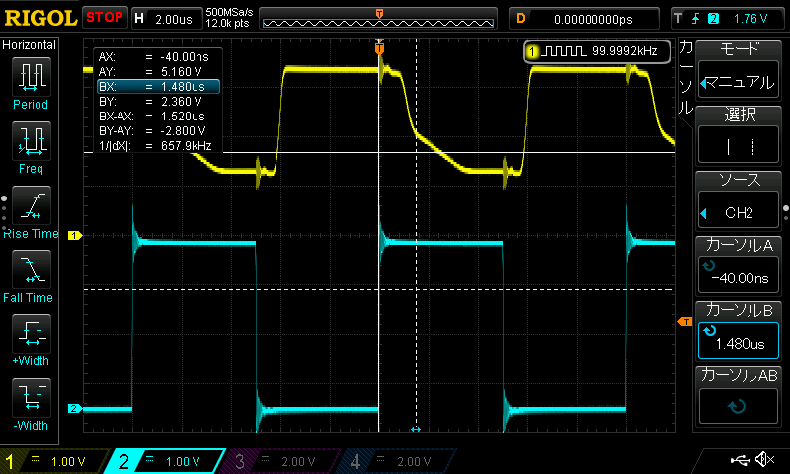
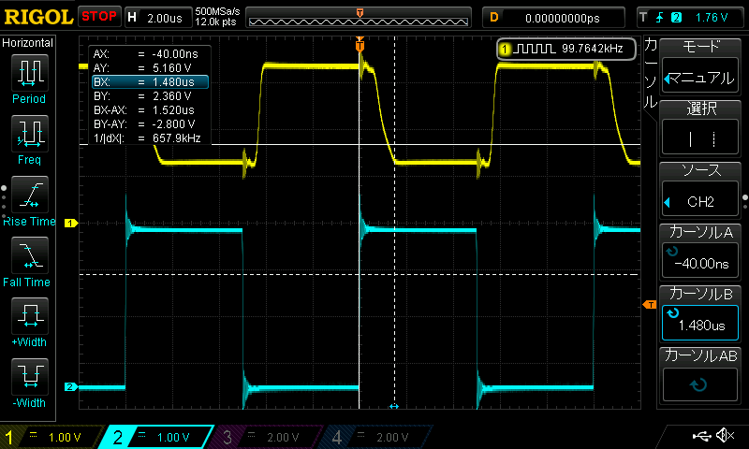
The waveform between two unit
Analysis unit
The slew rate changes while the signal falls.
The phenomenon is the same if input channel is changed.
The customer is thinking of some failure.
Is this normal?
Good unit
The slew rate doesn’t change while the signal falls.
Is this normal?

