Slide 1
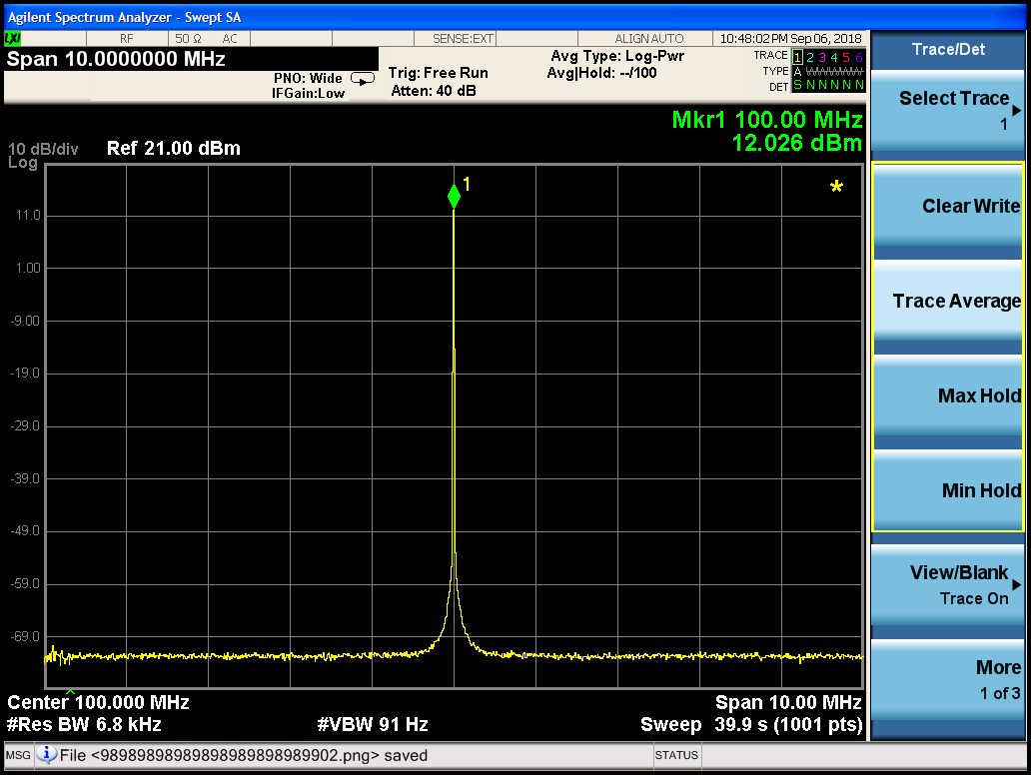
CLK_ref_100Mhz

Slide 2
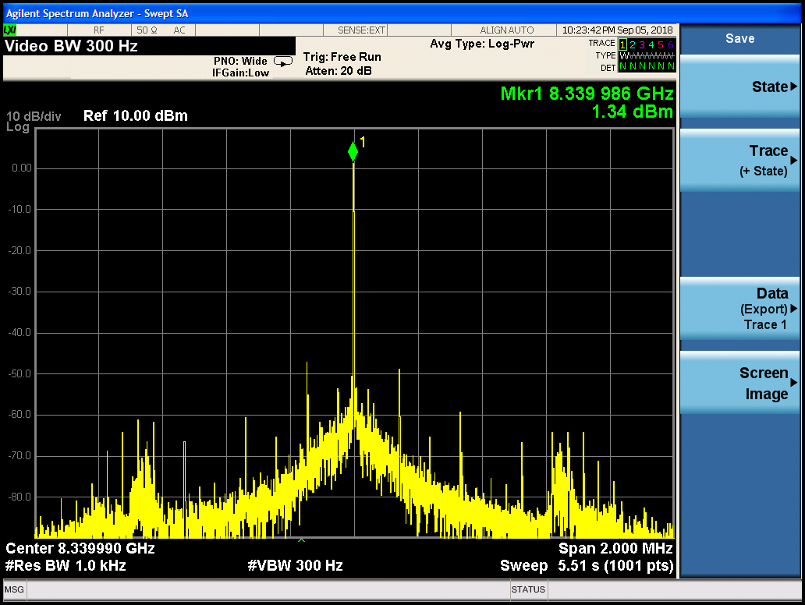
PLL + CLK - lot of spurs_B

Slide 3
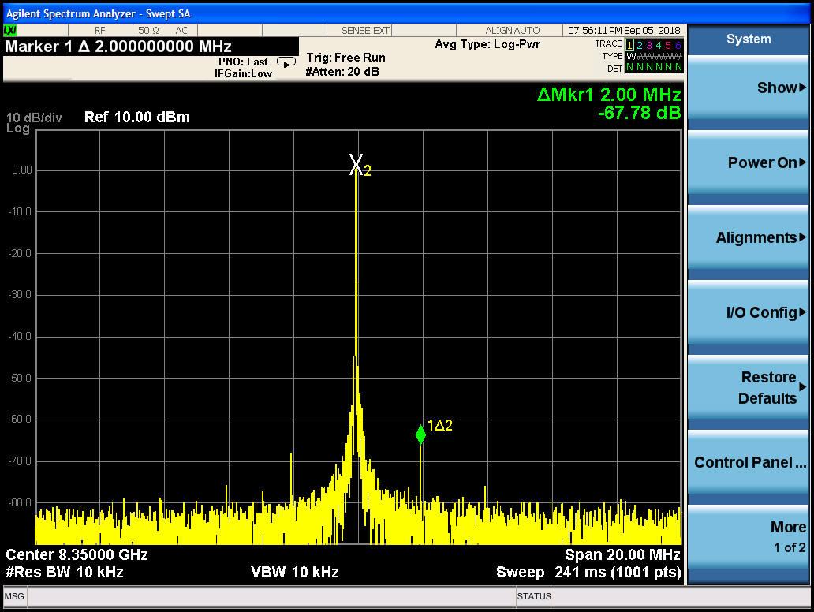
PLL + Spur in 2Mhz_B

Slide 4
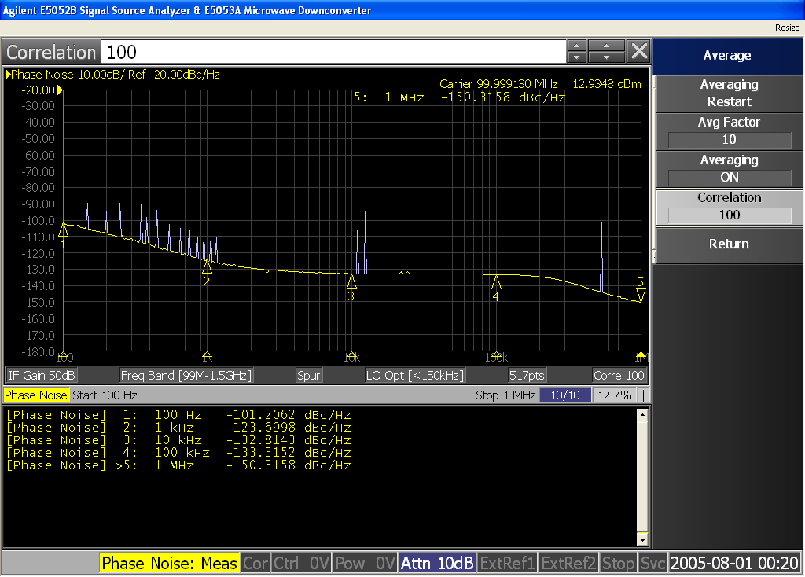
CLK_ref_100Mhz

Slide 5
CLK_ref_100Mhz

