Slide 1
LMX2571
4 FSK modulation in SPI mode.

Slide 2
Setup description
A pattern generator is streaming SPI write to produce the 4 FSK modulation. 160 random symbol are being sent in a loop so randomization is not ideal.
Specifications:
  Gaussian transmission 4FSK
  BT = 0.63
  Symbol oversampling = 4
  Symbol rate = 60kHz
  Fc = 868 MHz
  Freq. deviation +/- 17 and +/- 50 kHz.
Limitations:
  Current silicon requires 2 SPI write per data point
  Current setup (wirering/pcb) does not allow speed to go to 110k symbol/s.
New Si will: have I2S style interface and SPI specifications is 50 MHz now

Slide 3
SPI example
R11 and R37 are written for each data point. Each register is 24 bit long and includes address (8 bit) and data (16 bit):
Key advantages of this technique are:
  Self calibrated system with closed loop operation.
  Immune from process, voltage and temperature.
  No additional components required.
time[us] | freq[kHz] | code R11 [hex] | code R37 [hex]
0.000000 | 49.9 | 0B003E | 0252C38
2.272727 | 49.9 | 0B003E | 0252C38
4.545455 | 49.1 | 0B003D | 0252C38
… | … | … | …

Slide 4
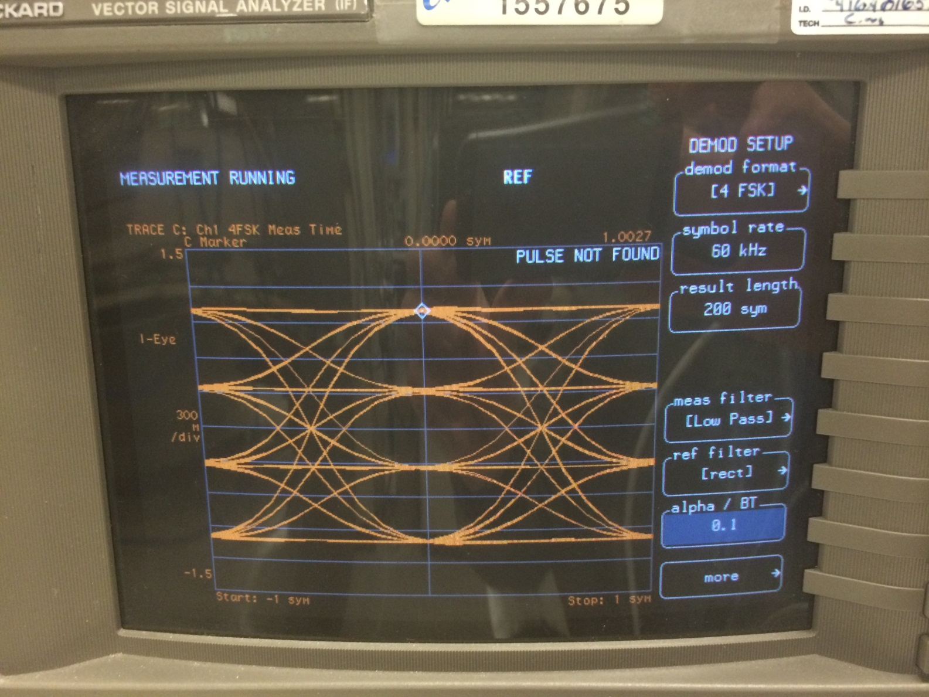
Results

Slide 5
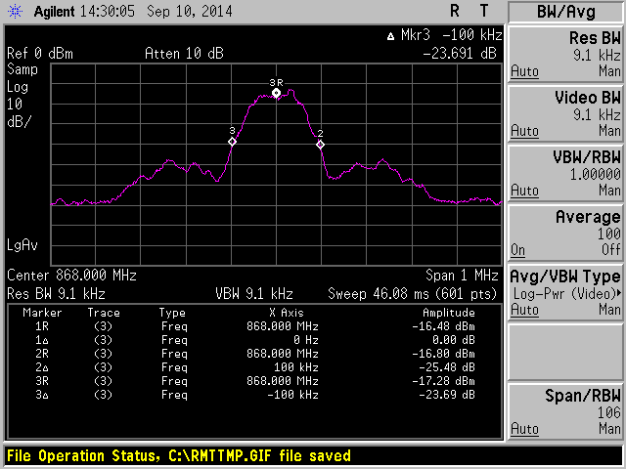
Results

Slide 6
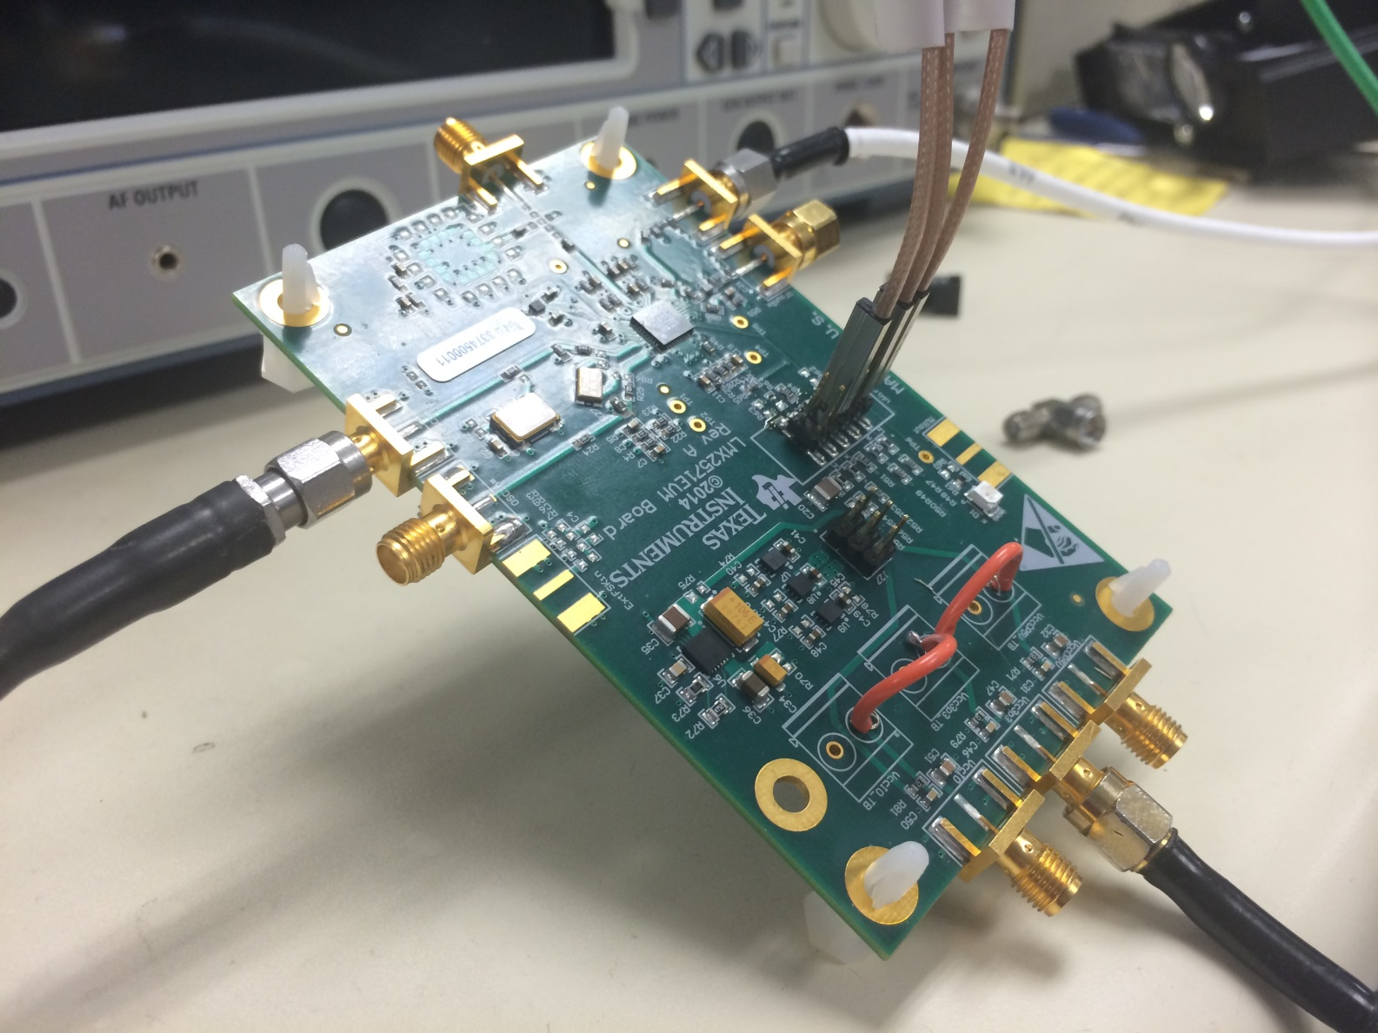
PCB

Slide 7

Sept. 2014

