Slide 1
Multi-Device Synchronization of JESD204B Data Converters –
June 1, 2014

Slide 2
Abstract
Multi-device synchronization has always been a challenge with high-speed ADCs and DACs. This remains true even with the new JESD204B high-speed data converter digital interface. While the JESD204B interface simplifies some issues with synchronization, it also adds some additional complexity. This presentation will discuss the advantages and disadvantages of JESD204B regarding multi-device synchronization. Further, it will help the audience understand and work through the main issues in achieving multi-device synchronization including deterministic latency and clock design.
The concepts and examples presented will enable a system designer to:
  Understand the requirements for synchronization in a JESD204B system
  Recognize the tools available to achieve synchronization
  Know the considerations for synchronizing giga-sample converters

Slide 3
Agenda
What is multi-device synchronization?
What are the requirements for multi-device synchronization in a JESD204B system?
Phase aligning device clocks
SYSREF signal requirements
Achieving deterministic latency
Giga-sample ADC/DAC synchronization considerations

Slide 4
Multi-Device Synchronization Intro
The ultimate goal of device synchronization is:
  ADCs – to align the sampling instant and the latency through the ADC and across the interface to the FPGA so that samples are aligned for signal processing
  DACs – to fix the latency across the interface from the FPGA and through the DAC signal processing to align the sampling instant at the DAC output
Multi-device synchronization is required in many systems:
  Multi-antenna communications systems
  Phased array radars
  Magnetic resonance imaging
  Etc.

Slide 5
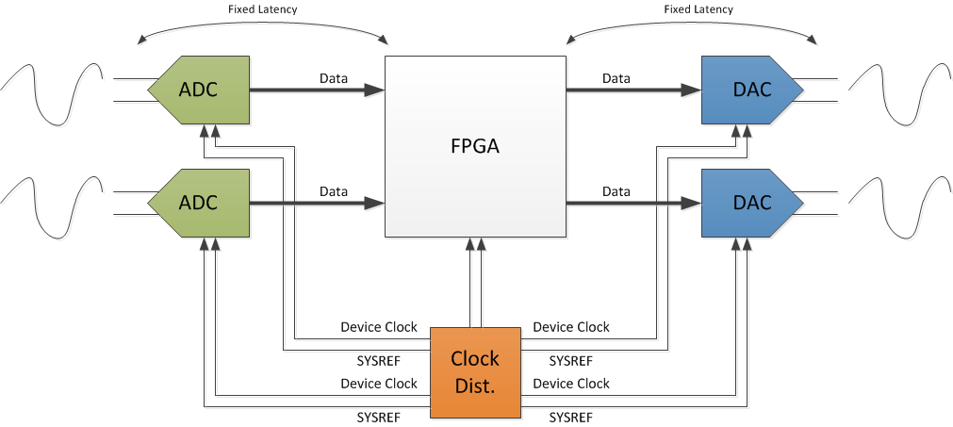
Multi-Device Synchronization Diagram

Slide 6
What Is Required for Synchronization?
There are three requirements for device synchronization using JESD204B data converters
  Phase align device clocks at each converter/logic element
  Generate and capture proper SYSREF signal
  Achieve deterministic latency by choosing an appropriate elastic buffer release point
What about serdes data trace lengths?
Not required since the JESD204B deterministic latency mechanism can absorb large variations in data trace lengths (multiple inches)

Slide 7
Multi-Device Synchronization Diagram
3. Choose appropriate elastic buffer release point
1. Phase Aligned Sampling Clocks
2. Generate and capture SYSREF signal

Slide 8
Phase Aligning Device Clocks

Slide 9
What Is Required for Synchronization?
There are three requirements for device synchronization using JESD204B data converters
  Phase align device clocks at each converter/logic element
  Generate and capture proper SYSREF signal
  Achieve deterministic latency by choosing an appropriate elastic buffer release point

Slide 10
What is a “Device Clock”?
At the simplest level the “device clock” is the sampling clock of the ADC or DAC
However, the device clock can also be:
  A higher frequency clock that is divided down to generate the sampling clock (harmonic clocking)
  A reference clock that is multiplied up using a PLL to generate the sampling clock
The device clock is also used to generate other clocks required by the device
  Divided down clocks for use in signal processing or interleaving
  Serdes PLL reference clock for JESD204B interface

Slide 11
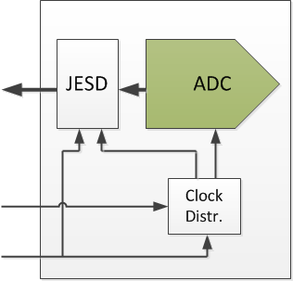
Clocking Schemes – Device Clock = Fs
SYSREF resets the LMFC
JESD204B Data
May be a divided down clock
Fs
Fs
Device Clock
SYSREF
May contain clock dividers that require syncing w/ SYSREF
SYSREF is captured by the Device Clock

Slide 12
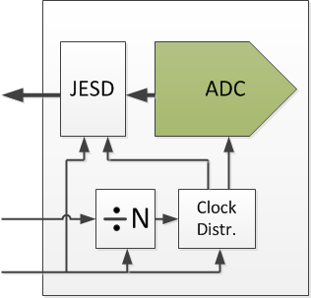
Clocking Schemes – Device Clock = Fs * N
JESD204B Data
Fs * N
Device Clock
SYSREF
Device clock divider requires syncing w/ SYSREF
May contain clock dividers that require syncing w/ SYSREF

Slide 13
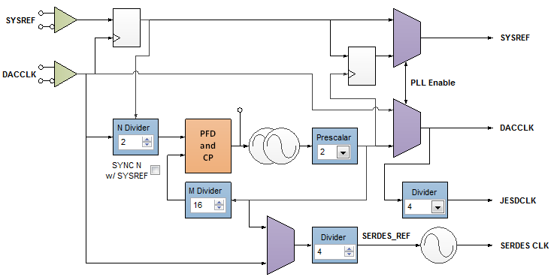
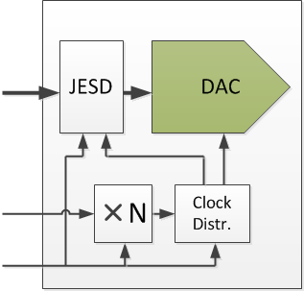
Clocking Schemes – Device Clock = Fs / N
JESD204B Data
PLL
Fs / N
Device Clock
SYSREF
If PLL reference divider is greater than 1, syncing may be required
May contain clock dividers that require syncing w/ SYSREF

Slide 14
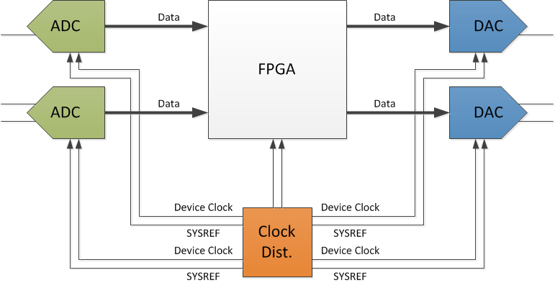
Phase Aligning Device Clocks
  The phase alignment of the device clock dictates how well the sampling instant is aligned between parts
Phase alignment can be achieved by
  Matching clock trace lengths to each device
  May be able to use programmable clock delays in clock chip
Clock chip may have device clock delay adjustments
Match device clock trace lengths

Slide 15
Clock Delays to Adjust Device Clock Skew
Worst case =
Half Step / 2 =
~83 ps for 3 GHz
At 3 GHz, 333.3 ps period of VCO. Half Step = 166.65 ps. Delaying green by 166.65 ps will reduce system skew.

Slide 16
Clock Delays to Adjust Device Clock Skew
Worst case =
Half Step / 2 =
~83 ps for 3 GHz
At 3 GHz, 333.3 ps period of VCO. Half Step = 166.65 ps. Delaying green by 166.65 ps will reduce system skew.

Slide 17
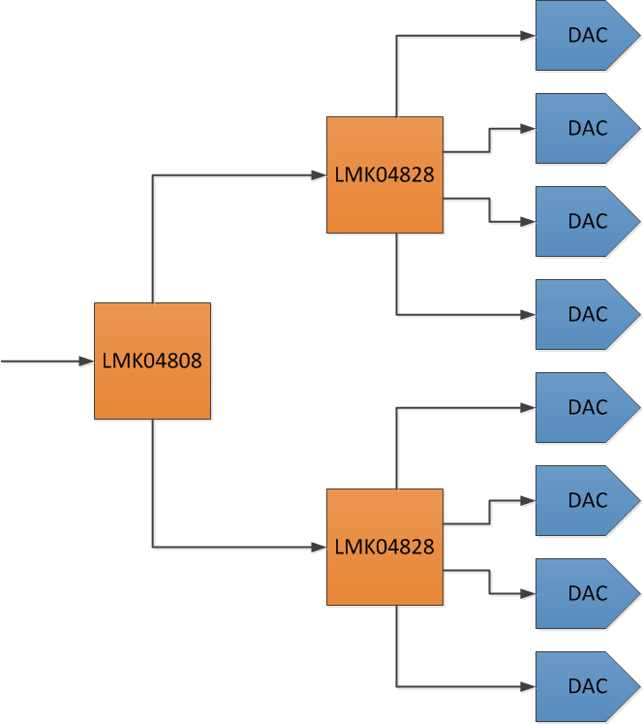
Synchronizing Many Devices/Boards
If multiple clock sources must be used (> ~6 ADCs or DACs) then clock delays will likely be needed
Match trace lengths
Distribute SYSREF to each LMK04828
Use programmable delays to adjust relative phase of each LMK04828
Reference
Generate SYSREF signal
Setup LMK04828 for 0-delay mode
Notes:
Lmk04828 vco mode,

Slide 18
SYSREF Signal Requirements

Slide 19
What Is Required for Synchronization?
There are three requirements for device synchronization using JESD204B data converters
  Phase align device clocks at each converter/logic element
  Generate and capture proper SYSREF signal
  Achieve deterministic latency by choosing an appropriate elastic buffer release point

Slide 20
What is SYSREF?
SYSREF is a system timing reference that is distributed to all JESD204B devices in the system
SYSREF serves multiple purposes
  Alignment of local multi-frame clocks (LMFCs) in all JESD204B devices to achieve deterministic latency
  Synchronize internal clock dividers in all devices
  Synchronize digital functions among devices (NCOs, gain/delay adjustments)
The SYSREF signal can take multiple forms
  Single-pulse
  Periodic signal
  Gapped-periodic signal

Slide 21
Types of SYSREF Signals
Continuous SYSREF
  Easiest from a hardware standpoint
  Can be used with AC coupling to avoid Vcm issues
  Constant “sub-harmonic” of the sampling clock may
  cause spurs due to radiated noise or isolation issues
Gapped Periodic SYSREF
  Periodic pulses
  Depending on periodic frequency, could possibly
  use AC coupling
  Reduces radiated spurious noise
One-shot SYSREF
  Single (or multiple) pulses only when requested
  Cannot use AC coupling
  Eliminates radiated noise during normal operation
  Requires method to “request” SYSREF when needed
Notes:
SYSREF can be one shot, pulsed, gapped periodic, etc.
- Why do we care about AC coupling? What are it’s advantages.
Two reg write or sync input can trigger sysref

Slide 22
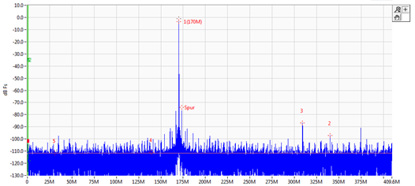
What Type of SYSREF to Use?
It is recommended that SYSREF be turned off during normal operation to avoid coupling of SYSREF into the clock or analog paths through board, device, or power supply paths (SYSREF is a sub-harmonic of sampling clock)
Pulsed SYSREF is the easiest and gives best performance but requires DC coupling
If DC coupling is not possible, then AC coupling the SYSREF signal may require some special considerations to guarantee synchronization and allow the SYSREF signal to be turned off
SYSREF Spurs

Slide 23
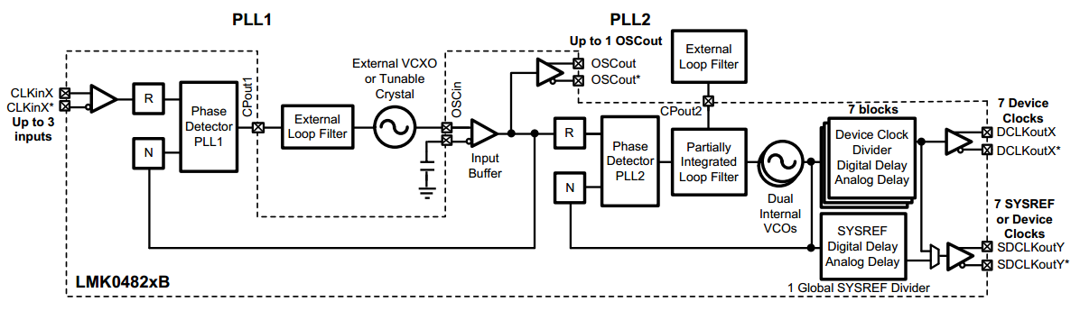
Generation of SYSREF
Specialty JESD204B clock chips (LMK04826/8) are ideal for generating and distributing SYSREF (and device clocks) to each device
  Able to generate all three types of SYSREF signals
  Device clocks and SYSREF signals from a pair of drivers increases immunity to delay shifts over temperature and voltage
  Programmable digital and analog delays allow adjustment of SYSREF to device clock delay to meet setup and hold times
LMK04828

Slide 24
SYSREF Synchronization Requirements
There are two requirements for SYSREF in order to achieve multi-device synchronization
  SYSREF must meet setup and hold times relative to the device clock
  The frequency of SYSREF must meet LMFC and clock divider requirements
The implementation requirements of SYSREF will depend on whether the interface is AC coupled or DC coupled
Errors in the capture of SYSREF will result in some number of device clock cycle variations between parts
JESD204B clock chips and devices may have some features that can help meet some of these needs

Slide 25
Using Programmable Delays to Meet SYSREF Setup and Hold Times
Skew Source | Skew Variation
Skew at output between Device CLK and SYSREF Source: Typical maximum from LMK04800 | ±30 ps
Skew from trace mismatch | ±30 ps
Skew at input between Device CLK and SYSREF | Accounted for by SYSREF to Device Clock Window size
Device Setup/Hold Time | 400 ps/100 ps
Clock Period | 1000 ps
SYSREF to Device Clock Window | 380 ps
167 ps
167 ps
167 ps
167 ps
3 GHz VCO digital delay adjustment
SYSREF
Window
60 ps
60 ps
400 ps
380 ps
1 GHz, 1 ns

Slide 26
Clocking Mode Effect on SYSREF
The clocking mode can ease or complicate SYSREF capture by growing or shrinking the valid capture window
Clocking Mode | SYSREF capture difficulty | Additional Notes
Device clock = Fs | Moderate | The clock provided sets the clock performance
Device clock = Fs * n | Most Difficult | The same clock can be provided to all devices in the system and internal dividers can divide down to the appropriate Fs for each device
Device clock = Fs / n | Easiest | Internal PLL may degrade the analog performance of the part - phase noise / clock mixing

Slide 27
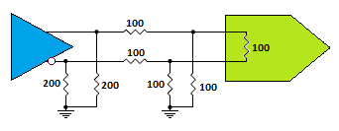
AC coupling vs DC coupling
The largest deciding factor for AC vs DC coupling are the common-mode voltage requirements for the clock drivers and receivers
DC coupling may require additional components to match common-mode voltages which may effect “matching” between device clock and SYSREF causing setup and hold issues
AC coupling may prevent pulsed SYSREF signals due to DC offsets between the clock driver and receiver
LCPECL
0.5V Vcm

Slide 28
SYSREF Frequency Requirements
The frequency and implementation requirements for SYSREF will depend on whether the interface is AC or DC coupled
  DC coupled is the easiest since a single-pulse can be guaranteed to meet setup and hold times and be registered at each device more easily than in AC coupled systems
  AC coupling adds additional complications to the system including guaranteeing clock divider synchronization among multiple devices and being able to start and stop SYSREF without causing issues
  It may be possible to use a one-shot pulse with AC coupled SYSREF signals
Additional system requirements may require continuous SYSREF signals even in DC coupled systems
Notes:
Pulse mode would be low freq

Slide 29
Basic SYSREF Frequency Requirements
The SYSREF frequency is based on the frequency of the local multi-frame clock (LMFC)
  F_{Linerate} = Linerate of serdes lanes
  F = Octets per frame
  K = Frames per multi-frame
Valid SYSREF frequencies are then:
F_{LMFC} = F_{Linerate} / (10 * F * K)
F_{SYSREF} = F_{LMFC} / n
Where n = positive integer

Slide 30
Accounting for Clock Dividers
Some devices contain clock dividers that need to be synchronized in order to achieve multi-device synchronization
  Clocks used for digital signal processing (interpolation/decimation)
  Using higher frequency device clock and dividing down to generate sampling clock
  Using internal PLL with reference dividers greater than 1
For AC coupled systems using continuous SYSREF signals the SYSREF frequency must account for resetting of these clock dividers to achieve synchronization
Alternatively a two step approach can be taken to achieve synchronization

Slide 31
2 Step Synchronization of Devices
Synchronization of devices using internal clock dividers can be done in using a two step process
  Synchronize the clock dividers in all devices
    Run SYSREF at a frequency that is an integer division of the lowest clock frequency in the device
    Enable clock divider syncing in all devices to sync the clock dividers in all devices
    Disable clock divider syncing
  Synchronize LMFCs in all devices
    Set the SYSREF frequency to an integer division of the LMFC frequency
    Enable SYSREF processing in all devices to synchronize all LMFC frequencies
    Disable LMFC processing
    Turn off SYSREF
F_{SYSREF} = F_{S} / max(divider) / n
F_{SYSREF} = F_{LMFC} / n

Slide 32
1 Step Synchronization of Devices
Synchronization of devices using internal clock dividers can be done in one step
  Run SYSREF at a frequency that is an integer division of the lowest clock frequency in the device AND an integer division of the LMFC frequency
  Enable clock divider syncing in all devices to sync the clock dividers in all devices
  Disable clock divider syncing in all devices
  Enable SYSREF processing in all devices (“use only the next pulse”) to synchronize all LMFC frequencies
  Disable LMFC processing
  Turn off SYSREF
F_{SYSREF} = GCF( F_{S}/max(divider), F_{LMFC} ) / n

Slide 33
Achieving Deterministic Latency
There is a full presentation on this topic, this is just a quick snapshot of the process

Slide 34
What Is Required for Synchronization?
There are three requirements for device synchronization using JESD204B data converters
  Phase align device clocks at each converter/logic element
  Generate and capture proper SYSREF signal
  Achieve deterministic latency by choosing an appropriate elastic buffer release point

Slide 35
What is Deterministic Latency?
Once clock dividers are synchronized and the LMFCs have been aligned in all devices, the final requirement is to achieve deterministic latency across the JESD204B link
Wikipedia: ”A deterministic system is a system in which no randomness is involved in the development of future states of the system. A deterministic model will thus always produce the same output from a given starting condition or initial state.”
The most important aspect of deterministic latency is that the latency should stay constant from system startup to startup.
Having “deterministic latency” does not necessarily mean the latency is known
Notes:
A deterministic system is defined as being a system in which no randomness is involved in the future states of the system. A deterministic model will thus always produce the same output from a given starting condition or initial state.
So, what is the starting condition in a JESD204B deterministic system? The LMFC phase alignment in each device
What is the “same output” in a JESD204B system? The latency
So we create a starting condition using SYSREF to align the LMFC clocks in each device, such that every time the system starts the LMFC’s start in the same state. We’re then able to create the same output, or latency, across the link.
So the most important aspect of deterministic latency is that the latency should stay constant from system startup to startup.
Note that having deterministic latency does not mean that you necessarily know the latency. In many cases, the total latency isn’t a concern so much as having matched latency among multiple devices.

Slide 36
How Do We Guarantee Deterministic Latency?
There are two requirements needed to guarantee deterministic latency from startup to startup:
Guarantee the LMFCs in each device are aligned (or have constant phase difference) every time the system starts
Set release point to occur after the latest arriving lane by:
  Having total link delay less than the LMFC period
  Setting a buffer release point that occurs after all lanes have arrived
  Must account for link delay variation!
This is what the standard expects, but it’s not always possible based on hardware tradeoffs (smaller buffers)!

Slide 37
Buffer Release Point
The elastic buffer release point can be shifted from the LMFC rising edge by using the RBD parameter
RBD is defined as a shift in the elastic buffer release point from the LMFC rising edge by “RBD” frame periods
  So an RBD setting of 4 shifts the release point 4 frame cycles from the LMFC rising edge
  Frame period = 10 * F / Linerate
  RBD must be between 1 and K
  K corresponds to the LMFC edge
RBD can be used for:
  RBD is used to release the buffer earlier to achieve minimum latency
  RBD is used to shift the release point away from the area of uncertainty near the total link delay
Notes:
DAC in frames.

Slide 38
Calculating Elastic Buffer Release Point
This process can be used to calculate the appropriate elastic buffer release point
  Determine Alignment of LMFCs
    Account for skews between SYSREF signals
    Add in SYSREF-pins-to-LMFC-reset delays
  Calculate expected link delay
    Total data delay from LMFC edge to arrival of data at the receiver’s elastic buffer input
    Account for delay variations due to device and board variations
  Choose release point that provides margin against error
    Set the release point to occur away from the data arrival time to avoid releasing data too early/late due to delay variations

Slide 39
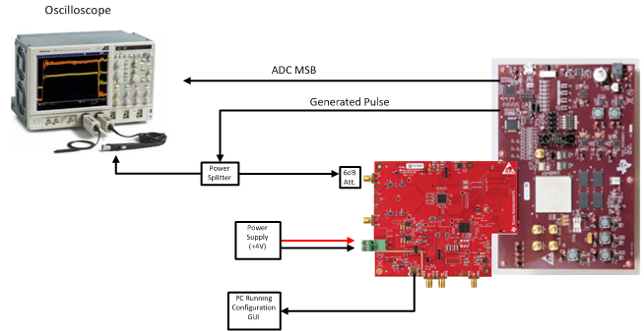
Deterministic Latency Test Setup
Generate a pulse with FPGA
Capture FPGA pulse
with ADC
Output ADC’s MSB from
FPGA
Observe relative timing on scope
Power up the system many times to
confirm the relative timing stays constant

Slide 40
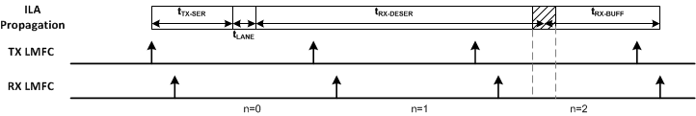
Determine Release Point by Experiment
Setup test from previous slide to monitor relative delay across the link
Vary RBD until a 1 LMFC period latency jump is observed
Choose release point by taking the last RBD value before the latency jump was observed and add the expected latency variation to that value (plus extra margin)
Release Point
Release Point
Release Point
Release Point
Release Point
Release Point
Total Latency
Optimal Release Point

Slide 41
Giga-Sample ADC/DAC Synchronization Considerations

Slide 42
Giga-Sample ADC/DAC Synchronization
Giga-sample converters add additional challenges
  High frequency sampling clock may be difficult to generate and synchronize between converters
  Reliably capturing the SYSREF signal on the same edge at all devices is more difficult
Programmable delays in clock devices can be used to try to meet setup and hold times
Achieving synchronization
  Use of internal PLLs can greatly simplify synchronization by relaxing SYSREF setup and hold times and reference clock generation
  Devices may include additional aids to help capture SYSREF reliably
  Calibration of delays or synchronization may be needed

Slide 43
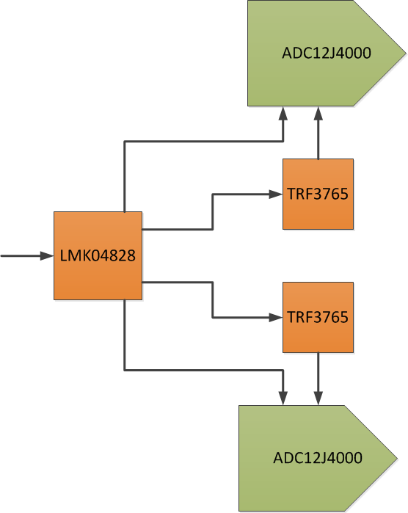
Example Giga-Sample System Diagram
Use RF synthesizers (TRF3765) to generate
high frequency sampling clock (4 GHz)
The LMK04828 provides the reference
clock to the RF synthesizers
The LMK04828 provides the SYSREF
signal to the ADC’s
Adjustments
  TRF3765 reference clocks can be
  adjusted using programmable delays
  to align sampling clocks at each ADC
  SYSREF to sample clock delays can be
  adjusted to meet setup and hold times for
  each ADC

Slide 44
SYSREF Delay Adjustment
The ADC12J4000 has a built in adjustable delay element on the SYSREF input to help maximize setup and hold times
To help choose the appropriate SYSREF delay, the ADC12J4000 has a “dirty capture” bit that looks for setup and hold issues on SYSREF
To set the delay
  Run SYSREF signal
  Sweep the delay adjustments and monitor the “dirty capture” bit
  Find settings where a “dirty capture” occurs to determine setup and hold time boundaries
  Choose delay setting halfway between the delays where setup and hold errors occur to maximize setup and hold time

Slide 45
End!

