Slide 1
CDCE6214 Programming

Slide 2
Write to EEPROM from Registers

Slide 3
Using TICSPro

Slide 4
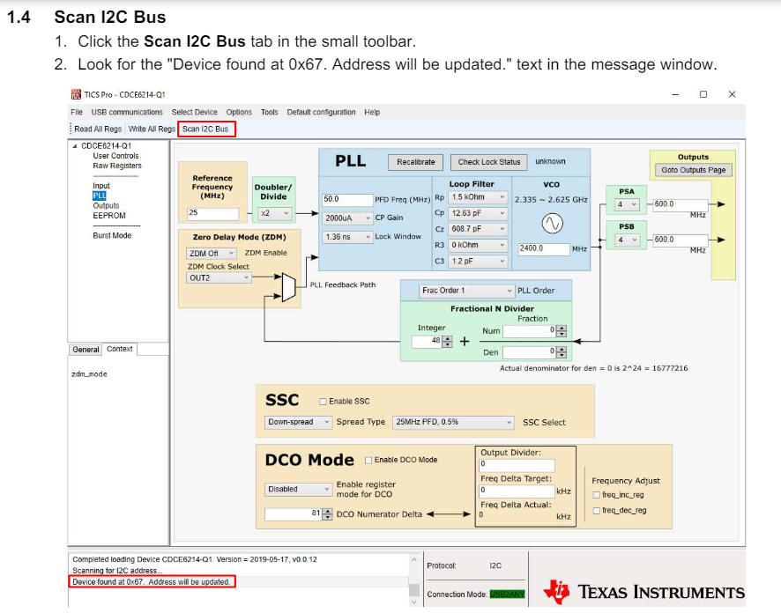
Connect to Device
Power on device and Scan I2C as shown to the right
The default I2C address is 0x67

Slide 5
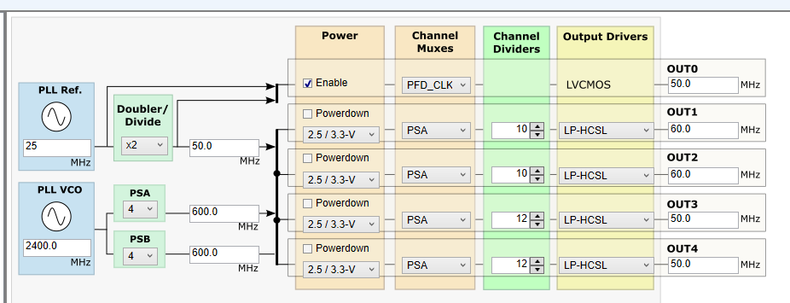
Verify Config
Create or Load the desired config using the TICSPro GUI
Write All Registers and verify part is outputting as expected
Read All Registers and confirm desired config is properly displayed

Slide 6
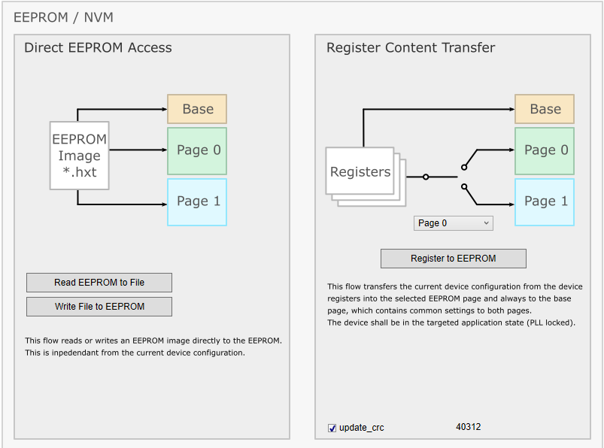
Select EEPROM Page
Using the drop down menu under Register Content Transfer, select which EEPROM page you want the current config to be written to
Select update_crc in the bottom corner

Slide 7
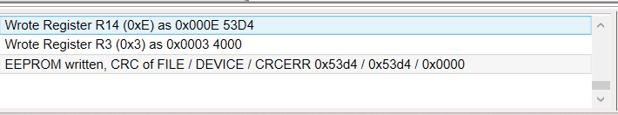
Program EEPROM
Click Register to EEPROM
After EEPROM write is complete, you will see the following in the Status Box:
CRC of FILE and DEVICE values may be different than above, but they should be equal each other.
CRCERR should be 0x0000
After EEPROM write is complete, power cycle the device.

Slide 8
For More Info
More info can be found in the EVM User’s Guide
https://www.ti.com/lit/ug/snau244a/snau244a.pdf

Slide 9
Without TICSPro

Slide 10
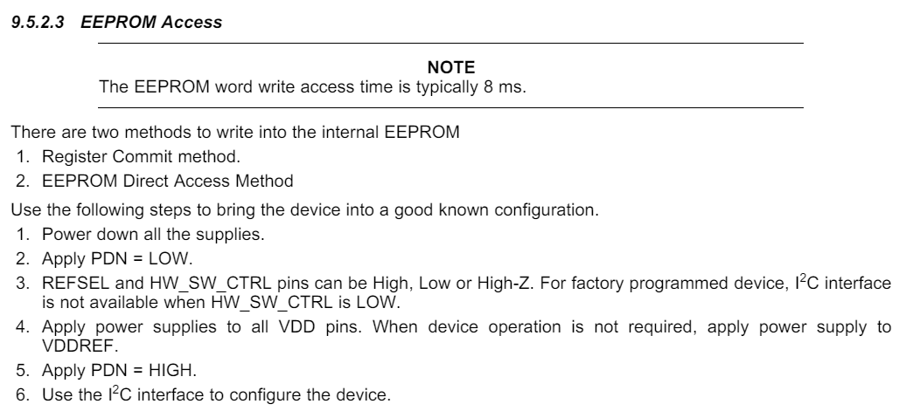
EEPROM Access

Slide 11
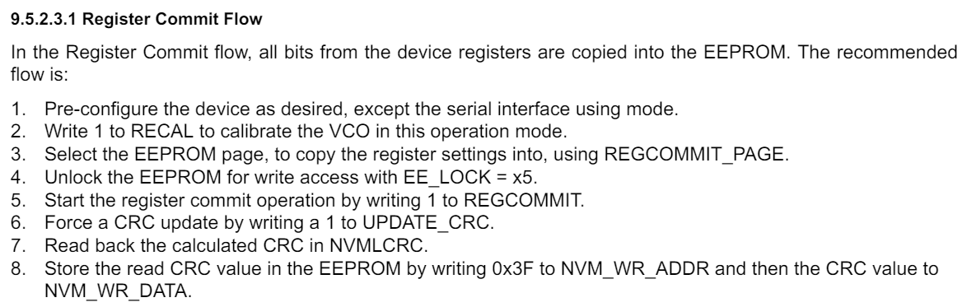
Writing EEPROM Data from Registers
Power cycle the device after the EEPROM has finished being written to.

Slide 12
For More Info
More info can be found in the Programming section of the Datasheet
https://www.ti.com/lit/ds/symlink/cdce6214.pdf

Slide 13
Write to EEPROM from File

Slide 14
Using TICSPro

Slide 15
Connect to Device
Power on device and Scan I2C as shown to the right
The default I2C address is 0x67

Slide 16
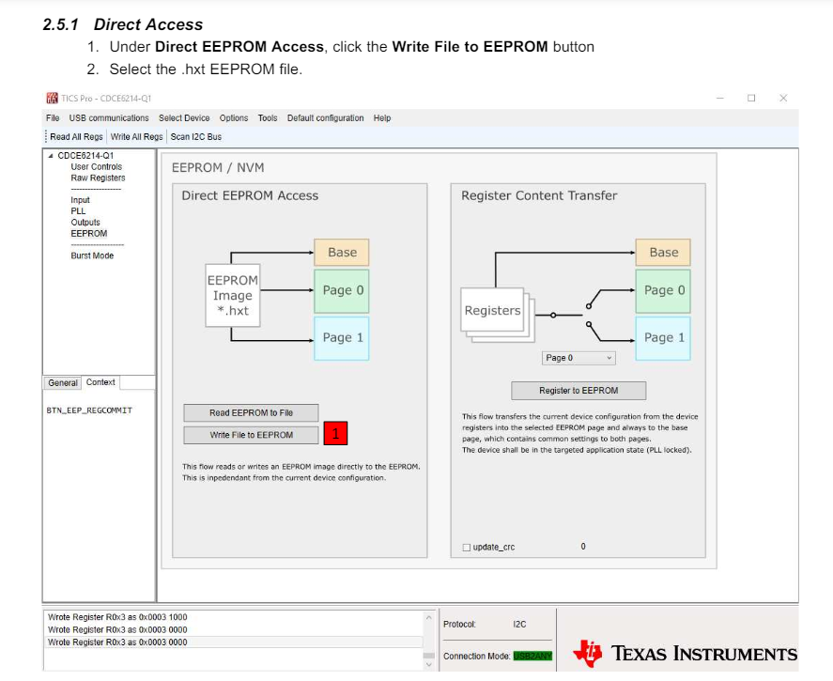
Program EEPROM
After EEPROM write is complete, you will see the following in the Status Box:
CRC of FILE and DEVICE values may be different than above, but they should be equal each other.
CRCERR should be 0x0000
After EEPROM write is complete, power cycle the device.

Slide 17
Verify Config
Power on device
Connect to Device by Scanning for I2C
Read All Registers and verify config displayed is correct

Slide 18
For More Info
More info can be found in the EVM User’s Guide
https://www.ti.com/lit/ug/snau244a/snau244a.pdf

Slide 19
Without TICSPro

Slide 20
EEPROM Access

Slide 21
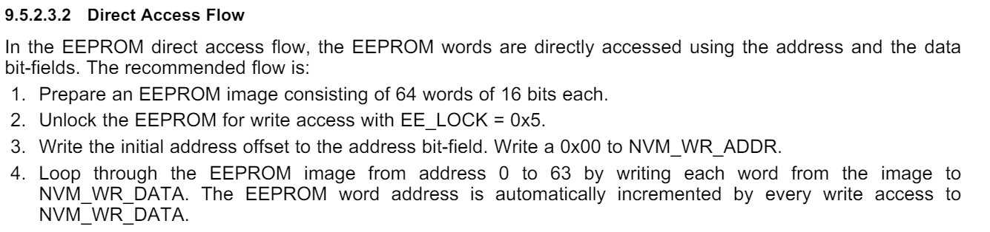
Writing EEPROM Data from File
Power cycle the device after the EEPROM has finished being written to.

Slide 22
For More Info
More info can be found in the Programming section of the Datasheet
https://www.ti.com/lit/ds/symlink/cdce6214.pdf

Slide 23
Reading EEPROM to File

Slide 24
Using TICSPro

Slide 25
Connect to Device
Power on device and Scan I2C as shown to the right
The default I2C address is 0x67

Slide 26

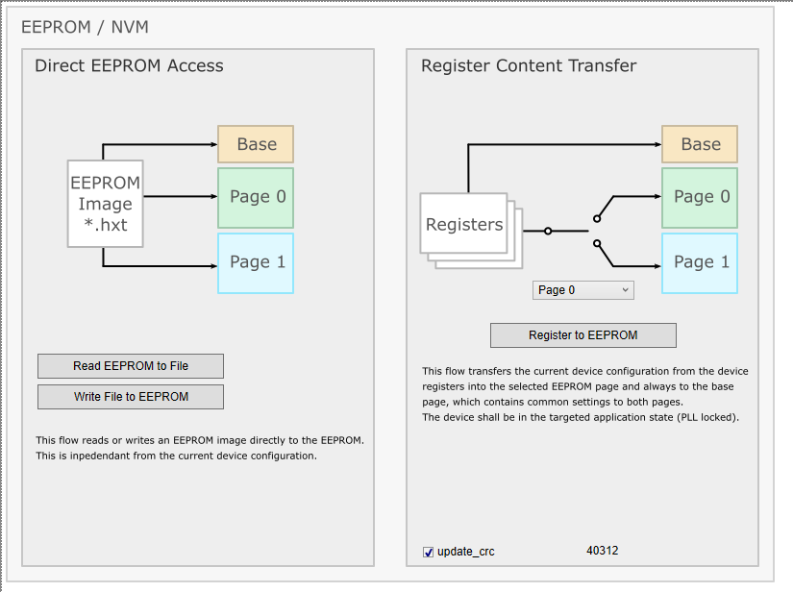
Read EEPROM Content

Slide 27
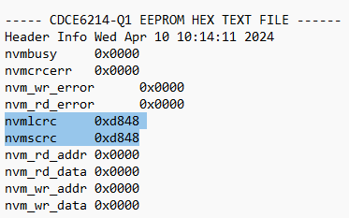
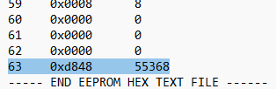
Adjust EEPROM File if needed
After the .hxt file has been exported, it may need to be adjusted
nvmlcrc and nvmscrc MUST be the same value. If they are different, change nvmscrc to match nvmlcrc
Byte 63 must also match nvmlcrc in both hex and decimal form
nvmcrcerr must be 0x0000

