Slide 1
AM273x MCASP Clock Switch

Slide 2
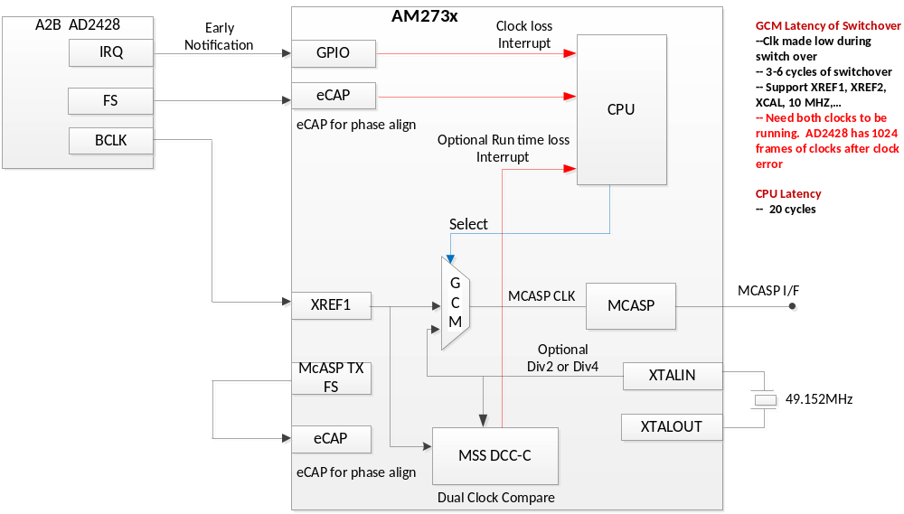
Current Audio Clock Switch Concept

Slide 3
McASP Clock Connections
GCM Select Register | Clock Divider Register | Output Clock | Connected MCASP Clock
RCSS_MCASPA_REF0_CLK_SRC_SEL | RCSS_MCASPA_REF0_CLK_DIV_VAL | RCSS_MCASPA_REF0_CLK | ahclkx_pi
RCSS_MCASPA_REF1_CLK_SRC_SEL | RCSS_MCASPA_REF1_CLK_DIV_VAL | RCSS_MCASPA_REF1_CLK | ahclkr_pi
RCSS_MCASPA_AUX_CLK_SRC_SEL | RCSS_MCASPA_AUX_CLK_DIV_VAL | RCSS_MCASPA_AUX_CLK | aux_clk
RCSS_MCASPB_REF0_CLK_SRC_SEL | RCSS_MCASPB_REF0_CLK_DIV_VAL | RCSS_MCASPB_REF0_CLK | ahclkx_pi
RCSS_MCASPB_REF1_CLK_SRC_SEL | RCSS_MCASPB_REF1_CLK_DIV_VAL | RCSS_MCASPB_REF1_CLK | ahclkr_pi
RCSS_MCASPB_AUX_CLK_SRC_SEL | RCSS_MCASPB_AUX_CLK_DIV_VAL | RCSS_MCASPB_AUX_CLK | aux_clk
RCSS_MCASPC_REF0_CLK_SRC_SEL | RCSS_MCASPC_REF0_CLK_DIV_VAL | RCSS_MCASPC_REF0_CLK | ahclkx_pi
RCSS_MCASPC_REF1_CLK_SRC_SEL | RCSS_MCASPC_REF1_CLK_DIV_VAL | RCSS_MCASPC_REF1_CLK | ahclkr_pi
RCSS_MCASPC_AUX_CLK_SRC_SEL | RCSS_MCASPC_AUX_CLK_DIV_VAL | RCSS_MCASPC_AUX_CLK | aux_clk

Slide 4
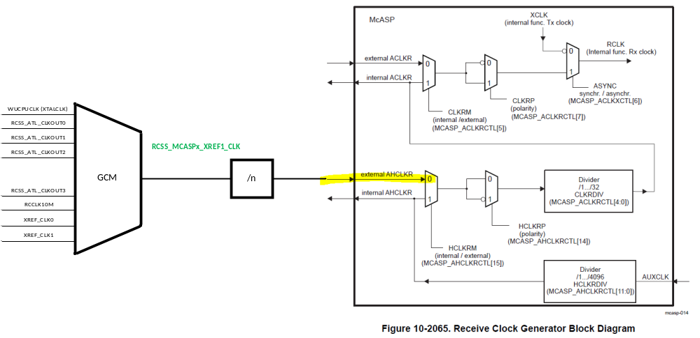
McASP Clock Connections

Slide 5
McASP AHCLKR (REF1_CLK) GCM Selections
See “TPR12_Clock_Tree_0.6.xlsx”
  GCM selections for RCSS_MCASPA_REF1_CLK_GCM_CLKSRC_SEL are shown in worksheet “Clock_Muxes”
  GCM inputs are shown in worksheet “Root_Clock”
GCM selections for all RCSS_MCASPx_REF1_CLK_GCM_CLKSRC_SEL are the same:
RCSS_MCASPA_REF1_CLK_GCM_CLKSRC_SEL | 0 | WUCPUCLK | XTAL clock
 | 1 | RCSS_ATL_CLKOUT0
 | 2 | RCSS_ATL_CLKOUT1
 | 3 | RCSS_ATL_CLKOUT2
 | 4 | RCSS_ATL_CLKOUT3
 | 5 | RCCLK10M
 | 6 | XREF_CLK0
 | 7 | XREF_CLK1 | A2B clock

Slide 6
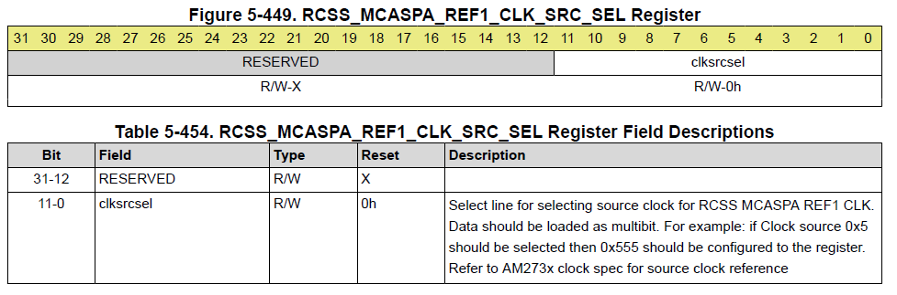
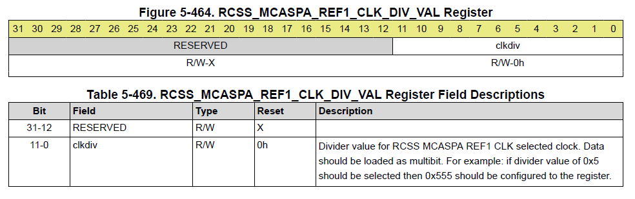
Register Formats
GCM Select Register
Clock Divider Register

Slide 7
GCM Clock Switch Timing
Whenever the MMR is programmed for switching the clock source
  It will take roughly 3 old clock source cycles + 3 new clock source cycles before the clocks switch inside the logic
  It will be glitch free as the design ensures that switching happens at inactive phase of the old clock source
Both clocks must be running before starting the MMR programming or the switching will not happen

Slide 8
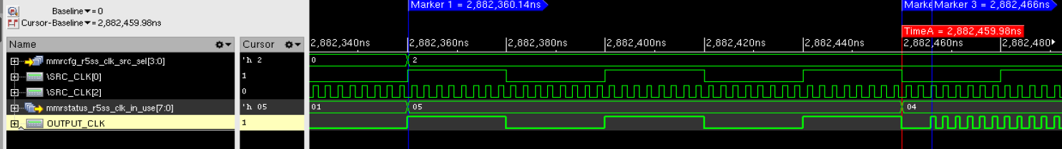
GCM Clock Switching Diagram
GCM clock switching :
Marker 1 is where CLK_SRC_SEL gets updated after MMR configuration
Time A is a point where GCM actual GCM status gets reflected
Marker 3 is where actual newly selected starts flowing
Time taken for switching (WC) = 3 cycles of old source clock + 3 cycles of newly selected clock

