Slide 1
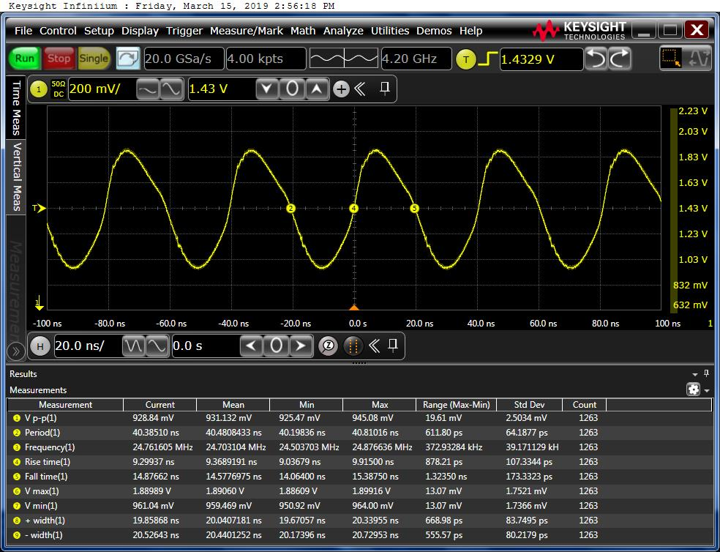
CDCE913 Voltage at Vin pin
1.89V
0.96V
Are these level correct?

