Slide 1
CDCM6208 Phase Noise
September 16, 2025
DCC-CTS

Slide 2
Test Setup
CDCM6208V1 is configured with the customer provided register values
Only the external loop filter values are changed between captures
Captures are taken on Y2

Slide 3
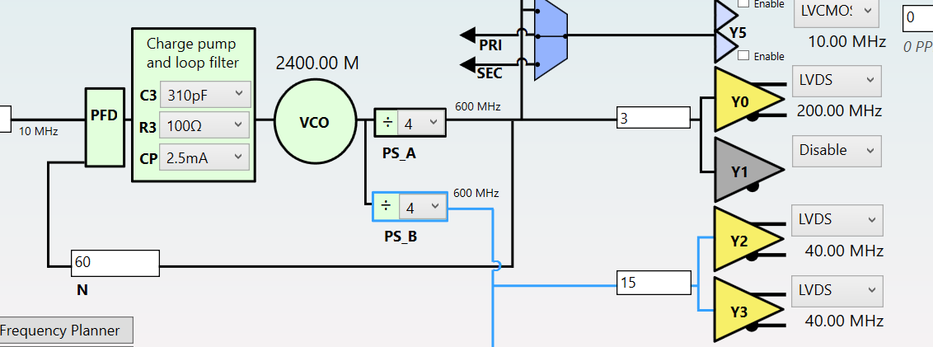
Base Internal Loop Filter Values

Slide 4
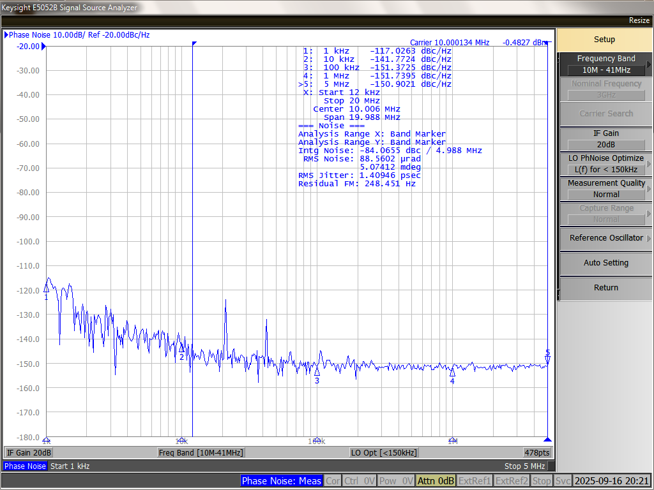
Input Reference
Jitter: 1.4ps
10kHz offset: -142dBc/Hz

Slide 5
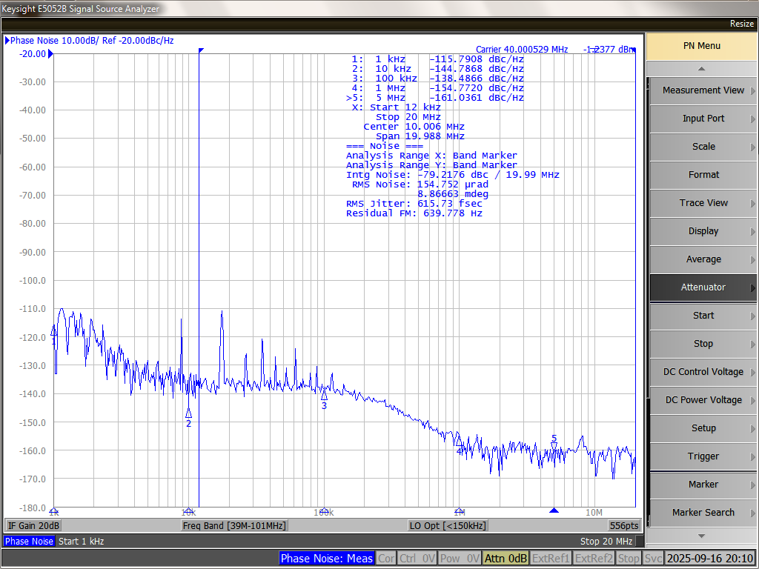
Configuration 1
C1=100pF, R2=500, C2=22nF
Jitter: 615fs
10kHz offset: -144dBc/Hz

Slide 6

Configuration 2
C1=220pF, R2=400, C2=22nF
Jitter: 582fs
10kHz offset: -136dBc/Hz

Slide 7
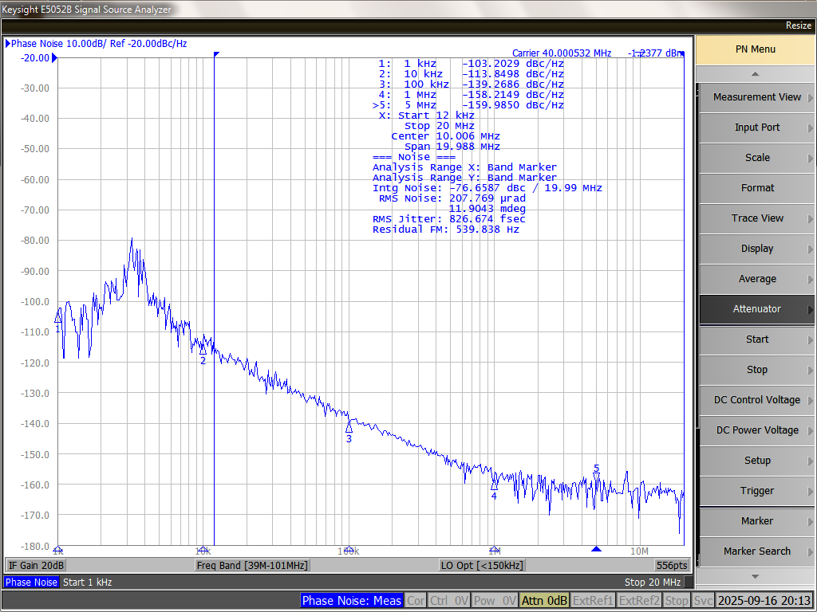
Configuration 3
C1=4.7uF, R2=145, C2=47uF
Jitter: 826fs
10kHz offset: -113dBc/Hz

Slide 8
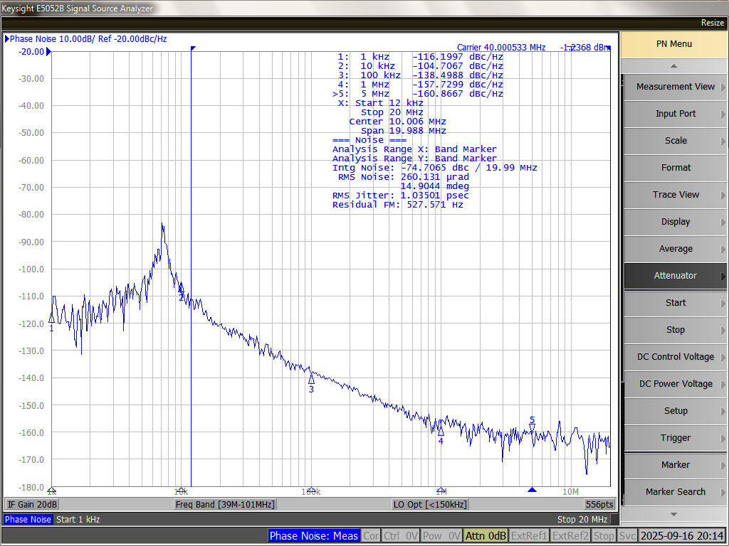
Configuration 4
C1=1uF, R2=1.3k, C2=22uF
Jitter: 1.03ps
10kHz offset: -104dBc/Hz

