Slide 1
Clocking High Speed Data Converters
High Speed Data Converters

Slide 2
Presentation Goals
Understand the theory behind the relationship between SNR, noise sources, ADC performance
Know how to select the appropriate clocking solution for a given application
Learn about additional techniques for improving sampling clock quality to the ADC
Understand the clocking effects of DACs and the tradeoffs between jitter and NSD specifications
Become familiar with TI’s clocking solutions portfolio

Slide 3
UnderstandING the theory for adcS
SNR, Noise Sources, and ADC Performance

Slide 4
Signal-to-Noise Ratio Basics
SNR is the ratio of the signal power to the noise power that corrupts the signal. This parameter does not include harmonic distortion.
In the time domain:
In the frequency domain:
Noise Signal Noisy Signal
FFT
Signal
Noise Level
FREQUENCY (Hz)

Slide 5
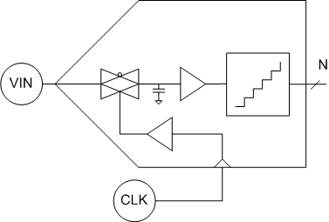
Maximizing the SNR in an ADC
SNR can be increased in the following ways:
Increase signal power ↑
  Full Scale Range (FSR)
Decrease noise power ↓
  Quantization Noise
  Clock Jitter
  ADC Aperture Jitter
  Thermal Noise
Quantization
Thermal
Aperture Jitter
Clock Jitter

Slide 6
SNR by Individual Contributors
Total SNR can be calculated by the sum of the individual sources:
SNR_{QUANT} = SNR due to quantization
SNR_{JITTER} = SNR due to clock and aperture jitter
SNR_{THERM} = SNR due to thermal and transistor noise
Design Choice | Effect on Noise
ADC Selection | N-bits affects quantization noise, aperture jitter and thermal noise by design
Sampling Clock Selection | Clock jitter
Sampling Rate | Bandwidth over which noise is distributed

Slide 7
Quantization Noise and SNR
SNR due to quantization error, assuming a sine wave input:
How to determine the required ADC resolution?
  An N-bit ADC determines the maximum possible SNR for the system
  Practically, an ADC’s SNR is limited by other factors:
    Sampling clock jitter
    ADC jitter and thermal noise
    Other system noise sources
    Over-sampling rate and application channel bandwidth
Example: 14-bit converter where N=14:

Slide 8
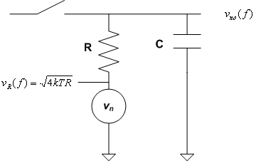
Transistor and Thermal Noise and SNR
Noise Mechanism | α | Spectral Profile | Source | Cause
Shot | I_{DC} | white | pn-junctions | DC bias current is not constant
Flicker | 1/f | 1/f | Active devices | Carriers are “trapped” and released in a semiconductor
Thermal | T | white | resistors | Thermal excitation of carriers in a conductor
Noise in an ADC:
Track-and-hold is dominant source
Capacitors source no noise
Resistor results in “kT/C” noise
Notes:
Noise bandwidth is given by (pi*2)/f
f = 1/(2*pi*RC) due to white spectral density

Slide 9
Clock Jitter and SNR
Clock jitter is the random variation of the clock edge compared to its ideal point in time
Theoretical limit of SNR due to jitter:
Total jitter is the rms sum of the individual jitter contributions
  For ADCs, this is generally the external clock jitter and aperture jitter

Slide 10
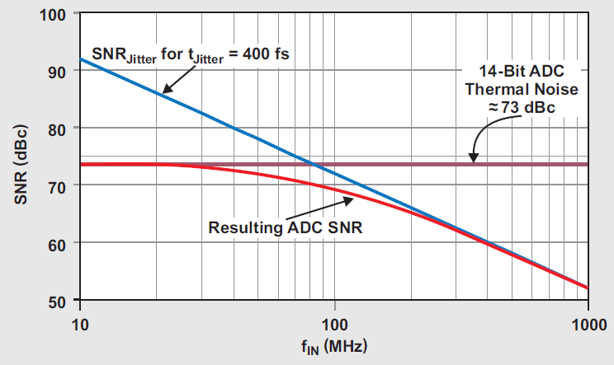
More on Clock Jitter
Clock jitter causes imprecise sampling intervals which results in incorrect sampling instances and therefore errors in the sampled signal
Clock jitter has an increased effect at higher input frequencies or higher maximum input slew rates

Slide 11
Sources of Clock Jitter
The total clock jitter for an ADC is from the aperture jitter and the external sampling clock jitter.
Clock jitter is the jitter contribution from the external clock source and can be measured by using a phase noise analyzer
Aperture jitter (a.k.a. aperture uncertainty) is the jitter contribution from the ADC, due to the internal clock buffers. This cannot be measured directly using a phase noise analyzer.
Example: aperture jitter for the ADS4249
The total clock jitter is determined by rms sum of all individual contributions:

Slide 12
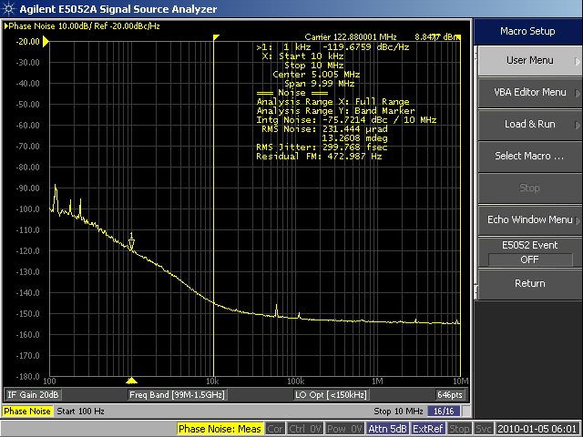
Example Phase Noise Plot
Noise Spectral Density (dBc/Hz)
Frequency (MHz)

Slide 13
Calculating Jitter from Clock Phase Noise
Jitter is a result of noise on the sampling clock. Assuming the wideband clock noise is relatively low, then the clock jitter is calculated by integrating the clock phase noise over a specified BW then converting to seconds.
Example from previous slide’s phase noise plot:
  Φ_{N} = -75.72 dBc/Hz (from 10 kHz to 10 MHz offset)
  F_{clk} = 122.88 MHz
  Where:
  Φ_{N}= Phase Noise Power (dBc)
  f₀, f₁= frequency limits of integration
  τ_{j} = clock jitter

Slide 14
SELECTING an ADC CLOCK

Slide 15
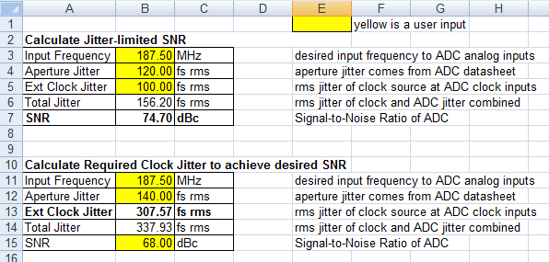
Determining Clock Jitter Requirements
The target SNR is generally based on the system requirements
Then ADC aperture jitter and IF center frequency can be used to calculate the required external clock jitter performance
Use Jitter Calculator Worksheet:
  http://www.ti.com/litv/zip/slac133
  The current worksheet does not account for the contribution from quantization and thermal noise (see total SNR from earlier)

Slide 16
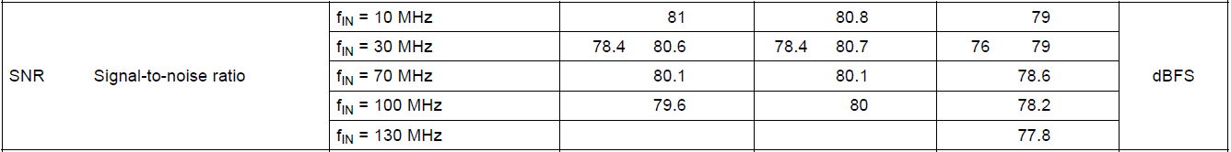
Example: ADS5483 (16-bit, 125 MSPS)
Aperture jitter: τ_{j} = 80 fs
Input Frequency: f_{IN} = {10 MHz, 100 MHz}
SNR from datasheet:
  Includes effect of thermal and quantization noise, and aperture jitter
  External clock jitter is negligible since the highest quality source was used
Clock source:
  LMK04803 with 80 MHz VCXO in dual-loop mode
  10 MHz reference from analog input signal generator
  125 MHz LC bandpass filter on clock signal
  Phase noise plot on next screen

Slide 17
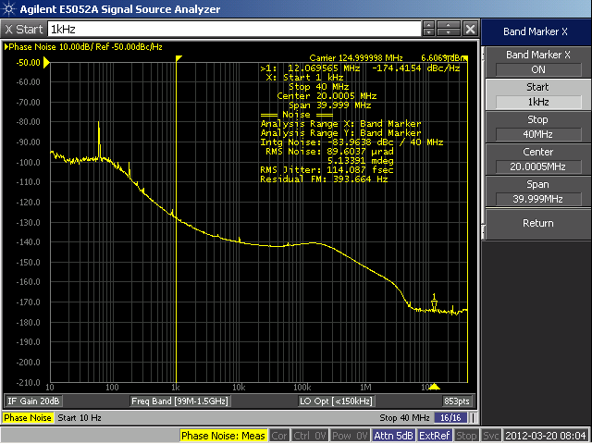
Example: ADS5483 – Clock Phase Noise
114 fs of jitter in integration band of 1 kHz to 40 MHz

Slide 18
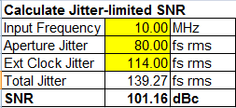
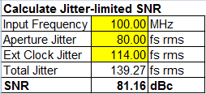
Example: ADS5483 – SNR Analysis
10 MHz Case:
From datasheet:
  SNR @ 10 MHz = 79 dBFS
From spreadsheet:
Total estimated SNR:
100 MHz Case:
From datasheet:
  SNR @ 100 MHz = 78.2 dBFS
From spreadsheet
Total estimated SNR:
Assuming -1 dBFS Input
Assuming -1 dBFS Input

Slide 19
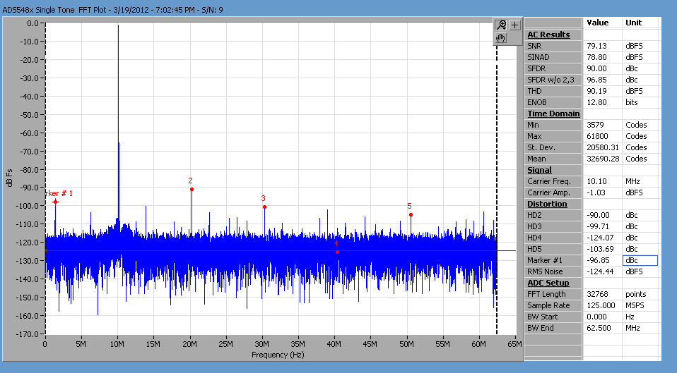
Example: ADS5483 – 10 MHz FFT
Error: | 79.13 dBFS – 78.98 dBFS | = 0.15 dB

Slide 20
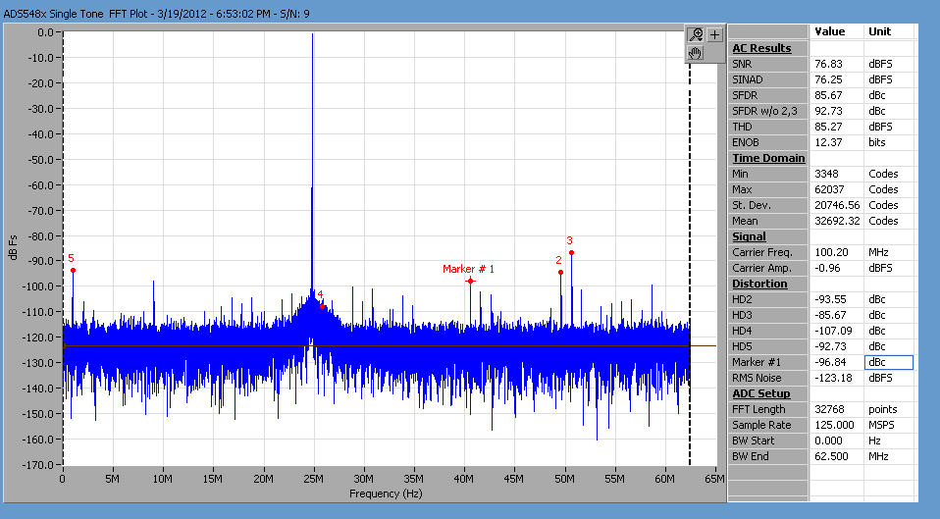
Example: ADS5483 – 100 MHz FFT
Error: | 76.83 – 76.73 | = 0.10 dBFS

Slide 21
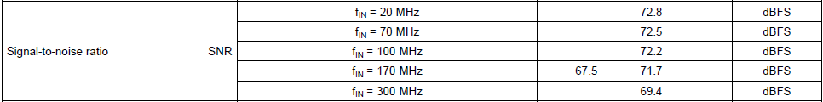
Estimating NSD from SNR
The Noise Spectral Density can be approximated by using SNR from the datasheet at low input frequency:
Example: from ADS4249 Datasheet with Fs = 250MSPS and N=14:
Clock noise can also be included in the NSD calculation by using the total SNR shown previously. It may be beneficial to look at the shape of the clock noise when considered NSD.
Ideal NSD by Quantization Noise:
Actual NSD by SNR at low Fin:

Slide 22
additional techniques
Improving the Sampling Clock Quality

Slide 23
A note on clock filtering
Clock sources have wideband noise that will also contribute to the overall jitter of the clock
  This is can be important since ADCs often have very wide clock input bandwidths (up to ~ 2 GHz)
In order to eliminate the wideband noise of the clock source, a filter can be placed on the clock lines
  A bandpass filter is preferred, but a low pass filter could be acceptable
  The amount of filtering will vary based on the system requirements
  A tight passband will have more loss which could have additional problems
Note that filtering a square wave will produce a sine wave with a slower slew rate, this may hurt the jitter performance slightly
Filtering the clock can eliminate clock related spurs, especially those associated with different frequencies coupling in due to clock isolation

Slide 24
Clocking with Sine Wave vs. Square Wave
A square wave clock (e.g. LVPECL) has a very high slew rate, but does not allow clock filtering as clock harmonics generate the high slew rate
Filtering the clock removes clock noise, but limits the slew rate
Clock
Slew Rate
Harmonics
Noise
Frequency
Slew Rate
Bandpass Filter
Lower Noise
Frequency

Slide 25
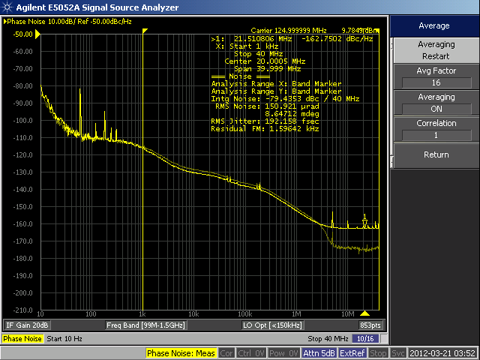
Example: LMK04803 Filtering
The plot below has two phase noise measurements overlaid from the same LMK04803, but the slightly darker trace has a relatively tight LC band-pass filter on it.
Note that the overall jitter in the
1 kHz to 40 MHz bandwidth
has actually degraded slightly
for the filtered case due to a
slower slew rate from filtering
out the harmonics.
However, the wideband noise
has gone from -163 dBc/Hz
to -174 dBc/Hz. Integrated
over 500 MHz, this will make
a significant difference (~200 fs) and will easily
overcome the added jitter due to a lower slew rate.
Higher in-band phase noise
Lower wide-band noise

Slide 26
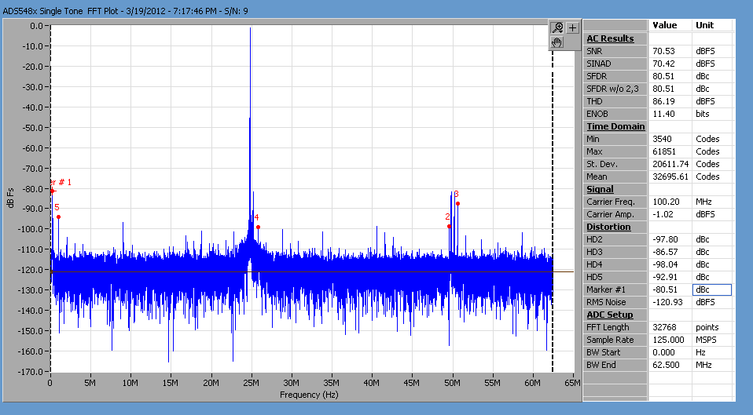

Example: ADS5483 w/ and w/o filtering
Without Filter
Clocking with a sine wave can reduce clock related spurs.
With Filter

Slide 27
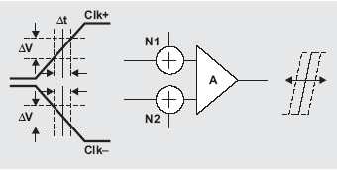
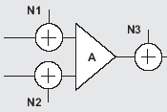
Clocking ADCs: Effect of Clock Slew Rate
The jitter generated by the ADC clock receiver is affected by the clock slew rate
Filtering the ADC clock will lower the clock slew rate by removing the harmonics
A slower slew rate causes the receiver to be more susceptible to variations in the zero crossing point
A faster clock slew rate lowers the jitter due to the receiver voltage noise
Receiver
noise
Aperture
Jitter
Total Jitter ~
(Clock Jitter² +
Receiver Jitter² +
Aperture Jitter²)^{1/2}
Clock
Jitter
ΔV/Δt =
slew rate
Receiver Jitter ~ Receiver Noise * ΔV/Δt

Slide 28
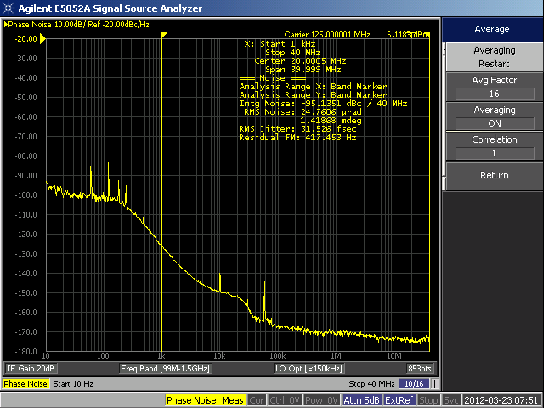
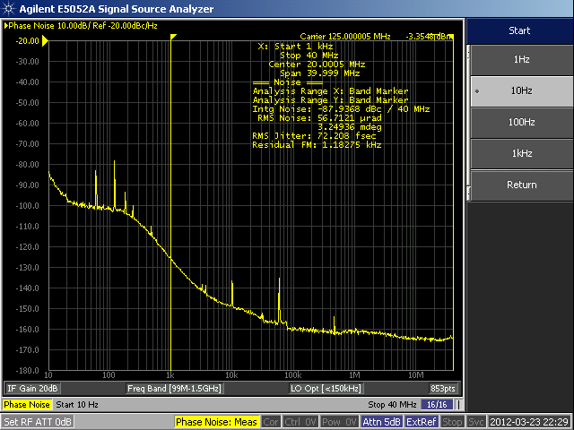
Phase noise for slower slew rate
For a clock that has ~9 dBm less power, jitter has been increased from 31.52 fs to 72.208 fs
6.11 dBm Clock:
-3.35 dBm Clock:

Slide 29
A different Way to look at Clock Jitter/Noise
29

Slide 30
Limitation of the Traditional SNR Calculation Due to Jitter
The traditional SNR due to jitter equation gives the SNR over the entire Nyquist band, with the jitter measured over a wide clock offset frequency
The equation is a function of the analog input frequency and jitter performance
If the ADC clock is already fine tuned to the best jitter performance, would the only option left to meet the stringent SNR performance is to adjust the input frequency?
If so, what is the point of over-sampling ADCs?

Slide 31
General Equation for ADC SNR
It turns out the SNR equation is also a function of clock frequency as well. Recall the jitter equation:
If we substitute the jitter equation into the SNR equation, we would get the following:
The first term is the inherent integrated noise due to clock noise. The second term is a correction term. This is important to help us understand the performance of over-sampling. If over-sampling is used, the SNR can be improved

Slide 32
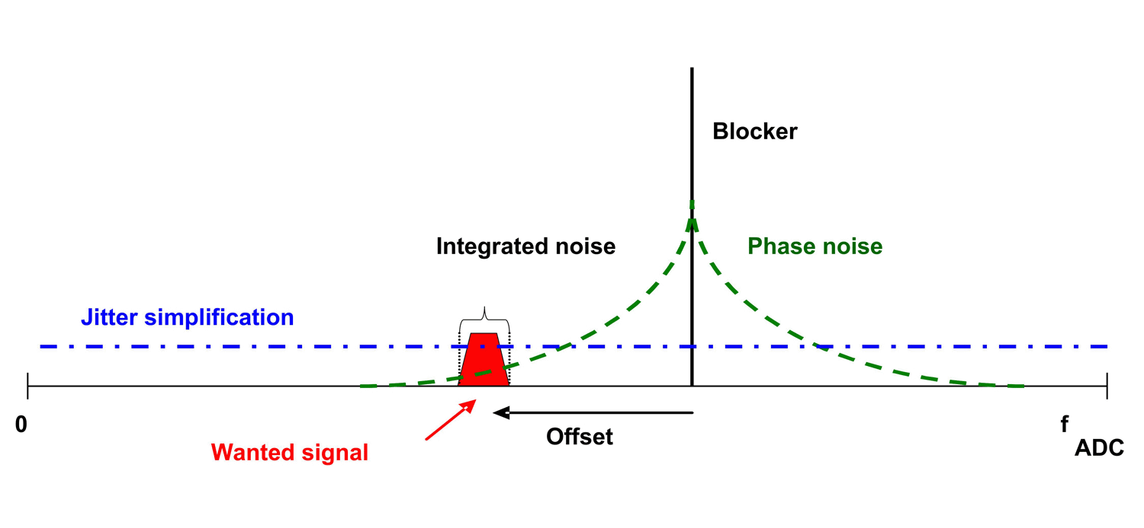
Why is the general equation important?
The general equation is important because the traditional equation often simplifies the ADC clock noise floor as an uniform white noise.
In reality, the ADC clock usually has better noise behavior as the offset frequency increases, and also, the clock is often well filtered.
Simplified integrated clock noise
Actual phase noise

Slide 33
System Requirement Implication
Most importantly, some of the stringent system requirements often are bandwidth specific. I.e. noise spec over a specific bandwidth.
For instance, when given a certain blocker signal, the traditional SNR calculation may overestimate the noise over the bandwidth of the wanted signal. This may make jitter specification of the clock impossible to achieve.

Slide 34
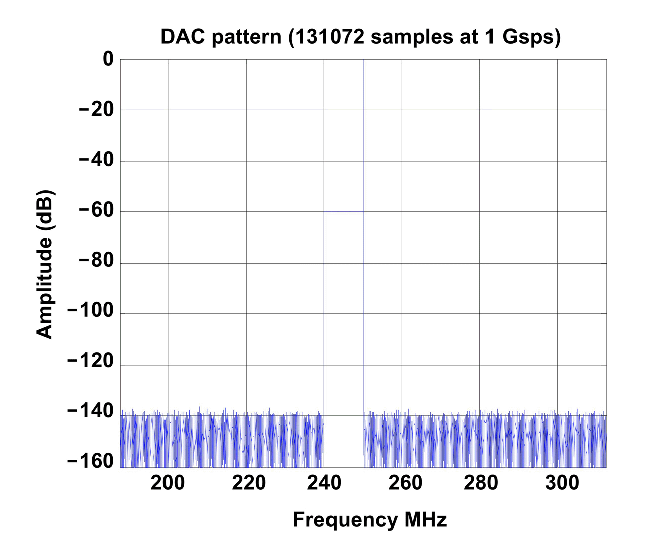
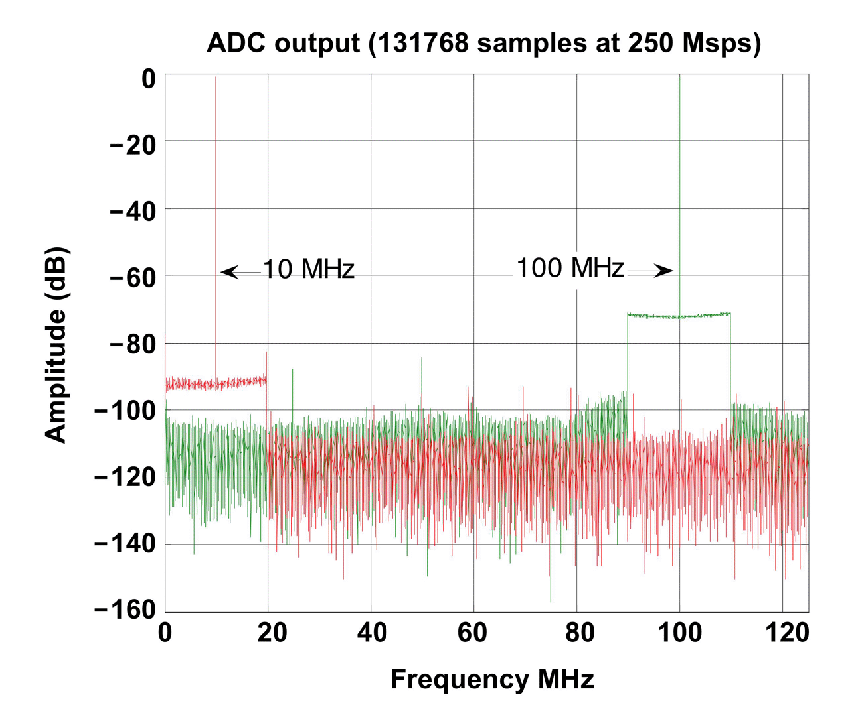
Experiment Result
Clocking the ADC with a 250MHz tone + 10MHz noise ranging from 240MHz to 250MHz
ADS4149 at 250MSPS
Two inputs shown and overlaid: 10MHz and 100MHz
(DAC5681 output)

Slide 35
ADC Test Result
20log(250/10) = 28dBc
20log(250/100) = 8dBc

Slide 36
DAC NSD vs SNR
36

Slide 37
SNR Jitter estimate is the same for DACs
SNR_{QUANT} = SNR due to quantization
SNR_{CLK} = SNR due to clock and aperture jitter
SNR_{THERM} = SNR due to thermal and transistor noise
37
The total SNR is the vector sum of all individual SNR contributions
Similar treatment of clock jitter (integrated phase noise) for SNR limit of DAC sampled system

Slide 38
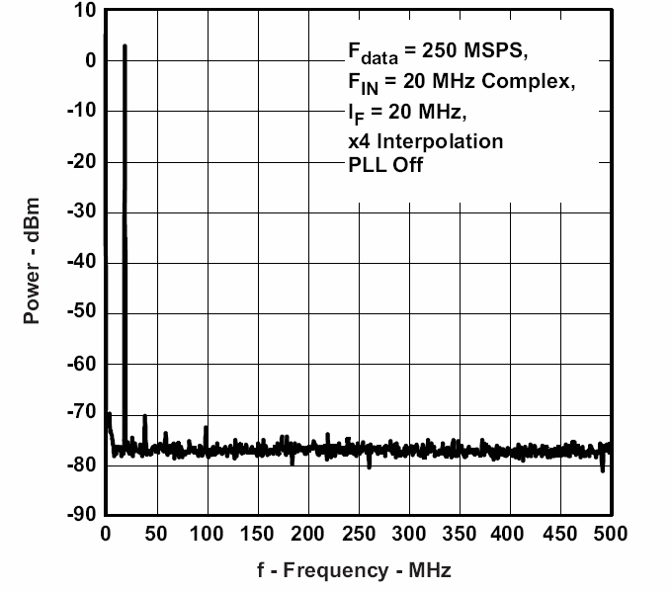
Is Jitter Applicable For DACs?
For DACs, generally the noise spectral density (NSD) is more important than overall SNR
  The shape of the NSD around the carrier must meet mask requirements
  When SNR is required, customer’s often limit the bandwidth of the transmitted signal by a bandpass or lowpass filter
For this reason, newer datasheets report NSD rather than SNR
fs = 1GSPS
f out = 20MHz
DAC output noise is comprised of
  Quantization noise
  Thermal noise
  Jitter noise
  Data dependent noise
Signal
Noise

Slide 39
Why NSD over SNR?
39
In real systems, there is often tight filtering around the band of interest, where all the noise outside of that band is filtered out.
Rather than showing the SNR of the signal in the first Nyquist zone, it is more convenient to show the noise power so that the total noise power in the unfiltered band can be readily calculated
For example, consider a DAC3484 running at 1228.8 MSPS with a band of interest of 100 MHz and the following filters:
  A 614.4-MHz low-pass filter (passing full first Nyquist zone):
  A 100-MHz low-pass filter:

Slide 40
Converting NSD to SNR
The SNR of the DAC can be calculated from the NSD spec
The SNR was traditionally defined as the ratio of the power of the fundamental to the power of the noise integrated over the first Nyquist zone.
It can also be calculated directly in dBFS from the NSD in dBc/Hz
Example: DAC3484 running at 1.25 GSPS with 10 MHz output
40

Slide 41
NSD to SNR tradeoffs – Jitter/Phase noise
SNR estimates based on Jitter are good estimates for SNR for the entire Nyquist band – may be too pessimistic for BW limited applications.
SNR estimates based on NSD (typically measured at some MHz offset) do not account for close-in phase noise which could affect inband EVM
  Useful for out of band estimates like ACPR
  Also useful for transmit mask requirements
Using the clock NSD curve and BW limited noise calculations would be the ideal solution for in-band and out-of-band measurements.

Slide 42
CLK Phase Noise effects on sampled systems
For both sampled systems of the ADC and DAC the CLK phase noise will be translated from the clock to the sampled outputs with the following relationship:
All in-band (%EVM, RX sensitivity) and out-of-band (ACPR, TX Mask) measurements can be based on the measured phase noise plot of the ADC and DAC clock source

Slide 43
Intrinsic DAC noise effects
At higher frequency offsets where the phase noise of the clock drops off, the intrinsic noise of the DAC will play a role in the overall noise floor of the output spectrum
Measurements of the CLK NSD and the DAC output NSD show that there is some discrepancy between the estimates – this is accounted for by the DAC intrinsic noise due to the Thermal/Device effects

Slide 44
Intrinsic DAC noise effects
The Intrinsic DAC noise is frequency dependent and measured at a particular offset frequency will only be approximately accurate for other offset frequencies.
Intrinsic Noise estimates made at 40MHz offset are somewhat accurate for NSD estimates at the same frequency offset using different clock sources.
The intrinsic noise is due to quantization and thermal noise sources
DAC intrinsic noise @40MHz
Error in all cases
-146
0
50
100
150
200
250
300
350
400
450
500
2
-148
1.5
1ps_peaking
500fs_peaking
200fs_peaking
1ps_1MHz
-150
1
500fs_1MHz
200fs_1MHz
DAC noise
Error (dB)
-152
0.5
-154
0
0
50
100
150
200
250
300
350
400
450
500
-156
-0.5
-158
-1
-160
-1.5
-162
-2
DAC output frequency
DAC output frequency (MHz)

Slide 45
Examples using NSD for %EVM and ACPR
45

Slide 46
DAC NSD Application measurement - EVM
WCDMA signal 3.84MHz BW, IF=122.88M, Sample rate 983.04Msps, 1% EVM
Assuming that %EVM is a measure of the SNR of the average inband signal power to the average inband NSD we can estimate the required average NSD of the clock (-105.84dBc/Hz avg at DAC output)
Scale by IF and Sample rate (-87.78dBc/Hz avg at Clock source)

Slide 47
DAC NSD Application measurement - EVM
Average Clock NSD within 3.84MHz around the fundamental clock frequency needs to be less than -87.78dBc/Hz
The average clock NSD must be less than the predicted clock NSD to meet system requirements for EVM
Phase noise
Peaking NSD – cause EVM fluctuation
Predicted clock NSD
Average in-band NSD @ clock – determine EVM
1.92MHz
Frequency shift

Slide 48
DAC NSD Application measurement - ACPR
WCDMA signal 3.84MHz BW, IF=122.88M, Sample rate 983.04Msps, ACPR=70dB, Alt ACPR=75dBc
The Clock NSD for both the ACPR and Alt ACPR is given by:
Clock NSD ACPR = -118dBc/Hz, Clock NSD Alt ACPR = -123dBc/Hz

Slide 49
DAC NSD Application measurement - ACPR
Using some common clock sources we can see that the Clock NSD at ACPR and Alt ACPR frequency offsets is well below these NSD numbers.

Slide 50
DAC NSD Application measurement - ACPR
Clock NSD at the ACPR and Alt ACPR offsets that there is negligible difference between using different clocks at different IF frequencies. Follows the shape of Intrinsic DAC noise.

Slide 51
DAC NSD Application measurement – Alt ACPR
Same results with Alt ACPR.

