Slide 1
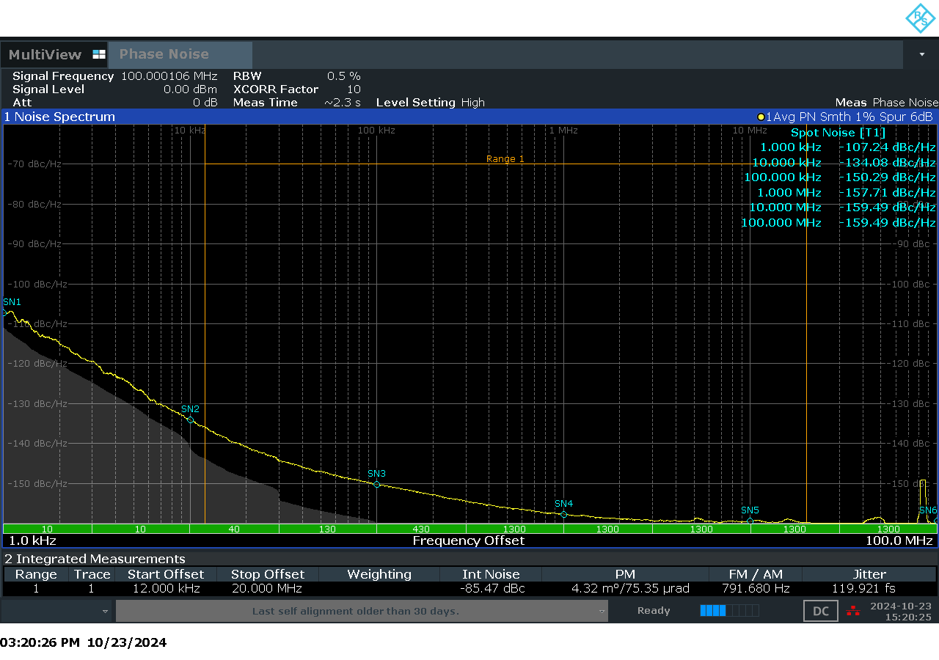
Baseline Measurement Scheme
PN Measurement of Direct LMK6H Output
LMK6H
Jitter = 119.921 fs

Slide 2
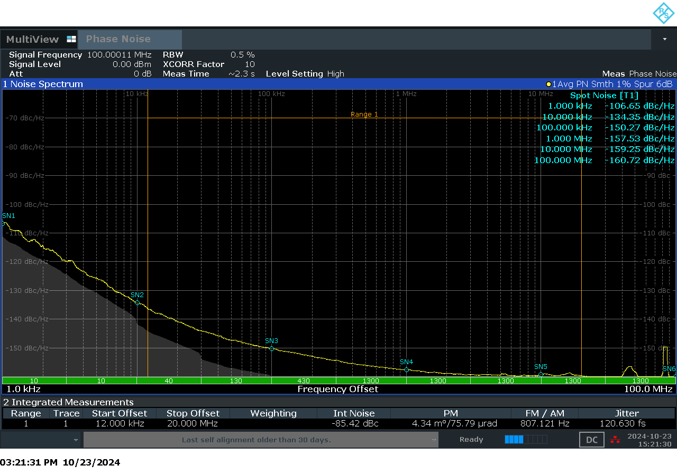
LMK6H
LMKDB1120/1108
PCIE Load
(10 in)
Measurement with 1 PCIE load and a Buffer
Jitter = 120.630 fs
PN Measurement of Buffer Output

Slide 3
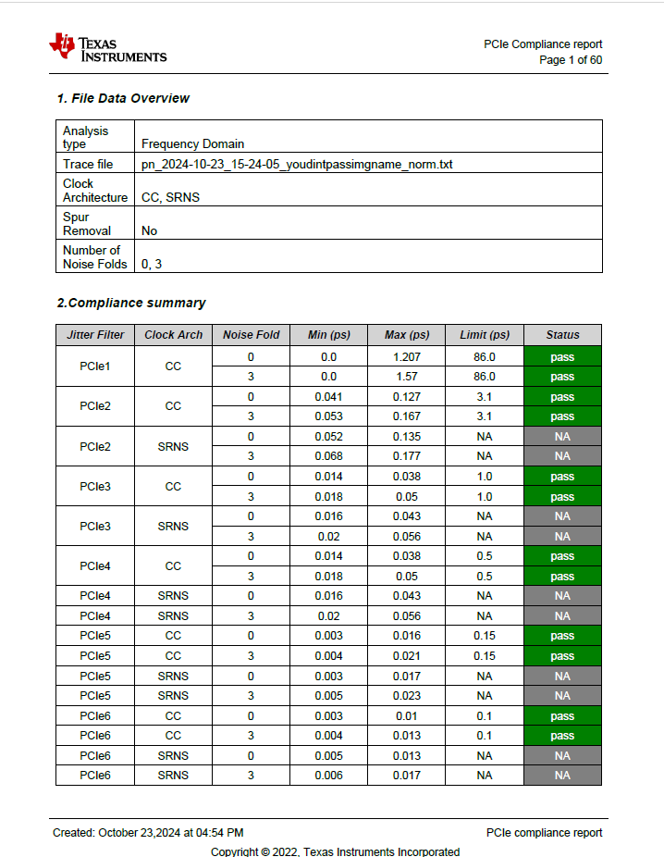
PCIE Compliance Report for Measurement in Previous Slide

Slide 4

LMK6H
LMKDB1120/1108
LMKDB1120/1108
PCIE Load
(10 in)
PCIE Load
(10 in)
Measurement with 2 PCIE loads and 2 Buffers
Jitter = 121.789 fs
PN Measurement of Second Buffer Output

Slide 5
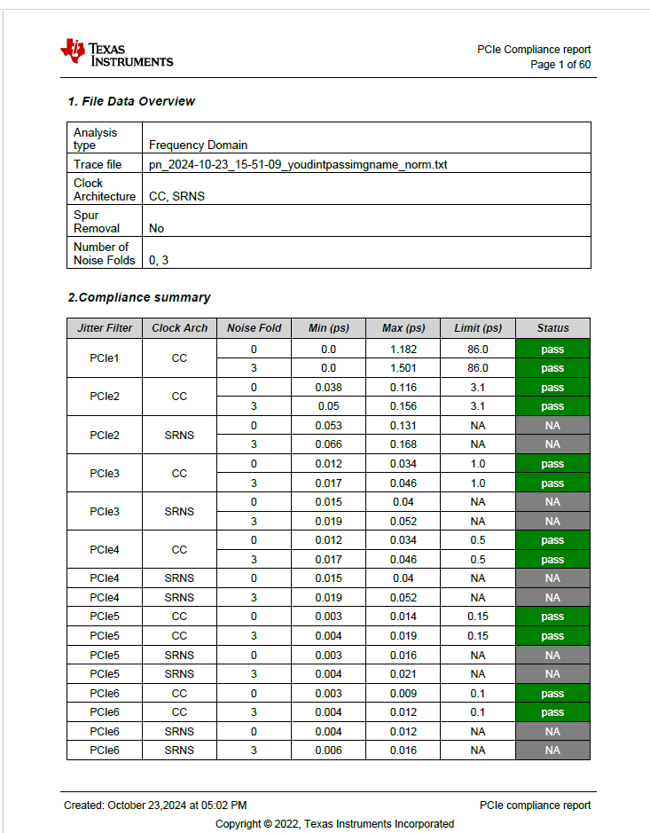
PCIE Compliance Report for Measurement in Previous Slide

