Slide 1
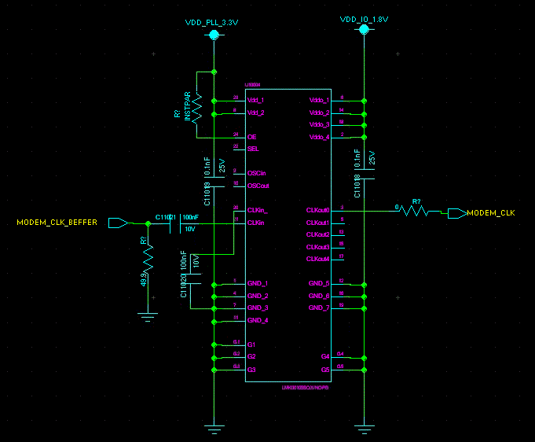
Customer LMK00105 circuit

Slide 2
LTC6957
LMK00105
Modem
CLK input
54M(3.3V CMOS)
54M(1.8V CMOS)

Slide 3
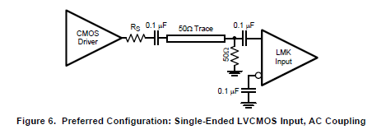
Rs is required for level matching. Right ?
Is it okay not to use 0.1uF AC coupling cap ? there is 0.1uF Cap already at the LMK input stage. LTC6957 is located close to LMK00105.
Output Enable pull up resistor value ? Is it okay to connect OE pin to 3.3V without Pull up ?

Slide 4
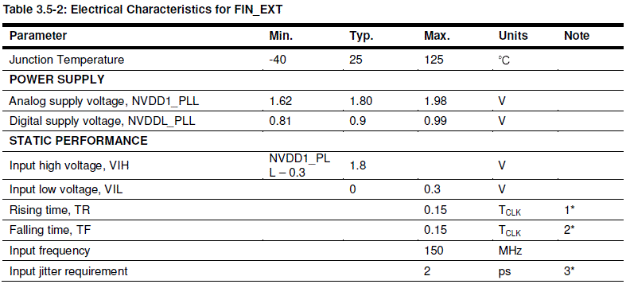
Modem CLK spec

