Slide 1
LMK03328 Jitter
July 28, 2025

Slide 2
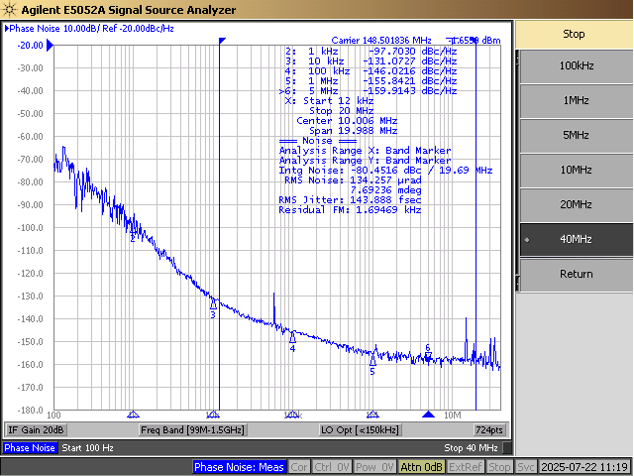
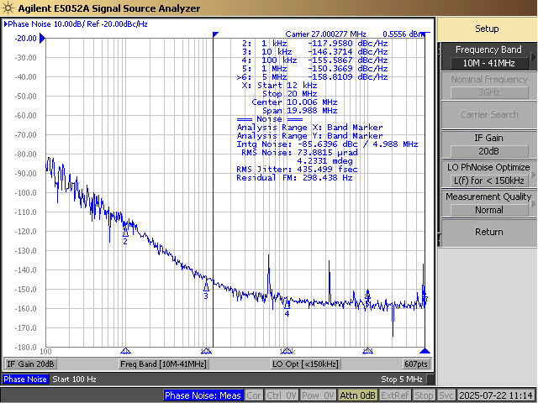
Input Clocks
148.5 MHz
27 MHz

Slide 3
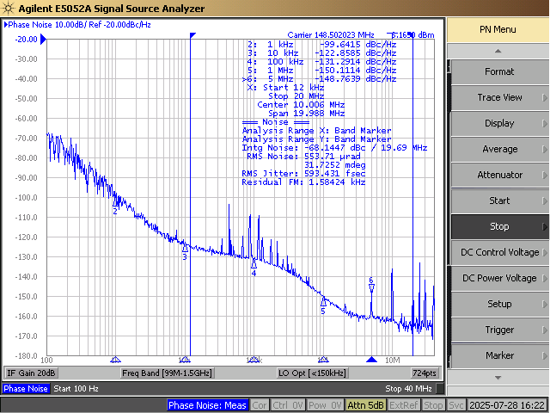
148.5 MHz LVPECL Output – 593 fs

Slide 4
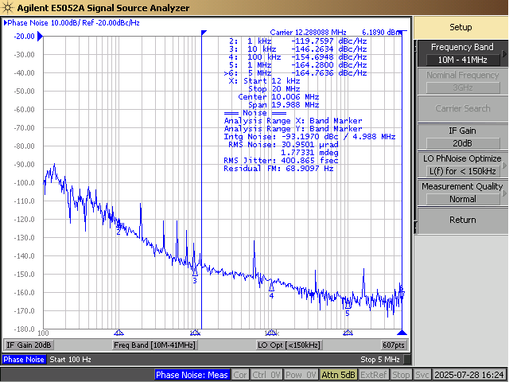
12.288 MHz LVPECL Output – 400 fs

Slide 5
Configuration
See attached for .tcs file
PLL1 uses Narrow Loop BW in Integer Mode
PLL1 C2 = 22uF
PLL2 uses Normal Loop BW in Fractional Mode
PLL2 C2 = 0.033uF

Slide 6
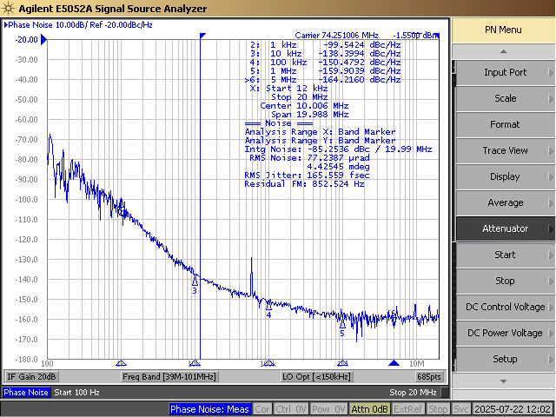
Input Clocks
74.25 MHz
27 MHz

Slide 7

148.5 MHz LVPECL Output – 594 fs

Slide 8
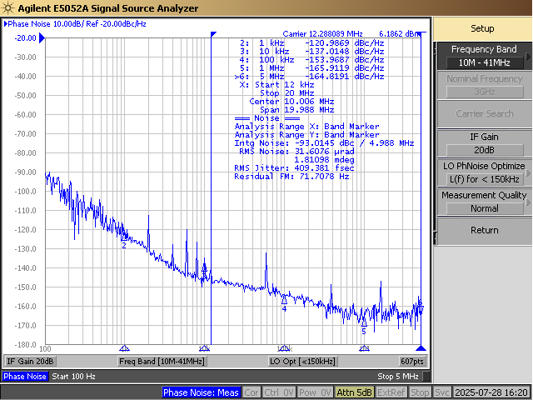
12.288 MHz LVPECL Output – 409 fs

Slide 9
Configuration
See attached for .tcs file
PLL1 uses Narrow Loop BW in Integer Mode
PLL1 C2 = 22uF
PLL2 uses Normal Loop BW in Fractional Mode
PLL2 C2 = 0.033uF

