Slide 1
LMK04832 architecture
  PLL1: Unlock
    . R divider=125
    . N divider=1536
  PLL2: Lock
    . R divider=15
    . N divider=16
LMK04832
PLL1
PLL2
10MHz
122.88MHz
131.072MHz
~
③
~
~
Vctrl
Vctrl
②
①

Slide 2
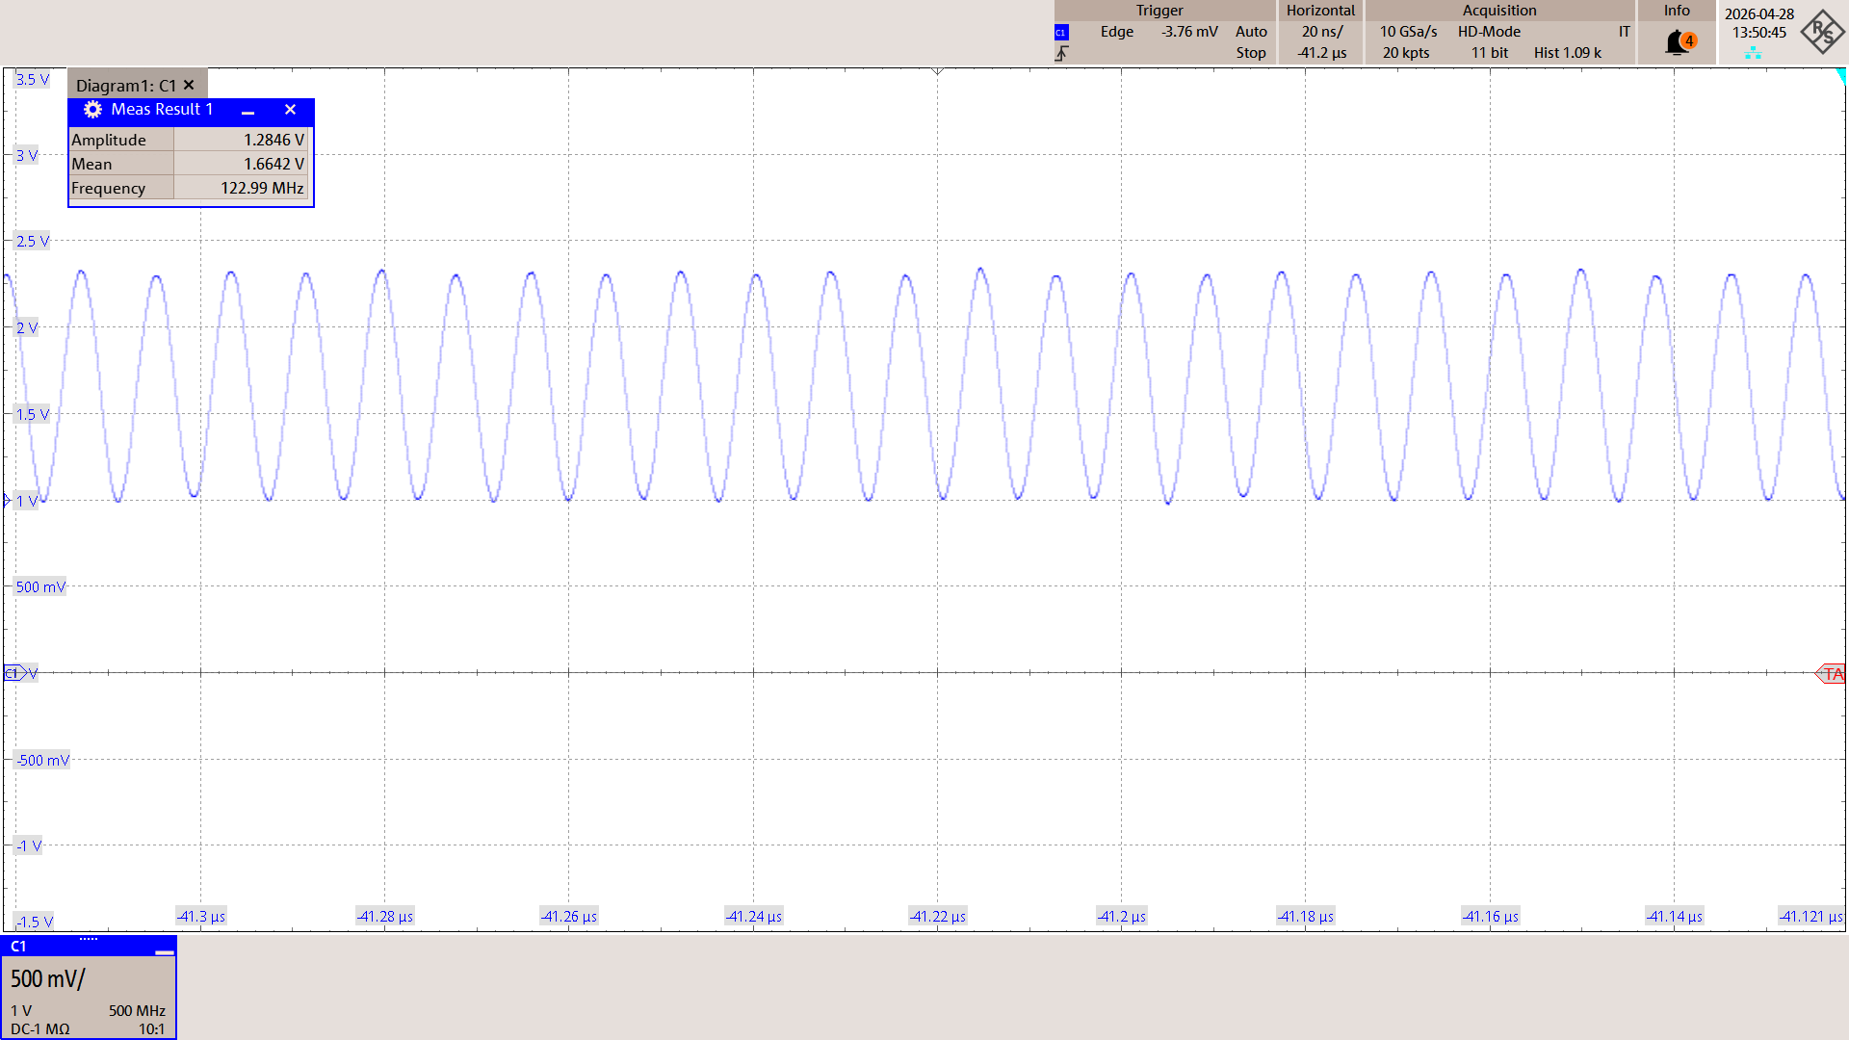
Measurement Result
  - ① 122.88MHz PLL Input (Oscilloscope)

Slide 3
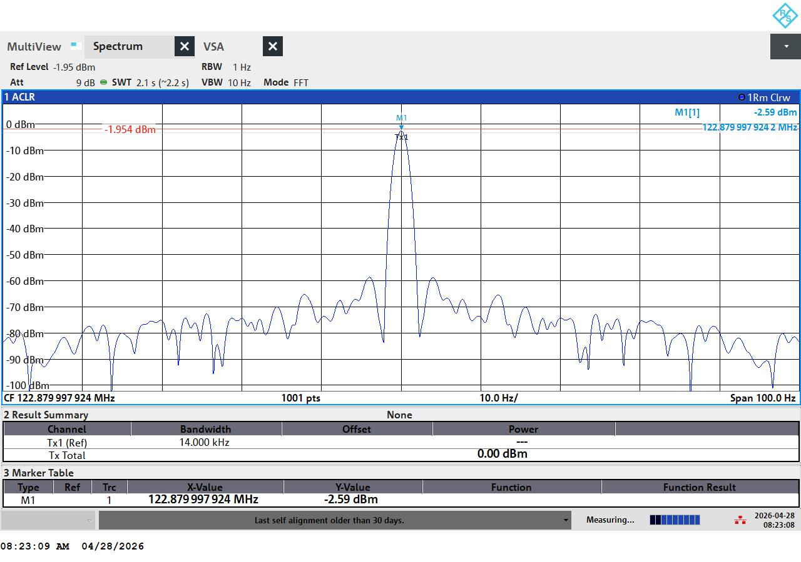
Measurement Result
  - ① 122.88MHz PLL Input (Spectrum Analyzer)

Slide 4
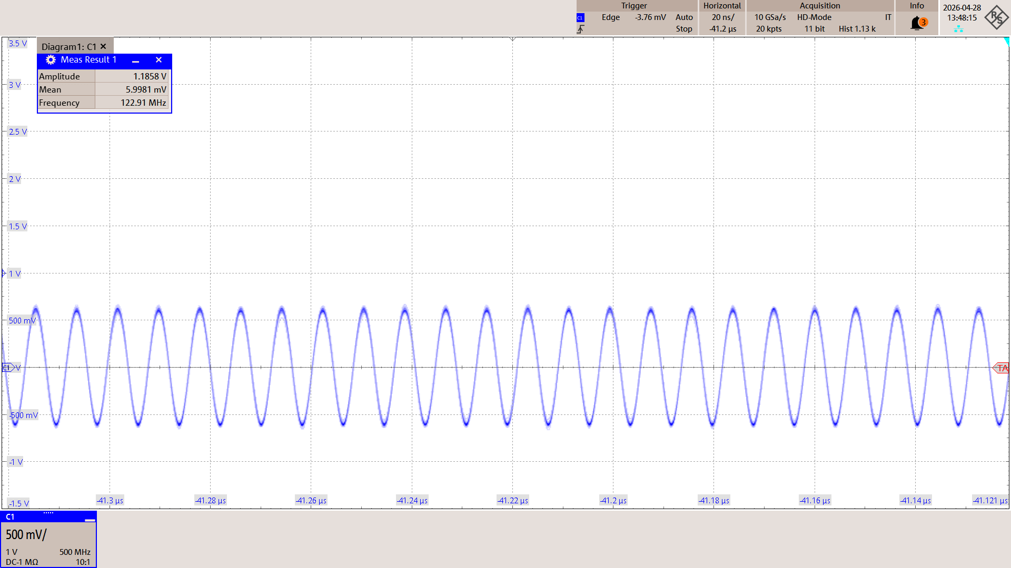
Measurement Result
  - ② 122.88MHz VCXO Output

Slide 5

Measurement Result
  - ③ VCXO Control Voltage

Slide 6
Question
  When reviewing the captured data from the measurement instrument, the control voltage remains constant and the 122.88 MHz frequency is also fixed. However, the lock‑detect signal does not appear.
    . We set PLL1_WND_SIZE to its maximum value of 43 ns, but the lock‑detect signal still does not appear.
    . We set PLL1_DLD_CNT to its lowest value of 1, but the lock‑detect signal still does not appear.
    . We set ‑PLL1_CP_GAIN to its highest value of 1550 µA, but the lock‑detect signal still does not appear.
    . The VCXO’s peak‑to‑peak voltage (Vp‑p) was measured to be between 1.1 V and 1.3 V, resulting in a slew rate of roughly 0.425 V/ns to 0.502 V/ns. This satisfies the data‑sheet requirements (minimum 0.15 V/ns, typical 0.5 V/ns).
    . We adjusted the R and C values of the loop filter to test loop bandwidths of 5 Hz, 50 Hz, 100 Hz, 200 Hz, 400 Hz, 1 kHz, and 2 kHz, but the lock-detect signal still does not appear.
  Please review and provide an analysis of the cause of this phenomenon.

