Slide 1
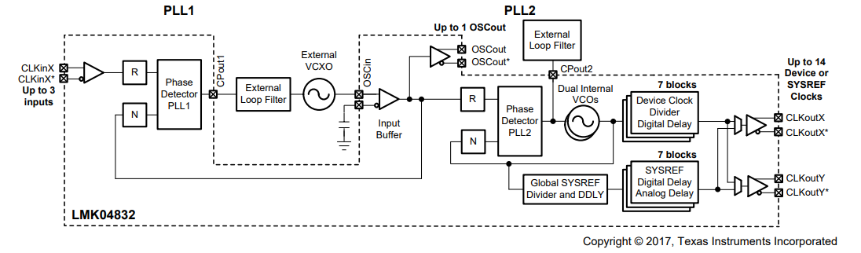
CLKIN0 = 10MHz
CLKIN1 = 10MHz
100MHz
3000MHz
3000MHz

Slide 2
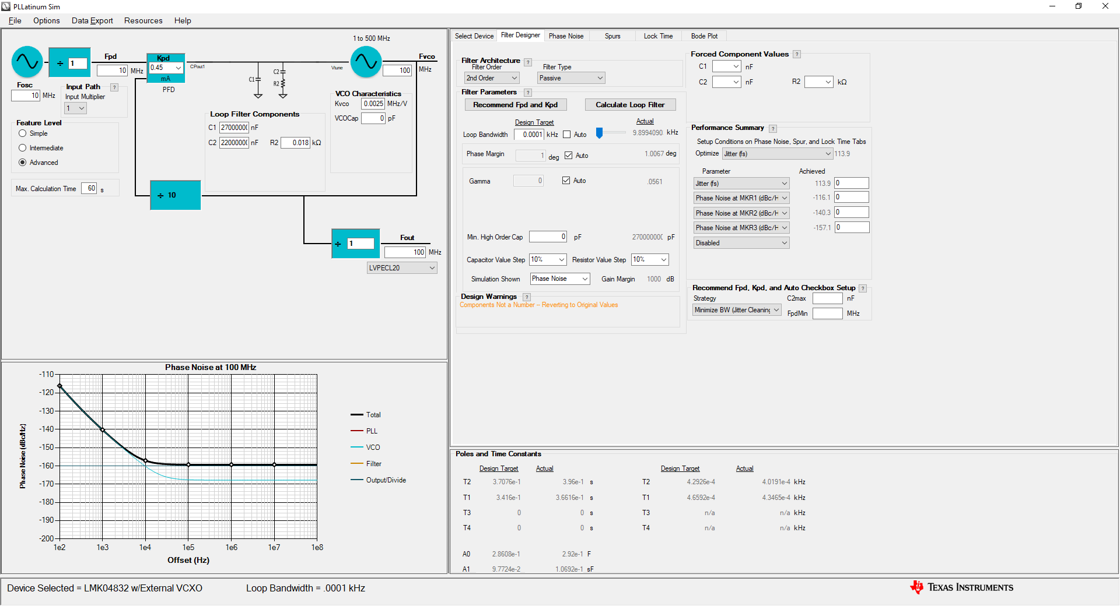
PLL1 - Calculate Loop Filter

Slide 3
PLL1 – Export VCO Phase Noise
Data Export -> Export Trace -> Phase Noise -> VCO
Save as “PLL1_VCO_Noise.txt”

Slide 4
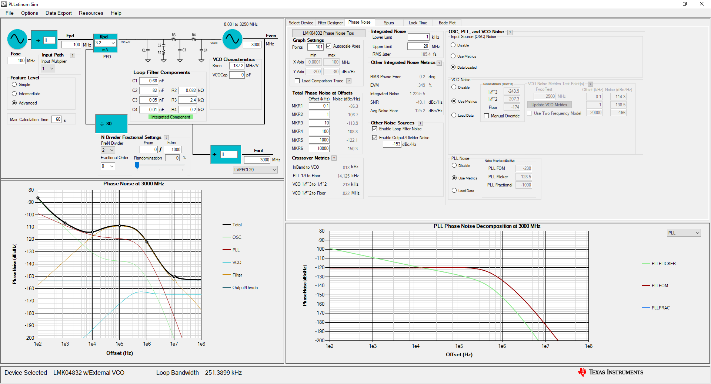
PLL2 – Load PLL1
Load“PLL1_VCO_Noise.txt”

Slide 5
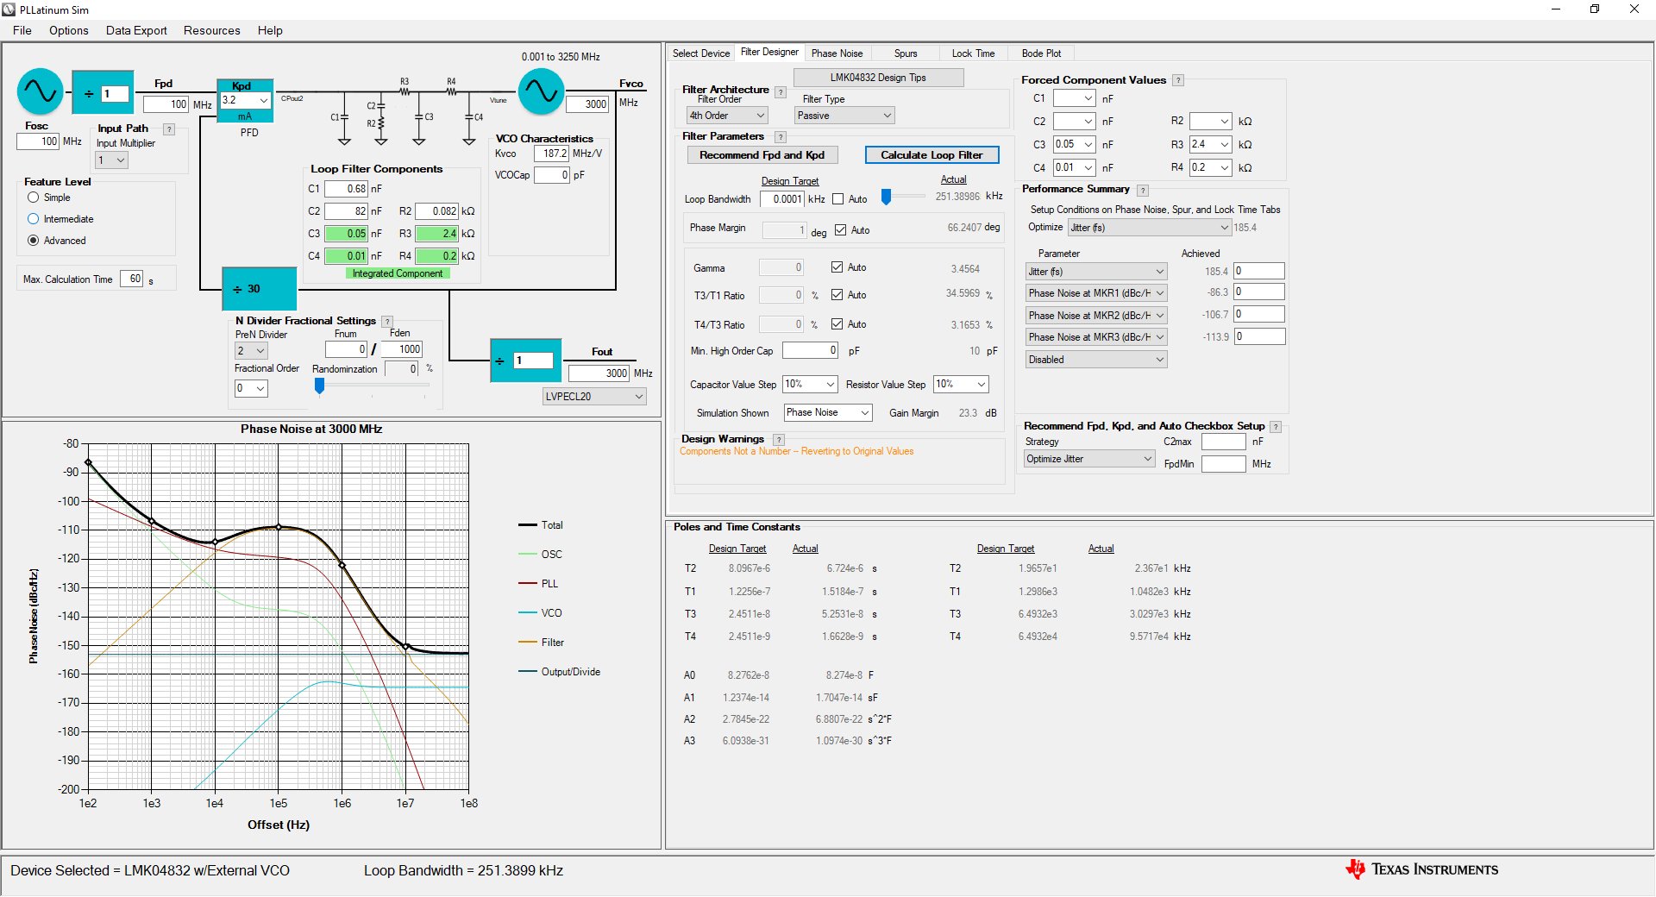
PLL2 – Calculate Loop Filter

